Slide 1



San Joaquin County
Fathers Initiative
FATHERS MATTER:
Collaborating with Communities to Re-imagine Father Focused Engagement & Service Delivery
San Joaquin County CQI Special Projects:
CWDA Conference October 2023

Slide 2
Panelists:
JUSTIAN O’RYAN
Supervisor Continuous Quality Improvement
San Joaquin County Child Protective Services
WILLIAM P. LATTIMORE, SR.
Special Projects Supervisor
Mary Magdalene Community Services
GUS PACHECO
Director of Prevention Services and Lead Family Coach
Parents by Choice
JOVANNA VIALDORES
Contracts Analyst
First 5 San Joaquin

Slide 3

About the Fathers Initiative
The purpose of the Fathers Initiative is to promote the well-being of children and families by empowering fathers to be knowledgeable, active, and engaged with their children and the systems that support them.

Slide 4

The Value of Fathers
“The well-being of men is inherently connected to the well-being of women and children because women and children are so often affected by the actions of their fathers, brothers, friends, husbands, and partners. Thus, [high-quality] social worker practice with men not only affects individuals, but can also produce positive systemic effects.” (Shafer and Wendt, 2015)

Slide 5
The Value of Fathers
The Benefits of Father Involvement for Children
1 in 4 children live without a biological, step, or adoptive father in the home.
In 2021, an estimated 10 million children in the US saw their fathers less than once a month.
Infant death within the first 28 days of life is four times higher for those with absent fathers than those with involved fathers.

Slide 6
The Value of Fathers
The BENEFITS of Father Involvement for Children
During early childhood, father involvement supports secure attachment and promotes children’s emotional regulation and cognitive development.
Father involvement is associated with longer-term outcomes, such as positive peer relationships and decreased odds of incarceration, crime, and teen pregnancy.
Positive benefits exist as long as fathers stay involved, regardless of whether or not they live with their children.

Slide 7

Addressing Barriers to Father Engagement
Opportunities for Systems Change

Slide 8
Addressing Barriers to Father Engagement
Theory of Change
A roadmap for implementing effective changes to improve outcomes
We observe… that mothers are more likely to have successful reunification with their children than fathers
We think… it is because there is systemic bias against fathers
So we plan… to develop a Fathers Initiative
Which we think will result in… increased rates of successful reunification for fathers with their children

Slide 9
Addressing Barriers to Father Engagement
Potential Barriers to Father Involvement in the Child Welfare System
Potential INSTITUTIONAL Barriers to Father Involvement in the Child Welfare System
Difficulty identifying or locating fathers
Lack of interest by fathers
A father’s inability to establish paternity
Father may struggle with financial insecurity, substance abuse, incarceration, a bad relationship with the child’s mother, or a lack of confidence in parenting skills
Negative stereotypes about fathers
Lack of staff capacity and time
Difficulty knowing how to get fathers more involved
Lack of resources to refer fathers to for help

Slide 10
Addressing Barriers to Father Engagement
We think… it is because there is systemic bias against fathers
CALIFORNIA CHILD & FAMILY SERVICES REVIEW (C-CFSR) FINDINGS:
  Agencies are less likely to search for fathers when their location is unknown
  Fathers are less likely than mothers to receive accurate needs assessments and appropriate services
  Overall, fathers receive fewer direct contacts from social workers than mothers
  Agencies less likely to identify, locate, and contact Indigenous fathers and fathers of color than White fathers

Slide 11
Addressing Barriers to Father Engagement
We think… it is because there is systemic bias against fathers
STAKEHOLDER FEEDBACK/PEER REVIEW:
County Self-Assessment (CSA) reflected a lack of father finding, father engagement, paternal family finding, and paternal relative engagement
CASE REVIEW DATE:
Onsite Review Instrument (OSRI) Items support CSA feedback
FOCUS GROUP FINDINGS:
Fathers cited top two barriers for reunification were the mother of the child and the courts

Slide 12
Addressing Barriers to Father Engagement
We think… it is because there is systemic bias against fathers
CALIFORNIA CHILDREN & YOUTH SERVICES REVIEW:
Caseworkers view mothers as “easier” to work with than fathers
  Caseworkers are trained to work with “parents”, not mothers and fathers
  Caseworkers express more relatability in working with mothers and maternal relatives
  Agencies are less likely to search for fathers when their location is “unknown”
  Fathers receive fewer direct contacts from social workers than mothers
Caseworkers often view fathers as irrelevant and not the primary target for services
  Services are primarily designed for mothers
  Caseworkers are less likely to co-create a case plan with a father
  Fathers are less likely than mothers to receive accurate needs assessments and appropriate services
Traditional gender roles view women as nurturing caregivers and fathers as absent, incompetent, and inherently dangerous

Slide 13
San Joaquin County Fathers Initiative
From Exploration to Implementation

Slide 14
San Joaquin County Fathers Initiative
We plan… to develop a Fathers Initiative
OBJECTIVES
ACTION STEPS
Changing the culture of child welfare and system partners to include fathers
Father finding and engagement — to include
paternal family
Father support groups and advocates
Peer-to-Peer mentoring program
Father’s parenting/education
Prevention programs for fathers
Pilot program for non-offending,
non-custodial fathers
Teaming with Community Based Organizations
Develop a Resource Directory
Policy & Procedure development
Training Child Welfare staff on Father Engagement
Data Tracking for each element
Feedback loops
Host Community Event

Slide 15
San Joaquin County Fathers Initiative
Which we think will result in… increased rates of successful reunification for fathers with their children
PROCESS
QUALITY
CAPACITY
Developing policy and procedure to be more inclusive of fathers and paternal relatives in the following areas:
  Family finding and engagement
  Social worker assessments
  Progressive visitation plans
  Behaviorally-based case plan development
Ongoing tracking of interventions:
  Supervised visits
  Emergency Placement with Relative(s)
Social Worker engagement with fathers
Behaviorally Based Case Plans with fathers
Training of social workers, supervisors, and support staff
Training of community partners
Build capacity of community-based organizations to provide father-focused services
Build capacity of social workers
Build community awareness
and education

Slide 16
San Joaquin County Fathers Initiative
Which we think will result in… increased rates of successful reunification for fathers with their children
INTERNAL WORK:
EXTERNAL WORK:
From 2020-2021 all relevant staff participated in mandatory training on the importance and value of Father Engagement
Since 2021, Father-Focused Engagement is embedded into Induction Trainings
Development of community awareness campaign
Development of a Fathers Initiative Coalition
New process in Dependency Court (Voir Dire)
Fathers Initiative Coalition launched in 2022 to explore:
Specific needs of fathers in our community
Identification of existing services that meet those needs
Community capacity to develop needed services
Development of outreach tools
Development of a grass-roots community event honoring fathers

Slide 17
OFFICE OF CHILD ABUSE PREVENTION (OCAP) &
FAMILIES FIRST PREVENTION SERVICES ACT
Keeping in Mind…
INTEGRATED CORE PRACTICE MODEL
SAFETY ORGANIZED PRACTICE
Foundation
Engagement
Assessment
Teaming
Service Planning and Delivery
Transition
Good working relationships
Critical Thinking
Decision-Support Tools
Creation of Detailed Plans for Enhancing the daily safety of children
Trauma-informed
Primary
Secondary
Tertiary

Slide 18
Multi-Faceted Approach to Services
PRIMARY STRATEGIES
SECONDARY SERVICES
TERTIARY SERVICES
Increasing communication and public awareness
Resource Toolkit
Public Awareness Campaign
Webpage
Community Events
Voluntary Community Services (non-referral based)
Community Services for Open Dependency (referral-based)

Slide 19










San Joaquin County Fathers Initiative
Developing and Strengthening Collaborative Efforts

Slide 20
Shared Vision Driving Collaboration
We envision a brighter, more father-inclusive future for San Joaquin County’s children, families, and community resulting in the positive transformation of our region.

Slide 21
Shared Goals Driving Collaboration
Educating fathers and communities on responsible fatherhood practices, healthy relationships, and economic stability among families while increasing the number of underrepresented fathers engaged across the region

Slide 22
Strategic Partnering for Systems Improvement
Multi-Faceted Approach via System Improvement Plan Strategies
FAMILY FINDING AND ENGAGEMENT STRATEGY
QUALITY SOCIAL WORKER VISITS WITH CLIENT STRATEGY
DISPROPORTIONALITY
STRATEGY
Specific to Paternal Relatives &
Non-Relative Extended Family Members
Behaviorally Based Case Plans
Concerted Efforts
Active Efforts
Locating and Engaging African-American Fathers and Paternal Relatives

Slide 23
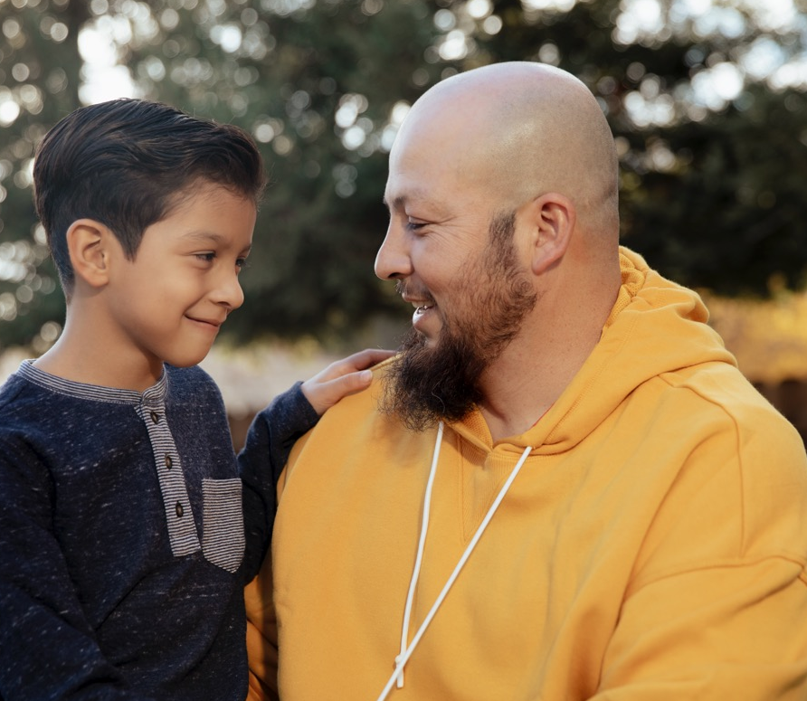
Partner Spotlight

Slide 24
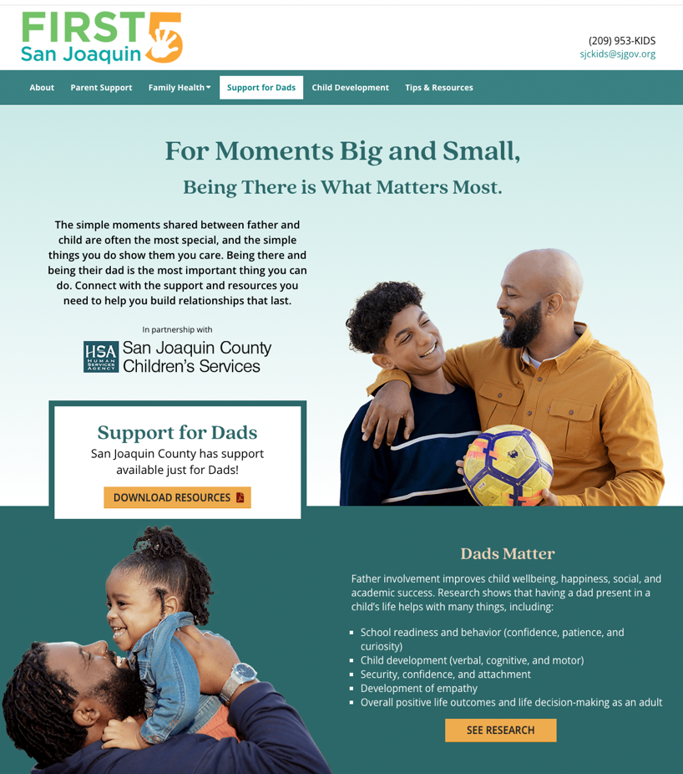
Support for Dads Webpage
First 5 San Joaquin website includes a dedicated webpage supporting fathers
  Resources and resource directory
  Tips and tools
  Awareness and encouragement

Slide 25

Primary Service:
Paid Media
OUT-OF-HOME
Posters, flyers, busses, and bus shelters
Contracted Impressions: 1,384,735
Added Value Impressions: 834,623
DIGITAL DISPLAY
Ads ran in priority SJC neighborhoods (i.e. gas stations, gyms, etc.)
Total Impressions: 2,424,630
PAID SOCIAL + SEARCH
Google + Meta
Total Impressions: 801,157

Slide 26
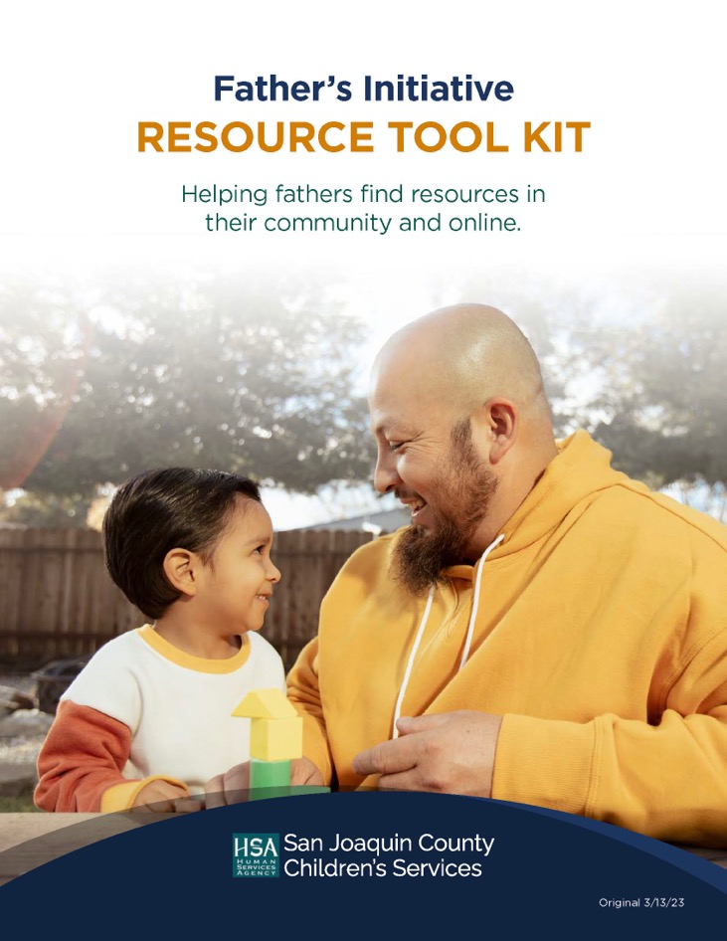
Primary Services:
Toolkit and Direct Outreach
ENGAGE PARTNERS AND
GENERATE ACTION
Digital toolkit (social posts, e-newsletter copy, etc.)
Posters, Flyers, rack cards
Event material needs (CBO Toolkits)
Press Release

Slide 27

Partner Spotlight

Slide 28
The Positive Parenting Program
Parents by Choice
Parenting Courses:
Co-Parenting
Parents of Children 0-12
Parents of Teens
Pathways to Positive Parenting
Stepping Stones
Child Welfare System Parenting Program
Fathers Served:
Parents by Choice served
238 fathers in 2022 (and
an additional 404 women)

Slide 29
The Positive Parenting Program
Looking Ahead:
Parents By Choice intends to add the following opportunities to enhance father engagement:
Father Focused
Parent Workshops
Discussion Groups
Courses
Incarcerated Fathers
(Led by a father/facilitator with lived experience.)
Parents by Choice
Fathers that complete a parenting course and apply the strategies, have decreased hostility towards their children and have increased their involvement in their parenting.

Slide 30

Raising Community Awareness
Father Appreciation Week
June 12-16, 2023 declared
Father Appreciation Week for
San Joaquin County

Slide 31
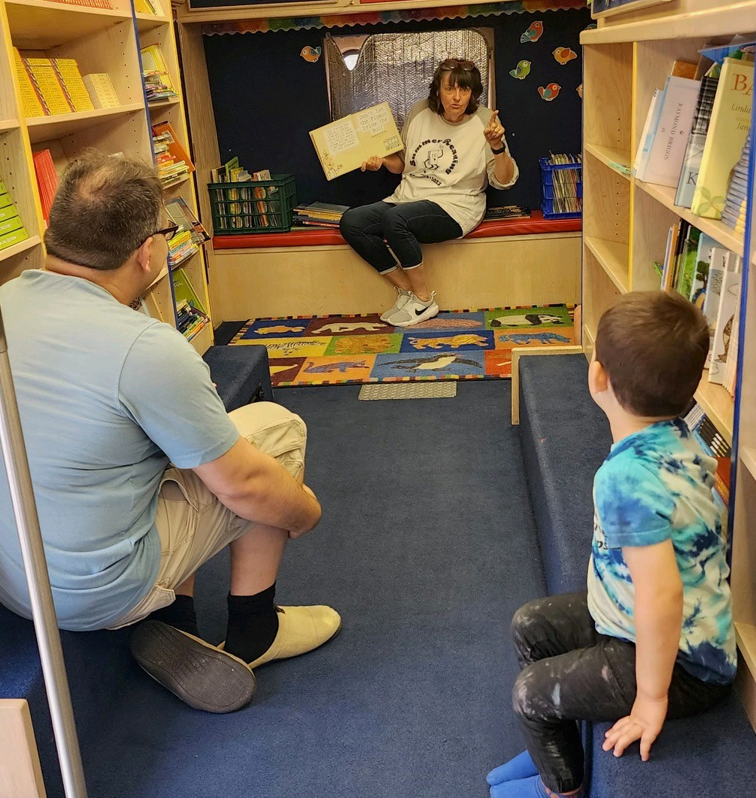
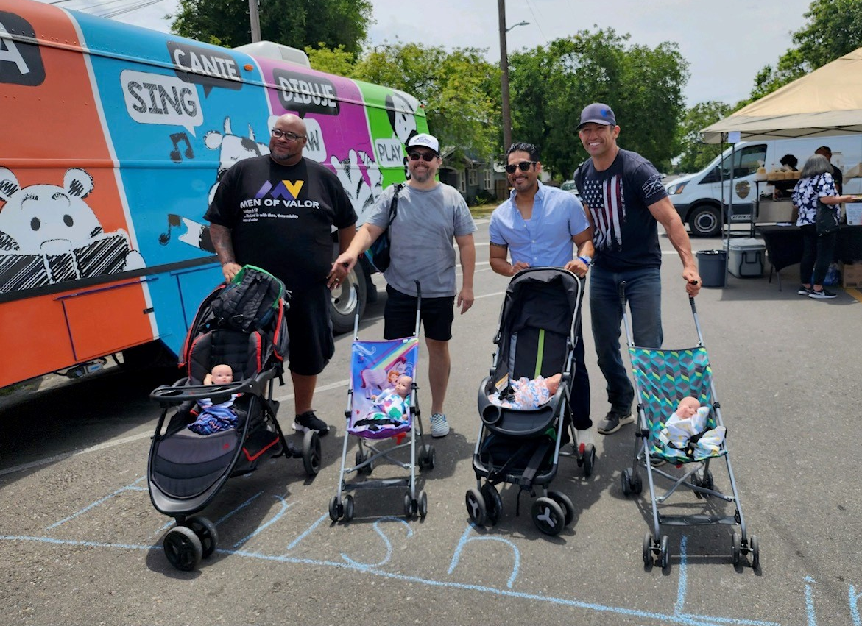
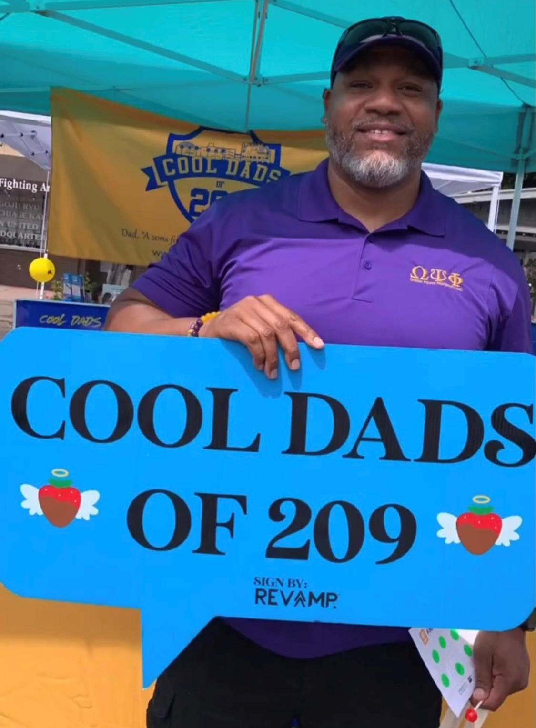
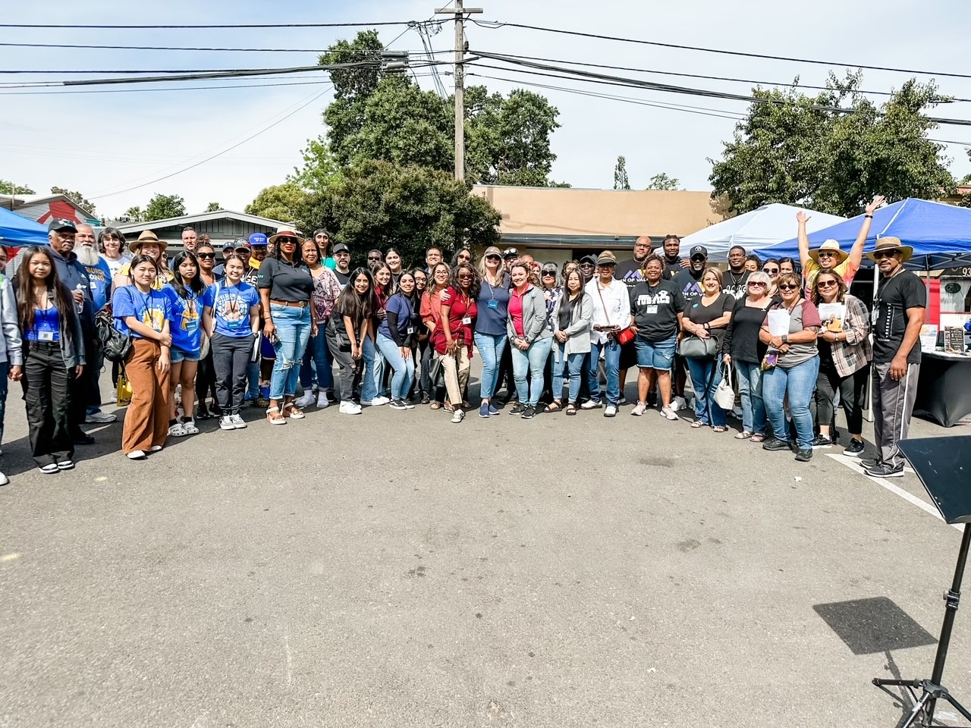
Raising Community Awareness
Fatherhood Festival
Community Outreach Event targeting fathers and families held June 10, 2023
Community-Based Organizations
Resources, Education, Support, Outreach, Games, Food, Music

Slide 32
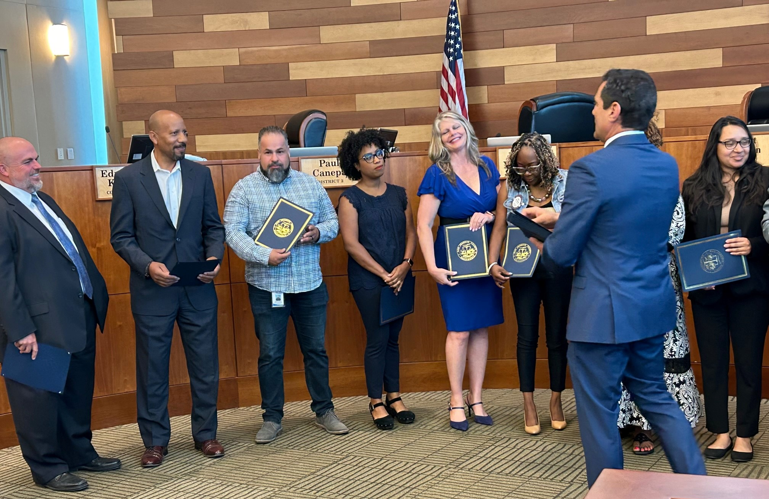
San Joaquin County Board of Supervisors Acknowledgement
In recognition of the Fatherhood Festival and community awareness
work of the Fathers Initiative Coalition

Slide 33

Partner Spotlight

Slide 34

Fatherhood Support Services
Passport to Fatherhood
Love. Safety. Security.
Mary Magdalene Community Services supports increasing the array of community services for individual and families who are in crisis or struggling with life challenges. We know that it is essential as it makes possible the opportunities for family and individual recovery, resilience, and overall wellness.
Fatherhood Support Services Offered:
Barbershop Talks (all dads), faith-based men’s support group, anger management and fatherhood courses
FamilyWORKs program for African-American parents on CalWORKs with children under five

Slide 35
Fatherhood Support Services
Passport to Fatherhood
PROGRAM OVERVIEW
Program Goals:
To empower San Joaquin County men with the skills, tools, and knowledge needed to become better fathers and partners in the home and community
To provide support and resource assistance to participating fathers
To increase self-awareness, compassion, and sense of responsibility needed to build the man first, father second
PROGRAM ELIBILITY
New or expecting fathers
Ages 16 and up
Mother must be African American
Residents of San Joaquin County

Slide 36
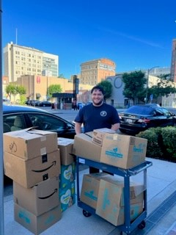
Local Impact
Success Stories
Dad Packs
Equipping fathers with packs that set them up for success
Senior Project for High School
San Joaquin County Office of Education
Stockton Service Corps

Slide 37
Next Steps
Future Plans…
Add more community partners to the Coalition
  Increase services & supports to fathers
Revise Fathers Initiative Resource Toolkit annually
Increase social media outreach and expand website
Elevate Fatherhood Initiative campaign in the community
Implement Fatherhood Festival 2024 - in the works! ☺
Expand father supports in the courtroom

Slide 38
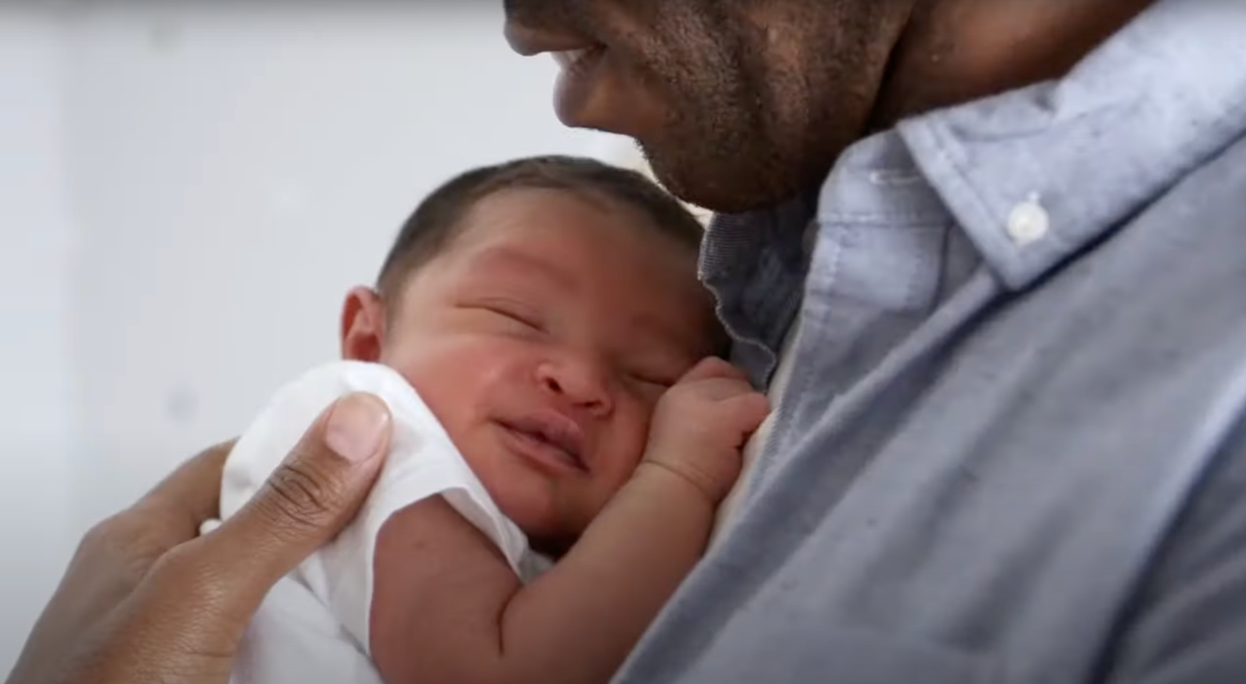
A letter to my son - A short film for fathers - YouTube

Slide 39

Questions?

Slide 40

JUSTIAN O’RYAN
San Joaquin County Child Protective Services
joryan@sjgov.org
WILLIAM P. LATTIMORE, SR.
Mary Magdalene Community Services
williammmagdalene@yahoo.com
GUS PACHECO
Parents by Choice
gus@parentsbychoice.net
JOVANNA VIALDORES
First 5 San Joaquin
jvialdores@sjgov.org
Thank You

