Slide 1
County Welfare Directors Association webinar
CalWORKS
Housing Support Program
California Dept. of Housing and Community Development Presentation
August 6, 2014

Slide 2
CA Policy Academy To Reduce Chronic Homelessness
2013 SAMHSA-Sponsored
Statewide Interests
Localities
State Agencies
Legislative Staff
Continua of Care
Persons w/Lived Experience
Housing & Service Providers
Federal Agencies

Slide 3
California Point-in-Time Data

Slide 4
Strategic Opportunities
Goal 1
Expand use of mainstream resources, taking full advantage of ACA and Medi-Cal reform.
Goal 2
Goal 3
Design the California PSH approach
Increase access to permanent supportive housing (PSH) in existing inventory and programs.

Slide 5
Strategic Opportunities
Goal 4
Goal 5
Increase State leadership and interagency coordination to reduce homelessness.
Support re-tooling of local crisis response system.

Slide 6
Federal Investment in Rapid Re-Housing
Notes:
As funding for capital construction was winding down, California received an influx of federal HPRP dollars for prevention and rapid re-housing. This funding helped to create the infrastructure and experience for this approach, and was obviously a significant contributor to this activity.
On February 17, 2009, President Obama signed the American Recovery and Reinvestment Act of 2009, which included $1.5 billion for a Homelessness Prevention Fund. Funding for this program, called the Homelessness Prevention and Rapid Re-Housing Program (HPRP), was distributed based on the formula used for the Emergency Shelter Grants Program.
The program ended on September 30, 2012

Slide 7
Federal Supportive Services For Veteran Families- 2014
For more information
http://www.va.gov/HOMELESS/SSVF.asp
$32 million
39 Grantees
14 Continuum of Care
Notes:
Also currently a small but growing part of the part of the Continuum of Care funding. Of the $271 nukkuib awarded ub 2013m 2% ir 5.4 million awarded to rapid rehousing programs

Slide 8
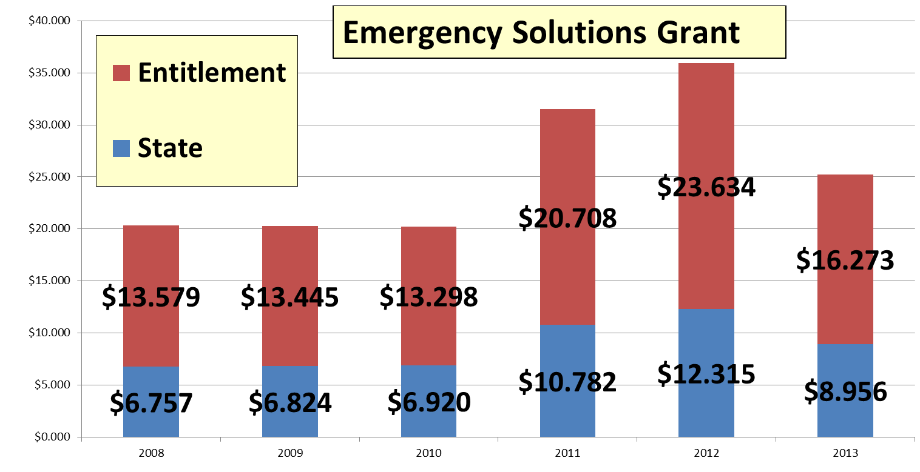
Ongoing Federal Funding
Notes:
Federal Emergency Solutions Grant levels are represented here. While down significantly in 2013, this program nonetheless represents an important investment in local crisis response systems. Increased emphasis on rapid re-housing.

Slide 9
Goal 4: Retooling Crisis Response
Align Existing Resources for RR
State ESG
Allocate Future Resources
Invest in Rapid Re-Housing
CalWorks
Build Continua and RR capacity
Notes:
TOM

Slide 10
Using the Lessons of HPRP And other Initiatives
Ending homeless requires robust, community-wide system of rapid re-housing
  Connect with local Continuum of Care
Lessons Learned
  Small amounts of assistance effective
  Works for people with many barriers
  Targeting prevention is extremely challenging
  Success relies on community-wide performance and outcome measurement progress
Build on existing capacity and program infrastructure
  ESG, SSVF, CoC providers
  Use HMIS for data and performance

Slide 11
Local Information
Continuum of Care and ESG Contacts
  https://www.onecpd.info/grantees/
Homeless Data Exchange (HDX) public reports
  Shelter and transitional demographics, length of stay, prior living situation
  http://www.hudhdx.info/PublicReports.aspx
Homeless Reports and Housing Inventories
  PIT Counts
  http://www.hudhre.info/index.cfm?do=viewHomelessRpts

Slide 12
Contact Information
Cindy Cavanaugh
Assistant Deputy Director, Homeless and Housing Policy
State Department of Housing and Community Development
Cindy.Cavanaugh@hcd.ca.gov
916 263-5883

