Slide 1
Determining eligibility under
Health Care reform
County Welfare Directors Association of California
Version 5
September 9, 2013

Slide 2

OVERVIEW OF TRAINING
Health Care Reform Coverage Requirement
Eligibility Programs Under Health Care Reform
Applications and Application Processing
Discussion of Key Eligibility Requirements

Slide 3
HEALTH COVERAGE REQUIREMENT
Beginning in 2014, most individuals will be required to have “Minimum Essential Coverage" or pay a penalty with their tax return.
A person has Minimum Essential Coverage (MEC) if he or she has:
    An eligible employer-sponsored plan;
    An individual policy (obtained through or outside Covered California); or
    A government plan (Medicare, Medi-Cal without a Share of Cost (SOC), TRICARE, VA, etc.)
Exceptions to MEC Requirement:
    Individuals with a religious conscience exemption (applies only to certain faiths);
    Incarcerated individuals;
    Undocumented immigrants;
    Individuals who cannot afford coverage (required contribution exceeds 8% household income);
    Individuals with a coverage gap of less than 3 months;
    Individuals in a hardship situation (as defined by the U.S. Secretary of Health & Human Services);
    Individuals with income below the tax filing threshold; and
    Members of Indian tribes.
  No final policy on whether SOC Medi-Cal meets MEC, but we do not think that it does.
  The state is operating under that assumption at this point.

Slide 4
ESSENTIAL HEALTH BENEFITS
Coverage sold to individuals and small employers must include essential health benefits which includes all of the following services:
    Ambulatory patient services
    Emergency services
    Hospitalization
    Maternity and new born care
    Mental health and substance abuse disorder services, including behavioral health treatment
    Prescription drugs
    Rehabilitative and habilitative services and devices
    Laboratory services
    Preventive and wellness services and chronic disease management
    Pediatric services, including dental and vision care
Small employers face no penalty for failing to provide coverage.
4

Slide 5
ENROLLMENT PERIODS
Pre Enrollment (October 1, 2013 – December 31, 2013)
Customers can apply for health care coverage that will take effect January 1, 2014.
    Customers with a current medical need can request to be evaluated for current pre-Affordable Care Act (pre-ACA) Medi-Cal programs, or the county should offer this upon its identification of a current Medi-Cal need and possible pre-ACA eligibility
Open Enrollment (October 1, 2013 – March 31, 2014)
To be eligible for coverage through Covered California, customers must apply for benefits during Open Enrollment or experience a qualifying life event
Starting in 2014, annual Open Enrollment will be October 15 through December 7
Special Enrollment (Must enroll within 60 days of occurrence)
Available when a customer has a life change that impacts eligibility such as:
    Birth of a child for the child
    Moving to a new state
    Marriage or divorce
Additional special enrollment circumstances are contained in Covered CA regulations
NOT available when a woman becomes pregnant or a customer becomes ill
  These open enrollment periods do not apply to Medi-Cal, which can be applied for at any time
Loss of Minimum Essential Coverage
Moving to a new plan area
Release from incarceration
5

Slide 6
HEALTH REFORM PROGRAMS
Modified Adjusted Gross Income (MAGI) Medi-Cal
Adults: Income level at or below 138% FPL
Covered California Subsidized Coverage
Covered California Unsubsidized Coverage
Income 100%-250% = Premium Assistance (APTC) and Cost Sharing Reduction(CSR)
Income level over 400%
Children: Income levels higher due to current higher eligibility, but not yet set (could be above 250% FPL - pending)
Income between 251%-400% = Premium Assistance
Not eligible for Medi-Cal
Non-MAGI Medi-Cal
Umbrella term for remaining Medi-Cal programs that will not follow MAGI rules. (See next slide for further details.)
6

Slide 7
NON-MAGI MEDI-CAL PROGRAM
Non-MAGI Medi-Cal is the new term for the existing Medi-Cal programs that are identified below:
  Supplemental Security Income (SSI)
  Foster Care
  Aged (65 or over), Blind or Disabled
  Long Term Care (LTC)
  Home and Community Based Waiver
  Medicare Savings Programs
  Medically Needy (MN)
  MN Sneede
  250% Working Disabled Program
  Disabled Adult Child (DAC)
  Pickle Program
Note: Minor Consent continues to exist – not really a MAGI or non-MAGI program – no changes to eligibility rules for that program at this time
7

Slide 8
applications
Single Streamlined Application
Current Applications for Medi-Cal
SAWS 2 / SAWS Plus
8

Slide 9
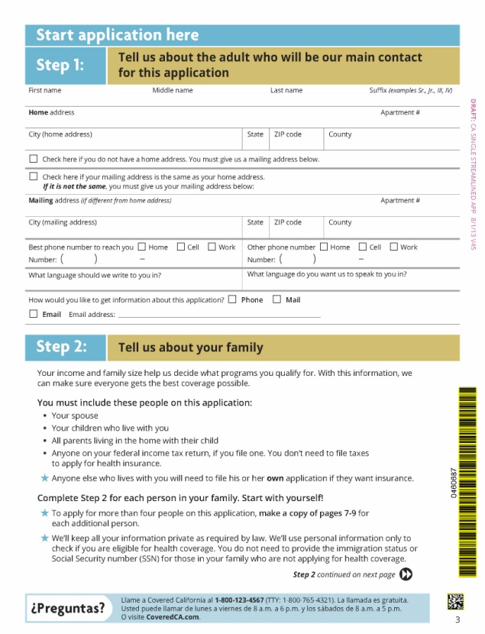
APPLICATIONS
Single Streamlined Application (SSApp)*
Used to apply for these health insurance
affordability programs:
    Medi-Cal (MAGI and non-MAGI)
    Access for Infants and Mothers (AIM)
    Subsidized Covered California coverage
SSApp captures tax filer and tax dependent information, including income and immigration status.
Does not ask for assets information; there is no asset test for MAGI Medi-Cal or for the Covered California subsidized coverage (APTC/CSR).
  SSApp can be used to start non-MAGI application, register app and protect app date, but additional information (i.e., asset information) must be collected.
*SSApp pending final development/approval.
9

Slide 10
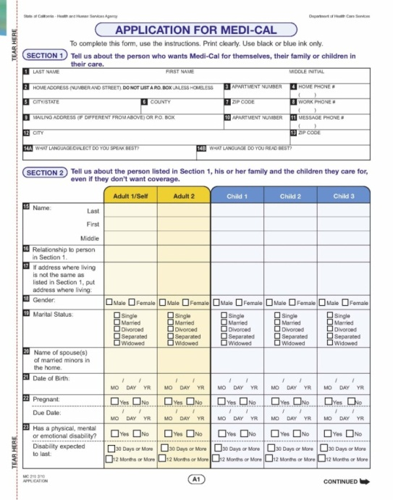
APPLICATIONS
Existing Applications for Pre-ACA Medi-Cal
Applications such as the MC 210 and the MC 321 Healthy Families/Medi-Cal Joint application will eventually sunset. These applications are being replaced by the SSApp.
  Counties must continue accepting all existing applications until January 1, 2016. (Do not ask someone who submits one of these applications to start over and fill out an SSApp instead.)
  Additional information will need to be collected to conduct MAGI Medi-Cal determination, especially tax household information. (A supplemental form may be developed, but this is still being determined.)
Supplements may be developed to be used in conjunction with the SSApp for non-MAGI
Medi-Cal; however this has not been finalized.
  The MC 210 PS – Property Supplement may be used to obtain asset information if needed.
10

Slide 11
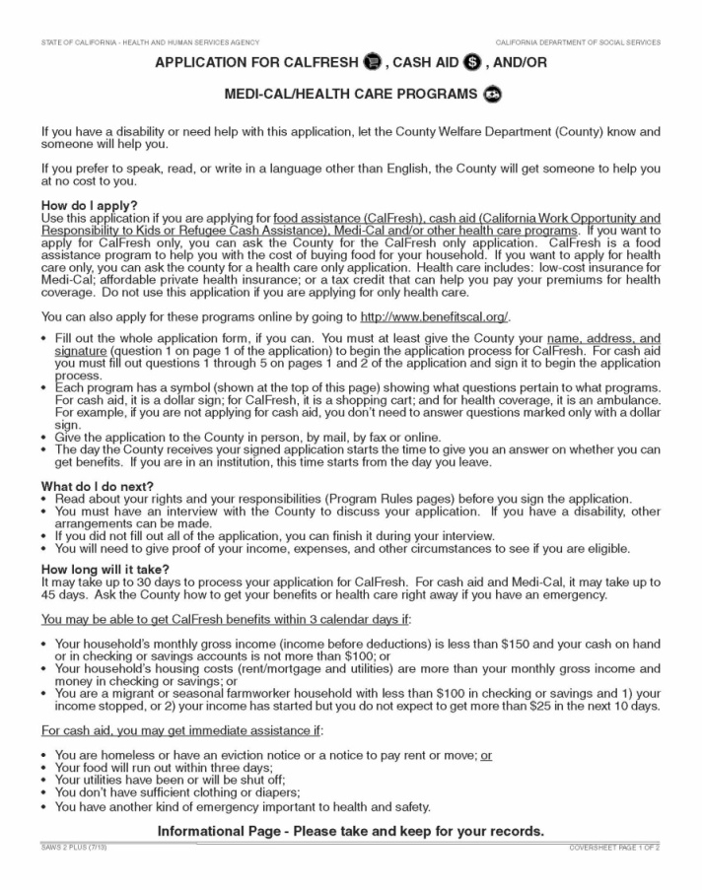



APPLICATIONS
SAWS 2/SAWS Plus
State revised the SAWS 2 application, and renamed it the SAWS Plus.
Revised application now includes the request for tax filer household information.
The application is pending Federal approval, but once provided, the application can be used to apply for all programs, including MAGI and non-MAGI Medi-Cal.
The SAWS Plus includes a page that can be used in a standalone format to serve as the SAWS 1.
Target date to begin using the application is October 1, 2013 (pending).
California Work Opportunities and Responsibilities to Kids
11

Slide 12





APPLICATION CHANNELS
In person at County Office
  Assisted by County eligibility staff
Online
  Through Covered California website
  Through appropriate SAWS Portal
By Phone
  Statewide phone number with warm handoff to network of designated county service centers using Quick Sort questions
  Direct to county or county call center
Mail
  Sent to Covered California
  Sent to county human services department
In person at Community Based Organization
  Assisted by certified enrollment assisters
12

Slide 13
TELEPHONIC SIGNATURES
Applying by phone will facilitate the application process for individuals who need assistance, and don’t have access to the internet.
A telephonic signature will be required for this type of application. Counties must obtain a telephonic signature by applying one of the following methods:
    A box in SAWS which the Eligibility Worker checks attesting that they heard the applicant affirm the required elements for a signature (schedules for adding this functionality to SAWS vary by system)
    Record the entire interview
    Record the portion of the interview where the applicant affirms the required elements for a signature
  Counties must be able to produce records for audits, hearings, program review, and quality control.
  Note: Telephonic signatures can be used on any electronic phone-in Medi-Cal or APTC/CSR applications being taken by the county. This does not apply only to calls transferred from Covered CA. This process can also be used for county phone-in applications or applications taken through the county’s regular call center.
13

Slide 14
PROCESSING DEADLINES
Medi-Cal (County Human Services)
Statutory time frames for Medi-Cal eligibility determination have not changed. They are:
  45 days for regular applications
  90 days for applications based on a disability
Covered California
Covered California setting its own time frames for processing applications it receives
Proposed regulations require eligibility determination within 10 days of receipt for paper applications received by Covered California
14

Slide 15
Application processing
Interim Period
October to December 2013
15

Slide 16
INTERIM PERIOD
OCTOBER TO DECEMBER 2013
During this period, both the pre-ACA Medi-Cal rules and the new, MAGI-based rules will be available to use.
Will require county to assess the needs of applicants and decide whether to process an application for pre-ACA coverage (“Now”) or January 2014 coverage (“Later”)
County will use SAWS for the “Now” path and CalHEERS for the “Later” path.
    The interface being built between the two systems is scheduled to be implemented on January 1, 2014; delayed from original date.
16

Slide 17
NOW OR LATER
OCTOBER TO DECEMBER 2013
The “Now or Later” approach requires upfront decisions about what eligibility to seek for a customer based on current medical needs and circumstances.
    Customers who come to the county in person or via direct phone call should be assessed for now or later.
    Customers who submit online applications through a SAWS portal should start on “now” path.
    Customers who are transferred as a “warm handoff” from Covered California should start on “later” path
    See intake workflow documents for further discussion of this, as well as the “Now or Later” document.
“Now” approach:
    Customer requests or is assessed as needing health care benefits now
    Complete Medi-Cal application for pre-ACA coverage
    Complete all entries in the SAWS eligibility system
    Determine if the customer is eligible…
      If eligible, customer receives Medi-Cal benefits Now
      If not eligible, customer will follow the Later process
“Later” approach:
    Customer is assessed as not needing health care benefits now or as likely ineligible for pre-ACA Medi-Cal and/or is determined ineligible for pre-ACA Medi-Cal and/or requests health care benefits effective January 1, 2014
    Complete SSApp
    Complete all entries in CalHEERS
    If determined eligible, benefits will be effective January 1, 2014
17

Slide 18
NOW OR LATER
OCTOBER TO DECEMBER 2013
The “Now or Later” approach requires review of the case documentation and circumstances to determine how far the application is pursued if the applicant applies using a form other than the SSApp.
If the applicant complies with the application process but is simply found ineligible to Medi-Cal “now” then proceed with obtaining the additional information required to determine eligibility for “later.”
If the applicant complies with most of the “now” process but fails to provide information that is not required for MAGI “later” (such as verification of assets or child support income), proceed with obtaining information to determine coverage for “later.”
If the applicant does not comply with the “now” process at all and there is not enough information to determine any eligibility, the “now” coverage is denied and the process is complete.
18

Slide 19
Application processing
Federal Data Hub
19

Slide 20
FEDERAL DATA HUB
The California Healthcare, Eligibility, Enrollment, and Retention System (CalHEERS) will send data to the Federal Data Hub to attempt to verify:
    Citizenship
    Income
    SSN
Information that is successfully verified through the Federal Data Hub will result in a response of “Reasonably Compatible.” The EW will not see actual income data from the hub, just whether the information is compatible or not (yes/no answer) and the information that the applicant reported on the application.
For Medi-Cal purposes, “Reasonably Compatible” income is defined as follows:
Both electronic source and reported income are below the MAGI FPL | Proceed to MAGI MC Eligibility
Both electronic source and reported income are above the MAGI FPL | Proceed to APTC/CSR Eligibility
Electronic source verifies that income is below MAGI FPL, but income reported by individual is above MAGI FPL | Proceed to APTC/CSR Eligibility (see next slide for more detail)
20

Slide 21
FEDERAL DATA HUB
For Medi-Cal purposes, if the third scenario occurs – the applicant reports income above MAGI FPL, but the data hub verifies income as below MAGI FPL – ABX1 1 (Statutes of 2013) requires:
    The eligibility worker will proceed, assuming the individual’s income is above the MAGI Medi-Cal FPL.
    The individual shall be notified that the income information provided by him or her was higher than the information that was electronically verified and that he or she may request a reconciliation of the difference.
    The notification process shall be implemented no later than January 1, 2015.
If income results are returned as “Not Reasonably Compatible,” the individual must provide additional information (verification) that reasonably explains the discrepancy. This could occur if:
  Applicant reports income below MAGI MC FPL but hub reports income above
  Applicant data cannot be located/retrieved from the hub
For its programs, Covered California’s regulatory definition of “reasonably compatible” is that any discrepancy in the information obtained from the applicant vs. the information obtained from other sources is not significant enough to impact the eligibility of the individual, including the amount of tax credits or the category of cost-sharing reduction eligibility.
21

Slide 22
Eligibility requirements
Household Composition
22

Slide 23
HOUSEHOLD COMPOSITION
Household composition under the MAGI methodology is determined differently from current Medi-Cal regulations.
Three categories are identified when determining the size of the MAGI household composition:
    Tax filer (not claimed as a tax dependent)
    Tax dependent
    Non-tax filers
Household size will be based on expected tax filing status for the coming year.
    Number of tax filers and tax dependents
    The number of expected babies for a pregnant woman shall be included regardless of stage in pregnancy
    Children are defined as individiuals under 19, or under 21 if a full time student
When there is more than one tax filer, each tax filer will be evaluated as a separate household with his/her tax dependents.
Married couples living together are included in each other’s household regardless of filing status.
23

Slide 24
HOUSEHOLD COMPOSITION
Additional rules for household composition under the MAGI methodology:
Existing Parent/Child rules apply:
  Parent-for-child and spouse-for-spouse rules that apply for Medi-Cal today will continue to apply for MAGI-based Medi-Cal.
  There are exceptions to the MAGI tax household rules for two spouses who are in the home, or for a parent who has a child in the home that is not claimed as a tax dependent.
      Under such circumstances, the parent or child is included in the household regardless of the tax filing status
New rules regarding step-parents:
  Sneede v. Kizer rules do not apply under MAGI-based Medi-Cal, therefore, the parent-for-child rules that apply to Medi-Cal will also extend to step-parents when determining eligibility for MAGI Medi-Cal.
  Thus, if the step-parent is in the same tax filing household as the stepchild, the
  step-parent’s income is counted towards the stepchild for MAGI Medi-Cal purposes.
  Sneede v. Kizer does continue to apply to the non-MAGI Medically Needy program.
24

Slide 25
HOUSEHOLD COMPOSITION
Rules for determining the size of the household composition:
If the individual is the ….. | Then, the MAGI Household includes:
Tax filer | Tax filer and his/her tax dependents.
Tax dependent | The same individuals as in the household of the tax filer who claimed the tax dependent. The tax dependent rule does not apply to: Tax dependents who are not the children, or spouse of the tax filer. Common children living with both parents who file separately. Children claimed as tax dependent by a non-custodial parent. In these exemptions, the non-tax filers rule below applies.
Non-tax filers | Adult individual and: His/her spouse Their natural, adopted, and/or step children.
 | Child plus: His/her natural, adopted, and/or step parent. Their natural, adopted, and/or step minor siblings.
25

Slide 26
HOUSEHOLD COMPOSITION
Households that do not file taxes must follow the rule for Non-Filers, and those not claimed as a dependent, which states:
    Adults – Include their spouse and children
    Children – Include their parents (including step) and siblings
The Federal Data Hub will not be able to verify household composition.
    Counties are to accept household composition information as provided on the SSApp, unless county has reason to believe the information is incorrect.
26

Slide 27
Eligibility requirements
California Residency
27

Slide 28
RESIDENCY
To be eligible for Medi-Cal, an individual must be a resident of California with the intent to stay permanently.
Pursuant to ABX1 1, the county must first attempt to verify residency using
available electronic sources.
    Other than the SAWS systems, counties will not initially have access to other electronic databases. [County should check SAWS first before proceeding to paper verification.]
    It could be some time before CalHEERS is programmed to access other electronic sources, meaning that paper verification will be required from most applicants prior to enrollment in Medi-Cal.
If electronic verification cannot be done, acceptable residency verifications are set forth in statute. These acceptable verifications include the same forms of residency verification accepted under current law.
Self-attestation is generally not accepted (see exceptions on next slide).
28

Slide 29
RESIDENCY
Acceptable forms of residency verification for Medi-Cal are:
    Recent rent or mortgage receipt or utility bill in the individual’s name
    Current motor vehicle driver’s license or Identification Card issued by the California Department of Motor Vehicles in the individual’s name.
    Current California motor vehicle registration in the individual’s name.
    A document showing that the individual is employed or is seeking employment in the state
    A document showing that the individual has registered with a public or private employment service in the state
    Evidence that the individual has enrolled his or her children in a school in the state
    Evidence that the individual is receiving public assistance in the state
    Evidence of registration to vote in the state
    A declaration by the individual under penalty of perjury that he or she intends to reside in this state and does not have a fixed address and cannot provide any of the documents listed
    A declaration by the individual under penalty of perjury that he or she has entered the state with a job commitment or is seeking employment in the state and cannot provide any of the documents listed.
All of these are currently accepted proof of residency for Medi-Cal.
29

Slide 30
Eligibility requirements
Citizenship
Recent Legal Immigrants
30

Slide 31
CITIZENSHIP
The Federal Data Hub will attempt to verify citizenship.
If unable to obtain verification of citizenship through the Federal Data Hub, acceptable verification includes:
    U.S. Birth Certificate
    U.S. Passport
    Lawful Permanent Resident Card
    Refer to Medi-Cal Handbook for additional acceptable verifications of citizenship
Note: The documentations which are currently acceptable as verification of legal residency or citizenship status will remain in 2014 for MAGI and
Non-MAGI Medi-Cal. These requirements and documents have not changed.
31

Slide 32
RECENT LEGAL IMMIGRANTS
Those currently eligible for state-only Medi-Cal remain eligible (for both new qualified immigrants and PRUCOLs).
State-only Medi-Cal is expanded for parents and caretakers from 100% FPL up to 138% FPL.
State-only Medi-Cal has been expanded to childless adults who are new qualified immigrants up to 138% FPL until a wrap-around program in Covered California is established (estimated to be April next year).
State-only Medi-Cal has been expanded to childless adults who are PRUCOLs up to 138% FPL.
32

Slide 33
Eligibility requirements
Social Security Number
33

Slide 34
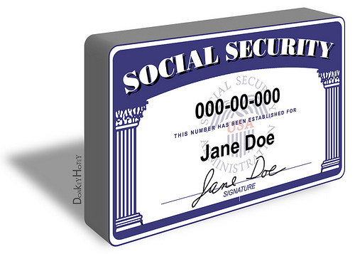
Social Security Number
Social Security Number (SSN) requirements will continue to follow existing Medi-Cal rules
Current verification channels for SSN will remain
34

Slide 35
Eligibility requirements
Treatment of Income
35

Slide 36
NEW INCOME ELIGIBILITY
Modified Adjusted Gross Income, otherwise known as MAGI, is the new form of budgeting income.
The new income calculation is based on IRS tax rules, which includes different countable income sources and deductions from those allowed under pre-ACA and non-MAGI Medi-Cal.
Some income sources and deductions are used for both MAGI and
non-MAGI; for example:
    Employment income; or
    Child support paid.
There are, however, income sources used for non-MAGI that are not used for MAGI, and expenses allowed for MAGI that are not allowed for
non-MAGI.
MAGI will include the tax filer’s income plus any additional income from the persons the primary taxpayer claims as tax dependents and are required to file a tax return.
36

Slide 37
COUNTABLE MAGI INCOME
Countable income for tax purposes will be used to determine eligibility for MAGI MC.
Countable Earned Income:
    Wages and salaries
    Tips
    Commissions
    Profits from Self-Employment
Countable Unearned Income:
    Unemployment
    SSA (Disability, Survivors, Retirement – taxable portion only)
    Retirement (IRA’s, Pension, 401(k), Military, Railroad)
    Rental Income
    Annuities
    Dividend Payments
    Per Capita Tribal Gaming Distributions
37

Slide 38
EXCLUDED INCOME FOR MAGI
Child Support payments
Veteran’s Benefits
Educational Assistance
Employment and Training Programs
Federal Tax Refunds and Earned Income Tax Credit
Bona Fide Loans
Employment and Training Programs
Sponsor Income
Foster Care Payments
Needs Based Assistance from Other Agencies
38

Slide 39
SELF-EMPLOYED INCOME FOR MAGI
Filed Federal Tax Return
Determine self-employment income by using the income and deductions claimed on the previous year’s taxes (1040, Line 12 of Schedule C), when an individual has worked long enough to file a federal tax return for the previous year and it represents their current income.
Not-Filed a Federal Tax Return
If an individual has worked less than a year, or not long enough to file a tax return in the previous year, self-employment income is determined by:
    Adding together gross self-employment income and any profit made from selling business property or equipment over the period of time the business has been in operation within the last year.
    Subtracting business expenses allowed by the Internal Revenue Service.
39

Slide 40
MAGI INCOME DEDUCTIONS
Many of the same expense deductions allowed on an income tax return are also allowed for MAGI MC; these include:
Educator Expenses
Health Savings Account Contributions
Moving Expenses
Alimony Paid
Student Loan Interest
IRA Deduction
School Tuition and Fees
40

Slide 41
INCOME VERIFICATION
The Federal Data Hub will attempt to verify income.
If the hub returns a finding of “Not Reasonably Compatible,” verification is needed. Acceptable verifications include:
    Paystubs
    Award letter
    UIB stub
    Refer to MC Handbook for additional acceptable forms of verification
Note: Acceptable types of income verification have not changed from pre-ACA Medi-Cal.
41

Slide 42
Eligibility requirements
Coverage Groups
42

Slide 43
MEDI-CAL COVERAGE GROUPS
MAGI
NON-MAGI
Childless adults 19-64
Pregnant
Children up to age 19
(or 21 if a full time student)
Parent/Caretaker Relative
Disabled (see next slide)
Aged
Blind
Disabled
LTC
MN/Medically Indigent (MI)
MN Sneede
43

Slide 44
MAGI COVERAGE
  The groups that will be evaluated under MAGI Medi-Cal are:
    ACA Adults
    ACA Parent/Caretaker Relative
    ACA Pregnant Women
    ACA Infant and Children up to 19 yrs.
    Targeted Low Income Children Program (TLICP)
Someone who has a disability and may be eligible for a non-MAGI program, but who also is eligible for MAGI MC coverage, is to be placed on the MAGI coverage prior to conducting a non-MAGI eligibility determination based on the disability.
  Non-MAGI eligibility may be important to determine, for example, if the person needs services (such as long-term care) that are not available to MAGI program recipients.
Current beneficiaries who could fit into one of the above groups, but who are currently aided under existing pre-ACA Medi-Cal programs, will continue receiving current benefits up to the time of their annual renewal (redetermination).
At their annual renewal, the household will be evaluated under the new MAGI rules. There is an exception for pre-ACA eligible children, who will continue to be eligible under
pre-ACA rules through 2014. Further details are pending on the child exception.
44

Slide 45
ADULTS
  The ACA will expand Medi-Cal eligibility to individuals who are:
    19 to 64 years of age
    U.S. Citizens/Legal Permanent Residents*
    Not pregnant
    Not eligible for Medicare Part A or B
    With income at or below 138% FPL
*Recent Legal Immigrants (Less than 5 years)
    Legal permanent residents in the U.S. less than 5 years will not be eligible for Federally funded MAGI Medi-Cal, but will be eligible under state-funded
    Medi-Cal.
    Recently enacted statute will create a “wrap around” program for childless LPR adults in the U.S. for less than 5 years. These adults will receive coverage through the Covered California plans upon implementation of the wrap around program, expected to occur sometime in 2014. More details will follow on this as the program is developed. In the meantime, this group will be aided in Medi-Cal as a state-only coverage group.
45

Slide 46
PARENTS/CARETAKER RELATIVES
The parents and caretaker relatives currently eligible under the MN, MI, or 1931(b) programs will be consolidated under this new group, and evaluated under MAGI Medi-Cal.
A caretaker relative is a person:
    Related to the dependent child by blood, adoption, or marriage
    Lives with the child
    Assumes primary responsibility for the child’s care
Parents and caretakers not eligible under this group because their income is over 125% FPL, but at or below 138% FPL, will be eligible for MAGI but are being tracked separately for federal claiming purposes and for potential Transitional Medi-Cal eligibility due to a change of circumstance. (Note that this should not affect eligibility processes.)
46

Slide 47
INFANTS AND CHILDREN
Children currently eligible under the MN, MI, 1931(b) and the percentage programs will be consolidated under the new HCR group, and evaluated under MAGI Medi-Cal at the time of their annual renewal.
  This group includes children up to age 19, however, children up to 21 years of age who are full time students and claimed as tax dependents will also be aided under this group.
The Targeted Low Income Program (TLICP) was created to aid the Healthy Families Children transitioning into Medi-Cal in 2013.
    TLICP will continue in 2014, meaning that higher-income children will continue to pay premiums to receive Medi-Cal.
    There will be new TLICP aid codes in 2014 that include undocumented children.
    This program continues to provide coverage only up to age 19.
47

Slide 48
Eligibility requirements
Advance Premium Tax Credits
Cost Sharing Reduction
48

Slide 49
APTC/CSR
Customers not eligible to MAGI MC will have eligibility determined for the Advanced Premium Tax Credit (APTC) Program and Cost Sharing Reduction subsidies (CSR); often referred to as Enhanced Benefits. County eligibility staff will be able to do this determination.
Starting January 1, 2014, any individual who meets the following requirements will be eligible for Premium Tax Assistance:
    No Other Health Coverage [and no offer of affordable employer coverage]
    Residency
    Citizenship/Immigration
    Household Composition
    Social Security Number
    Income 100% to 400% FPL
  Countable and Excluded Income for the Premium Assistance Program are the same as they are for MAGI MC
  Household composition under APTC is different than those under MAGI. While the “countable” and “excluded” income are based on the same factors, they may differ for each household based on the members counted in the APTC unit vs. the MAGI unit.
49

Slide 50
APTC/CSR
Advance Premium Tax Credits (APTC) will provide subsidies in the form of tax credits. Cost-Sharing Reductions (CSR) provide help in paying
out-of-pocket costs like deductibles and co-pays.
APTC/CSR will be available to:
    Individuals not eligible for MAGI-based Medi-Cal,
    Individuals receiving Non-MAGI Medi-Cal with a share of cost (SOC).*
    Individuals without MEC
For the initial enrollment period, open enrollment will be extended from October 1, 2013 through March 31, 2014. In future years, the open enrollment will be Oct 15– Dec 7.
*Still being finalized whether SOC MC and APTC/CSR can be received at
the same time, but we think it will be allowed. Depends on whether SOC MC is considered minimum essential coverage or not.
50

Slide 51
Eligibility requirements
Self-Attestation
Appeals
51

Slide 52
SELF-ATTESTATION
Self-attestation is a new term introduced by HCR. It means an individual is formally stating that something is true.
Self-attestation occurs when an individual reports information (income, citizenship, immigration status, etc.) related to an eligibility determination, and then signs acknowledging the information is true and correct.
The signature can be on a document, telephonic, or electronic.
Under HCR, counties may accept self-attestation, instead of requiring an individual to produce a document, for certain data elements (see list on next slide), assuming the county has no information that is not reasonably compatible with the self-reported information
52

Slide 53
SELF-ATTESTATION
Self-attestation is acceptable for APTC for:
    Age
    Date of birth
    Family size
    Household income
    Residency
    Pregnancy; and
    Any other information needed to determine eligibility.
Self-attestation is acceptable for Medi-Cal for:
    Age
    Date of birth
    Family size
    Pregnancy
    SSN if verified through the hub
    Citizenship if verified through the hub
Self-attestation is not allowed for Medi-Cal for:
    Residency
    Income
53

Slide 54
APPEALS
Customers can file an appeal within 90 days for any action taken on their case.
Medi-Cal appeals will remain the same. Counties will continue to conduct appeals for non-MAGI and for MAGI in 2014.
The appeals process for Covered CA is still pending.
54

Slide 55
Additional information
Pending Future Guidance
Resources
55

Slide 56
PENDING FUTURE GUIDANCE
Interaction between CalWORKs and Medi-Cal
Pregnancy
Citizenship
    Eligibility for Lawful Permanent Residents with less than 5 years of residency, including wrap-around program, and undocumented individuals
Reporting and processing changes
56

Slide 57
RESOURCES
ABX1 1 (Statutes of 2013)
http://www.leginfo.ca.gov/pub/13-14/bill/asm/ab_0001-0050/abx1_1_bill_20130627_chaptered.pdf
SBX1 1 (Statutes of 2013)
http://www.leginfo.ca.gov/pub/13-14/bill/sen/sb_0001-0050/sbx1_1_bill_20130627_chaptered.pdf
Covered California Eligibility Regulations
http://www.healthexchange.ca.gov/Regulations/Documents/NoticeofOALFiling-EligibilityandEnrollmentEmergRegulationsR.pdf
57

Slide 58

QUESTIONS?
58

Slide 59
Additional information
Supplemental Slides
(Added Post-Webinar)
59

Slide 60
“LARGE” EMPLOYER COVERAGE
“Large” employers = those with 50 or more employees
  “Large” employers are not required to buy “essential health benefits”: Note that most do, but not all
  Coverage offered by employers to employees and dependents is always considered minimum essential coverage
Minimum essential coverage may or may not be “good” coverage:
  “Large” employers can cover only preventive benefits (mammograms, immunizations, screening but not treatment)
  Unless an employee ends up on the Exchange, employers offering these limited benefits face no penalty
Large employers are not required to offer coverage but a large employer faces penalties if a full-time, non-seasonal employee enrolls in the Exchange

Slide 61
EMPLOYER-SPONSORED COVERAGE AND PUBLIC PROGRAMS
Some employers may offer coverage that:
  Costs a relatively high percentage of the person’s wages
  Covers less than 100% of the cost of care
  Has a relatively high deductible
  Covers children but not spouses
Medi-Cal is an entitlement
  An individual who is eligible for Medi-Cal is eligible whether or not they are offered employer-based coverage: this does not change in 2014
  Employer-based coverage is always primary but workers and dependents are not required to accept it
The Exchange treats employer-sponsored coverage differently than Medi-Cal
  A worker is barred from the Exchange if offered employer-coverage unless the employer coverage costs more 9.5% of wages or covers less than 70% of the cost of care.

