Slide 1
CWDA Fiscal Meeting:
Realignment
1991 & 2011
& AB85
November 14, 2013

Slide 2

Presenters
  Andrew Pease, San Diego – Health & Human Services
  Robert Manchia, San Mateo, Human Services

Slide 3
Agenda
  Realignment Overview & Structure
  Growth & Forecasting
  Group Discussions
    Preparing for Economic downturn
    Leveraging the flexibility of Realignment among programs

Slide 4

  Realignment Overview & Structure - 1991

Slide 5
AB-85 Impacts
  Redirection of Health Realignment
    New accounts (Child Poverty & Family Support)
    Counties have two formula options
  VLF and Sales Tax Swap
  Changes/Redirection in Growth

Slide 6
1991 REALIGNMENT STRUCTURE - STATE
SALES TAX/VLF DISTRIBUTIONS
Sales Tax/VLF
Source: ½ cent Sales Tax; Source: 74.9% Vehicle License Fees
Pre AB-85
Sales Tax/VLF Base Account
Sales Tax/VLF Growth Account
(Revenues in Excess of Base Payments)
Mental Health Subaccount ª
($1.12 billion base funding from 2011 Realignment)
Social Services Subaccount
Health
Subaccount
CMSP
(Base Account)
CalWORKs MOE ^{b}
(capped at $1.12 billion)
County Allocations
CMSP
(County Shares)
Sales Tax Caseload Subaccount
(1st call on Growth)
CMSP Growth
(2nd call on Growth; 4.027% plus 4.027%
of caseload growth paid if over $20M)
General Growth
(remaining Growth)
Mental Health
(approx. 40%)
Health
(approx. 52%)
Social Services
(approx. 8%)
If CalWORKs MOE has reached cap, funds in excess go to Mental Health

Slide 7
1991 REALIGNMENT STRUCTURE - STATE
SALES TAX/VLF DISTRIBUTIONS
Sales Tax/VLF
Source: ½ cent Sales Tax; Source: 74.9% Vehicle License Fees
Post AB-85
Sales Tax/VLF Base Account
Sales Tax/VLF Growth Account
(Revenues in Excess of Base Payments)
Mental Health Subaccount ª
($1.12 billion base funding from 2011 Realignment)
Social Services Subaccount
Health
Subaccount
CMSP
(Base Account)
Child Poverty and Family Supplemental Support Subaccount
(Base is $0 in 2013-14)
CalWORKs MOE ^{b}
(capped at $1.12 billion)
County Allocations
Sales Tax - Family Support Subaccount
($300 M in 2013-14)
CMSP
(County Shares)
Sales Tax Caseload Subaccount
(1st call on Growth)
CMSP Growth
(2nd call on Growth; 4.027% plus 4.027%
of caseload growth paid if over $20M)
General Growth
(remaining Growth)
Mental Health
(approx. 40%)
Health
(approx. 18.45%)
Child Poverty & Family Supplemental Support
(remaining growth)
If CalWORKs has reached cap, funds in excess go to Mental Health

Slide 8
AB 85: State to County Transfer
Family Support
Subaccount
Child Poverty & Family Supplemental Support Subaccount
State
NEW County Account
Family Support
Account

Slide 9
Child Poverty & Family Supplemental Support Subaccount: Key Dates
March 1, 2014: CalWORKs 5% grant increase.
January
February
March
April
May
June
October
January 10 thru May 14: Department of Finance calculates grant increases based on projected revenue and cost for FY 14/15 and for all fiscal years thereafter.
October 1: Effective date for any grant increases.
If projected revenue is equal to or less than the cost of all grant increases, no additional grant increase would be provided. (Section 11450.025 (b) (4))
Additional grant increases will not be provided until and unless the ongoing cumulative costs of all prior grant increases provided are fully funded by the Child Poverty and Family Supplemental Support Subaccount. (Section 11450.025 (d) (2))
Counties shall not be required to contribute a share of cost to cover the costs of grant increases. (Section 11450.025 (e))

Slide 10
AB-85 and the County Two Formula Options Decision
Determining County Health Realignment “Savings”
  $300 million this year
  Tied to Medi-Caid expansion
  Three County structures
    Hospital counties
    CMSP counties
    Payor/Clinic counties

Slide 11
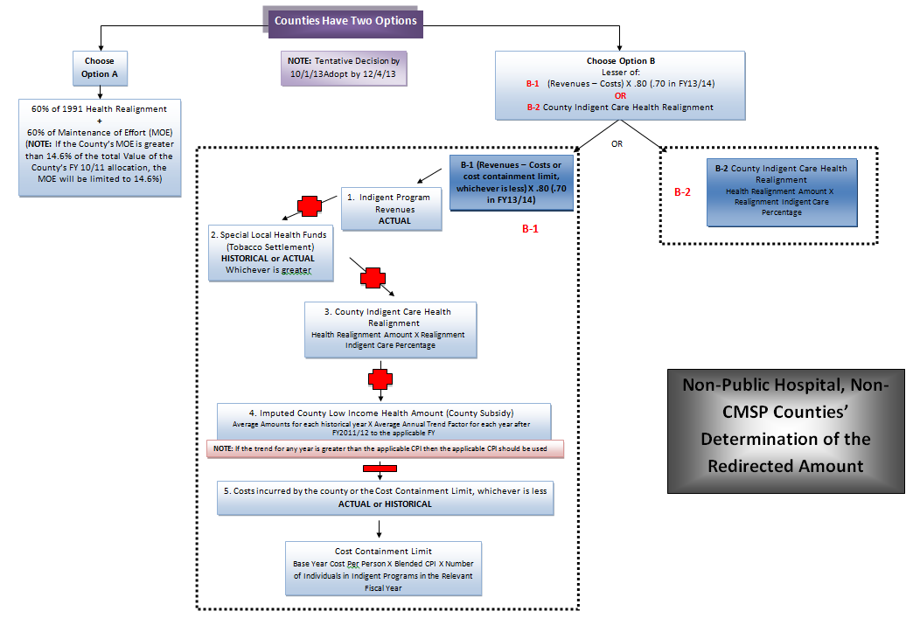
AB 85: Determination of the Redirected Amount
Non-Public Hospital and Non-CMSP Counties
See Hand-out:
“Non-Hospital & Non-CMSP Flowchart”

Slide 12
AB 85 TIMELINE: Key Dates and Decision Points
January 31, 2014: If DHCS and a county disagree on that county’s historical data, DHCS will use the county’s data on an interim basis to determine the estimated savings for the next fiscal year.
By October 31, 2013: Counties electing to use the Savings Formula (or think they might) must submit to DHCS historical data/percentages on health realignment and county funds spent on indigent care (if not then the State defaults to 85% on use of realignment)
January 2014: DHCS calculates an interim FY 14/15 redirected amount for each county choosing the Savings Formula.
November 1, 2013: Counties tentatively inform the state of their chosen option (60/40 split or savings formula)
October 2013
November 2013
December 2013
January 2014
February 2014
May 2014
December 15, 2013: If DHCS disagrees with a county’s historical data/percentages, they must advise the county and DHCS must issue its determination by January 31, 2014.
February 28, 2014: In case of disagreement, the county must submit a petition on this date to seek a decision on the historical percentages to the County Health Care Funding Committee.
January 22, 2014: Boards of Supervisors of each county must adopt a resolution and advise the state of their chosen option.
Updated for SB 98
May 2014: DHCS calculates an updated interim FY 14/15 redirected amount for each county based on more recent data.

Slide 13
AB 85: Sales Tax and Vehicle License Fee Swap (W&I Code 17600.15(d)
Social Services Sales Tax
First: Transfer Up To $1.0 B
Second: Transfer Up To $1.0 B
Health Sales Tax
(to fund Family Support Subaccount)
Health VLF

Slide 14
  Realignment Overview & Structure 2011
  Support Services

Slide 15
Local Revenue Fund 2011
State Structure for FY 2012-13
Local Revenue Fund 2011
$5,889,795,000
Mental Health Account
(1991 Mental Health Responsibilities)
$1,120,551,024
Support Services Account
$2,604,900,000
Law Enforcement Services Account
$1,942,633,000
Sales and use Tax Growth Account
(Excess revenues above
base allocations)
$221,710,976
County Intervention Support Services Subaccount
Trial Court Security Subaccount (34.2% or up to capped allocation)
$496,429,000
District Attorney and Public Defender Subaccount (1% or up to capped allocation)
$14,600,000
Support Services Growth Subaccount (65%)
$144,112,134
Law Enforcement Services Growth Subaccount (35%)
$77,598,842
Protective Services Subaccount (63% or up to capped allocation)
$1,640,400,000
Community Corrections Subaccount (58% or up to capped allocation)
$842,900,000
Juvenile Justice Subaccount (6.8% or up to capped allocation)
$98,804,000
Protective Services Growth Special Account (40% for CWS and 42% general) $118,215,184
Trial Court Security Growth Special
Account (10%)
$7,759,884
Behavioral Health
Subaccount (37% or up to capped allocation) $964,500,000
Enhancing Law Enforcement Activities Subaccount
$489,900,000
Juvenile Reentry Grant
Special Account
$5,453,000
Behavioral Health Services Growth
Special Account
(13%) $18,691,344
Community Corrections Growth Special
Account (75%)
$58,199,131
Youthful Offender Block
Grant Special Account
$93,351,000
Mental Health Subaccount (5%)
$7,205,607
Juvenile Justice
Growth Special
Account (10%)
$7,759,884
Women and Children’s Residential Treatment Special Account (subset of BH Subaccount) $5,104,000
Enhancing Law Enforcement Activities Growth Special Account (Residual VLF revenue above the capped allocation) $0
District Attorney & Public Defender Growth Special
Account (5%)
$3,879,942

Slide 16
State Structure for Support Services for FY 2012-13
Local Revenue Fund 2011
$5,889,795,000
Support Services Account
$2,604,900,000
Sales and Use Tax Growth Account
(Excess revenues above base allocations) $221,714,976
Protective Services Subaccount
(63% or up to capped allocation)
$1,640,400,000
Behavioral Health Subaccount
(37% or up to capped allocation)
$964,500,000
Support Services Growth Subaccount (65%) $144,112,134
County Intervention Support Services Subaccount
Women and Children’s Residential Treatment Special Account
(subset of BH Subaccount) $5,104,000
Protective Services Growth Special Account (40% for CWS and 42% general) $118,215,184
Behavioral Health Services Growth Special Account (13%) $18,691,344
Mental Health Subaccount (5%) $7,205,607

Slide 17
County Local Revenue Fund 2011
Support Services
County Local Revenue Fund 2011
Support Services Account
Support Services Reserve Subaccount
(Local option – subject to direction of BOS)
Behavioral Health Subaccount
Drug Court
Drug Medi-Cal
Nondrug Medi-Cal
Early and Periodic Screening, Diagnosis & Treatment (EPSDT)
MH Managed Care
Protective Services Subaccount
Adoptions
Adult Protective Services
Child Abuse Prevention, Intervention & Treatment (CAPIT)
Child Welfare Services
Foster Care
Ability to transfer up to 10% of the lesser subaccount between these Subaccounts
County Women and Children’s Residential Treatment Services Special Account

Slide 18
2011 Realignment - Annual Allocation
Go Over Hand-Out
See Hand-out:
“Annual Allocation Realignment 2011”
SUPPORT SERVICES

Slide 19
MHS Accounts & CalWORKS MOE
Go Over Hand-Out
See Hand-out:
“MH Realignment And CalWORKs MOE”

Slide 20
CalWORKS MOE Reconciliation Spreadsheet

Slide 21
2011 Realignment - Annual Allocation
General Observations
Allocations are adjusted over next several years before stabilizing
Allocations are based on percents &/or hard amounts
Mental Health Account has guaranteed funding level
We only know for certain the 12/13 base amounts

Slide 22
  Realignment Overview & Structure 1991 & 2011
  Similarities & Differences

Slide 23
1991 Realignment Programs
AB 8 County Health Services
Local Health Services
California Children’s Services
Indigent Health
CalWORKs
Employment Services
County Services Block Grant
In-Home Supportive Services
Foster Care
CWS
Adoptions
County Stabilization Subvention
County Juvenile Justice Subvention (AB90)
Mental Health
EPSDT
Managed Care

Slide 24
2011 Realignment Programs
Foster Care
CWS
Adoptions
Adult Protective Services
Child Abuse Prevention, Intervention & Treatment (CAPIT)
Women and Children’s Residential Treatment
Drug Medical
Nondrug Medical
Drug Court
Mental Health
EPSDT
Managed Care
Law Enforcement
  Trial Court Security
  District Attorney and Public Defender
  Juvenile Justice
  Community
  Corrections
  Local Public Safety
  Subventions

Slide 25
Intersection of Realignment Programs
1991 Realignment
2011 Realignment
AB 8 County Health Services
Local Health Services
California Children’s Services
Indigent Health
CalWORKs
Employment Services
County Services Block Grant
In-Home Supportive Services
County Stabilization Subvention
County Juvenile Justice Subvention (AB90)
Adult Protective Services
Child Abuse Prevention, Intervention & Treatment (CAPIT)
Women and Children’s Residential Treatment
Drug Medical
Nondrug Medical
Drug Court
Law Enforcement
  Trial Court Security
  Juvenile Justice
  District Attorney and Public Defender
  Community
  Corrections
  Local Public Safety
  Subventions
Shared
Foster Care
CWS
Adoptions
Mental Health
EPSDT
Managed Care

Slide 26
1991 Realignment Program Ratios
Program
CalWORKs Aid Payments
CalWORKs Eligibility
Foster Care
Child Welfare Services
Adoptions Assistance
CalWORKs Employment Services
In-Home Supportive Services
County Services Block Grant
California Children’s Services
Old Share (non-Fed)
11%
50%
5%
24%
0%
0%
3%
16%
25%
New 1991 Share (non-Fed)
5%
30%
60%
30%
25%
30%
35%
30% total
50% total

Slide 27
Impact of 2011 Realignment to 1991 Sharing Ratios
Program
Foster Care
Child Welfare Services
Adoptions Assistance
Adoptions Eligibility
Adult Protective Services
Child Abuse Prevention, Intervention, & Treatment (CAPIT)
60%
30%
25%
0%
MOE
16%
New 2011 Share (non-Fed)
100%
100%
100%
100%
100%
100%
1991 Share (non-Fed)

Slide 28
Similarities and Differences 1991 & 2011
  Base Restoration
  Programs
  Reserve Account
  VLF vs. Sales Tax
  Transfer Abilities
  Reporting Requirements
  Fed/Court Changes
  Flexibility
  Growth allocated
  County Intervention Services Account
  CWS
  Fiscal Years
  Constitutional Protections

Slide 29

Realignment Growth

Slide 30
Flow of 1991 Realignment - Theory and Reality
See Hand-out:
“1991 Realignment (Sales Tax and VLF) – Full Funding Assertion”

Slide 31
AB-85 Growth Impacts
Social Services no longer receives general growth
Health Realignment will receive significantly less growth
Growth diverted to Child Poverty & FSS
Mental Health not impacted

Slide 32
1991 REALIGNMENT STRUCTURE - STATE
SALES TAX/VLF DISTRIBUTIONS
Sales Tax/VLF
Sales Tax/VLF Growth Account
(Revenues in Excess of Base Payments)
Sales Tax/VLF Growth Account
(Revenues in Excess of Base Payments)
Post AB-85
Pre AB-85
Sales Tax Caseload Subaccount
(1st call on Growth)
CMSP Growth
(2nd call on Growth; 4.027% plus 4.027%
of caseload growth paid if over $20M)
General Growth
(remaining Growth)
Sales Tax Caseload Subaccount
(1st call on Growth)
CMSP Growth
(2nd call on Growth; 4.027% plus 4.027%
of caseload growth paid if over $20M)
General Growth
(remaining Growth)
Mental Health
(approx. 40%)
Health
(approx. 52%)
Social Services
(approx. 8%)
Mental Health
(approx. 40%)
Health
(approx. 18.45%)
Child Poverty & Family Supplemental Support
(remaining growth)

Slide 33
1991 Realignment Caseload Growth Funding
Reflects mandated growth in social services programs
Amount based on program expenditures, not caseload
Calculation based on change in County cost due to mandated cost increases (i.e. growth in caseload)
State Department of Social Services and Health Care Services calculate draft amounts for each county
Counties Review to validate amounts and recommend adjustments
Determined by comparison of County specific costs from two years ago compared to last year
Increased costs generally = more caseload growth

Slide 34
1991 Realignment Caseload Growth Tools

Slide 35
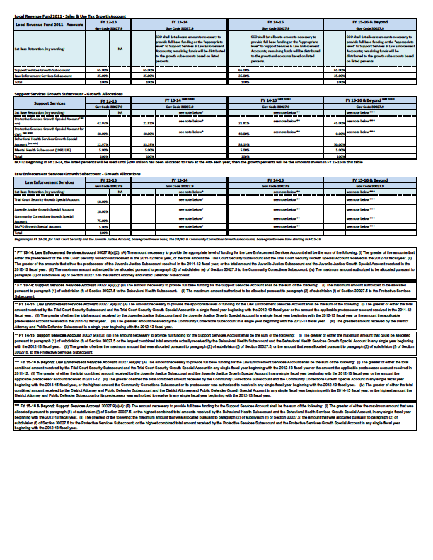
2011 Realignment Growth
See Hand-out:
“2011 Realignment Growth Chart”
SUPPORT SERVICES

Slide 36

  Realignment Forecasting

Slide 37
2011 Realignment Forecasting Tool

Slide 38
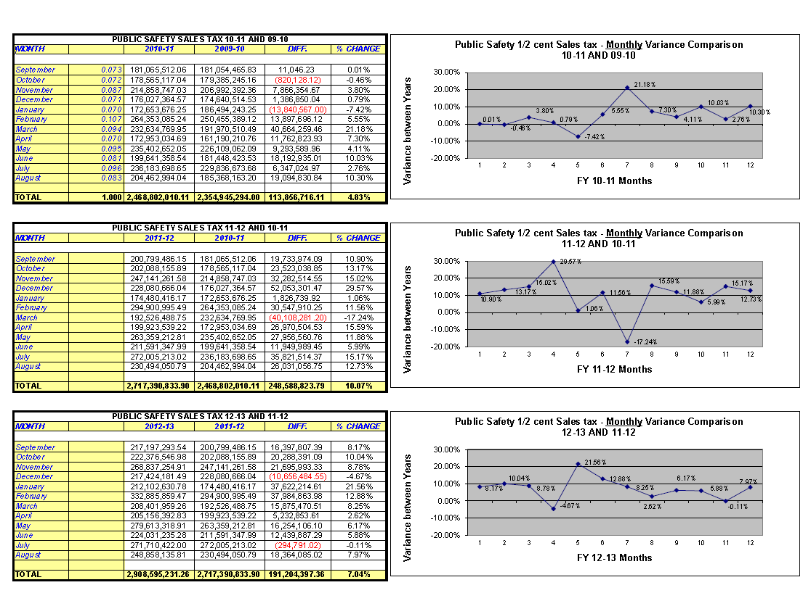
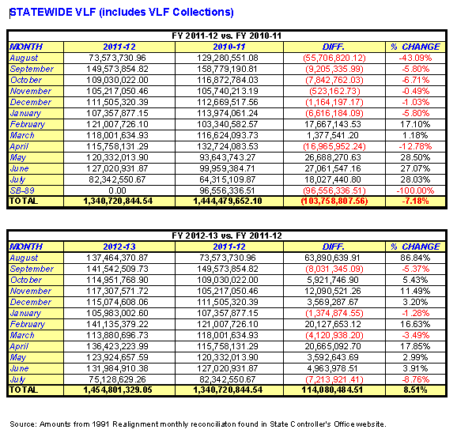
Forecasting VLF & Sales Tax

Slide 39
Group Discussions
  Preparing for Economic Fluctuations (downturns)
    Discuss strategies in setting up your county to handle future recessions and shortfalls in realignment
  Leveraging the flexibility of Realignment among programs
    Discuss opportunities in the integration of realignment among health and human services programs

Slide 40
Preparing for Economic Fluctuations
What is a reasonable Reserve amount?
What are different ways a county can set up a reserve(s)?
How can counties allocate realignment in such a way to be able to maneuver quickly to economic fluctuations? (turning off the spigot when the funding dries up)

Slide 41
Flexibility/Integration
Where are the intersections/integration opportunities between the programs that allow choices in which Realignment pot to use?
  SB-163 Wrap Around Services?
  Katie A.?
  Mental Health Managed Care Offset?
  AB-109?
  What Else?

Slide 42
Contact Information
PRESENTERS
  Andrew Pease, Executive Finance Director, County of San Diego, Health & Human Services Agency; (619) 338-2100; andrew.pease@sdcounty.ca.gov
  Robert Manchia, Deputy Director of Finance, San Mateo County Human Services; (650) 802-6491; rmanchia@smchsa.org

