Slide 1
DACA
Deferred Action for Childhood Arrivals
January 13, 2015

Slide 2
Defining DACA
On June 15, 2012, the President announced that certain individuals who meet specific guidelines, could request consideration of Deferred Action for Childhood Arrivals (DACA) status. DACA status is valid for a period of two years, subject to renewal. U.S. Citizenship and Immigration Services (USCIS) lists the following guidelines for DACA consideration:
Came to the U.S. before age of 16.
Continuously resided in the U.S. since June 15, 2007.
Under the age of 31 as of June 15th, 2012.
Did not have lawful immigration status as of June 15^{th,} 2012.
Pursuing education or military service.
No prior convictions (felony or significant misdemeanor).
Physically present in the U.S. on June 15th, 2012, and at the time of requesting DACA.
Note: Since the initial announcement was made establishing this criteria, the recent executive order may change some of this information and further details will be forthcoming.

Slide 3

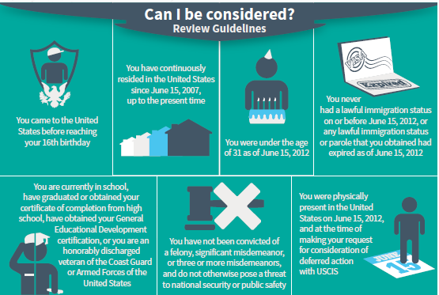
USCIS DACA Flyer

Slide 4
Defining DACA (continued)
Applicants/beneficiaries who are claiming DACA status, may also identify themselves as:
  Part of the “Dream Act”
  “Dreamers”
  “Immigrant Youth”
First point of contact staff, which could include customer service center staff, receptionists, screeners, etc., should route these individuals to designated eligibility staff who will evaluate them for full scope Medi-Cal benefits, based on their declaration of DACA status.

Slide 5
DACA is a Category of PRUCOL
PRUCOL: Permanently Residing Under Color of Law
PRUCOL, itself, is not an immigration status. It is a list of 16 immigration statuses, which provide a basis for otherwise eligible immigrants in any one of the 16 categories to receive full scope Medi-Cal.
Although PRUCOL immigrants are not U.S. Citizens or Legal Permanent Residents, they are considered to have the same rights as legal residents for Medi-Cal eligibility purposes.
Immigrants who are PRUCOL are eligible for full scope
Medi-Cal.
  Note: Documentation is necessary for all categories of PRUCOL, except for category #16.

Slide 6
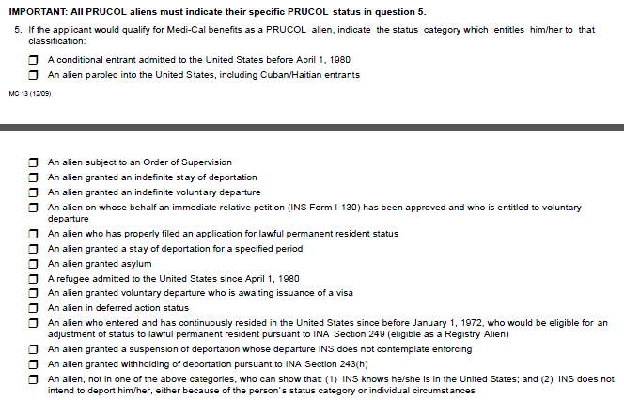
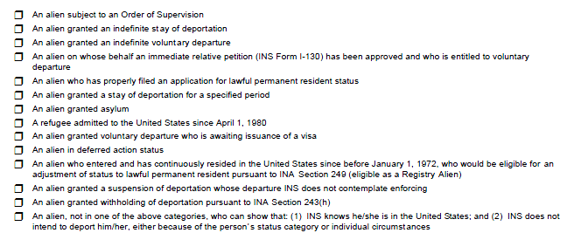
DACA is a Category of PRUCOL (continued)
PRUCOL has 16 status categories in Section B Question 5 of the MC 13, Statement of Citizenship, Alienage and Immigration Status, form (below).
DACA is PRUCOL category #12.

Slide 7
DACA Medi-Cal Eligibility
For Medi-Cal eligibility purposes, DACA individuals are:
Considered PRUCOL under category #12 in question 5 of the MC13: An alien in deferred action status; therefore,
Eligible for full-scope Medi-Cal if they meet all eligibility requirements.

Slide 8
DACA Verification Requirements
Initial self-attestation of DACA status is acceptable.
The MC13 form is only required if DACA verification of immigration status cannot be e-verified via the Federal Data Hub (HUB) or Systematic Alien Verification and Entitlement (SAVE).
If unable to verify immigration status, individuals will be allowed a 90-day Reasonable Opportunity Period (ROP) to provide documentation.
Full-scope Medi-Cal benefits must be granted to the applicant while DACA immigration status is verified, if the individual is otherwise eligible.

Slide 9
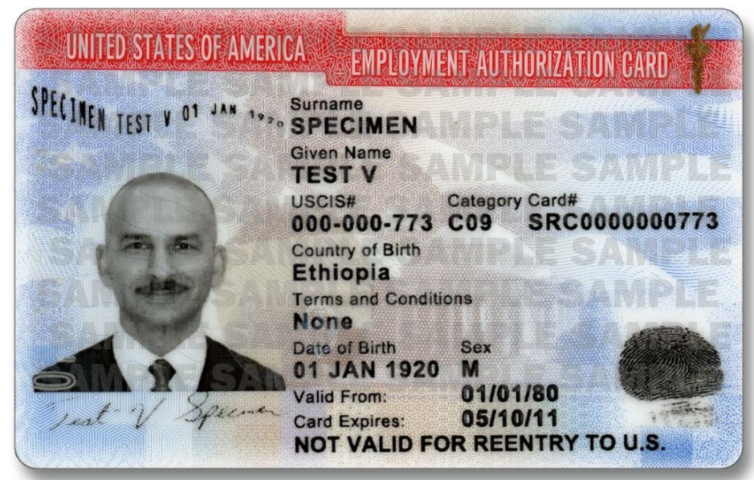
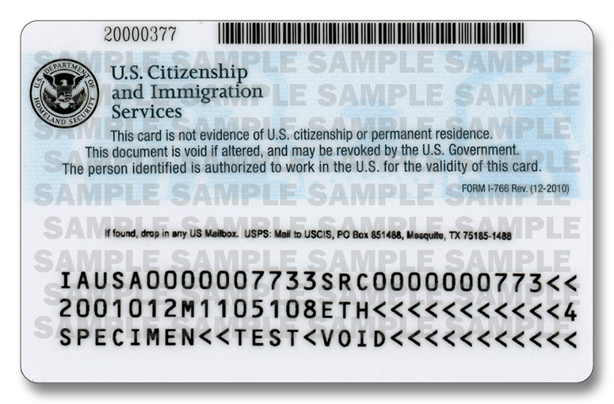
DACA Verifications
  I-766 Employment Authorization Document (EAD) card with status Category Code “C-33” (aka Work Permit)
C33
01/01/14
01/01/16
USCIS/Alien #
Category Code
Valid From &
Expiration Dates
FORM I-766 Rev. (12/2010)
Card/Document #

Slide 10
DACA Verifications (continued)
  Form I-797 Notice of Action
Valid From & Expiration Date
Form/Document Type

Slide 11
DACA Eligibility
DACA individuals are eligible for full-scope benefits for both Modified Adjusted Gross Income (MAGI) and non-MAGI
Medi-Cal.
Although DACA individuals may qualify for full scope
Medi-Cal eligibility, they are not eligible to receive the following benefits from Covered California:
  Subsidized Coverage (Advanced Premium Tax Credit [APTC] or Cost Sharing Reduction [CSR]), or
  Unsubsidized Coverage (full price health coverage).

Slide 12
CalHEERS Initiated Application
Individuals who identify themselves as DACA, may have initiated their application through the California Healthcare Enrollment, Eligibility and Retention System (CalHEERS). However, currently CalHEERS is not programmed with PRUCOL logic.
Eligibility staff should complete a detailed review of the Determination of Eligibility Response (DER) received from CalHEERS for all DACA individuals.
  If CalHEERS returned a full scope aid code and immigration status is e-verified, approve eligibility through your SAWS system.
  IF CalHEERS returned a limited scope aid code, staff should follow their county’s instructions to grant the appropriate full scope aid code.
  NOTE: Staff must ensure that the appropriate Notice of Action (NOA) is sent to the individual. If needed, staff must initiate a manual NOA.

Slide 13
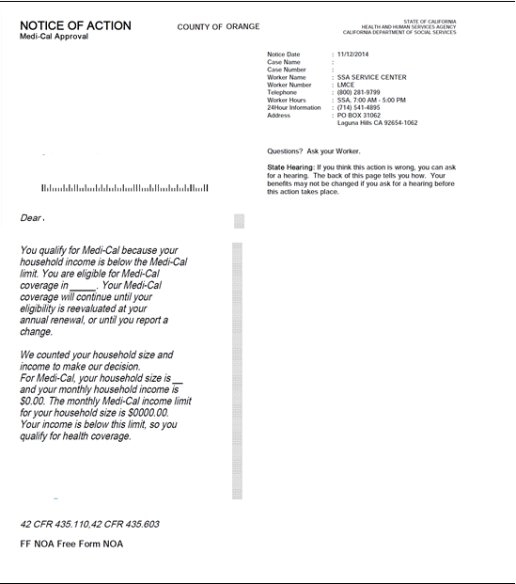
Sample Language for Manual NOA

Slide 14
SAWS Initiated Applications
  DACA individuals may also apply via the Statewide Automated Welfare Systems (SAWS):
    LEADER
    C-IV
    CalWIN
Eligibility staff should complete a detailed review of the Determination of Eligibility Response received from CalHEERS and take the following actions for DACA individuals:
  If the immigration status is e-verified, and full scope eligibility is granted, approve eligibility through your SAWS system.
  If a limited scope aid code is granted, staff should follow their county’s instructions to grant the appropriate full scope aid code.
Reminder: Staff must ensure that the appropriate Notice of Action (NOA) is sent to the individual. If needed, staff must initiate a manual NOA.

Slide 15
MEDS
MEDS: Medi-Cal Eligibility Data System
If SAWS fails to interface with or update MEDS correctly, and if MEDS is not displaying correct aid code, then manual update of eligibility is necessary.
  Staff must update MEDS INQM screen with the correct benefit aid code by using the EW20 transaction.
  Staff must also update MEDS INQE screen’s Citizen/Alien indicator field with an “S” code for “other documented full scope alien” by using the EW12 transaction.

Slide 16
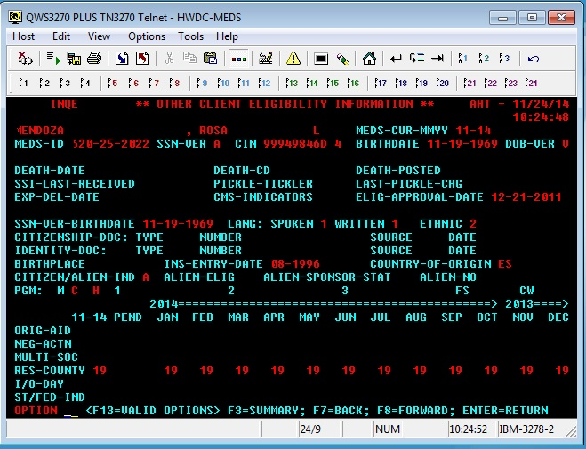
MEDS INQE Screen
DOE
JOHN
XXX-XX-XXXX
XXXXXXXXA
01-01-1985
01-01-1985
S

Slide 17
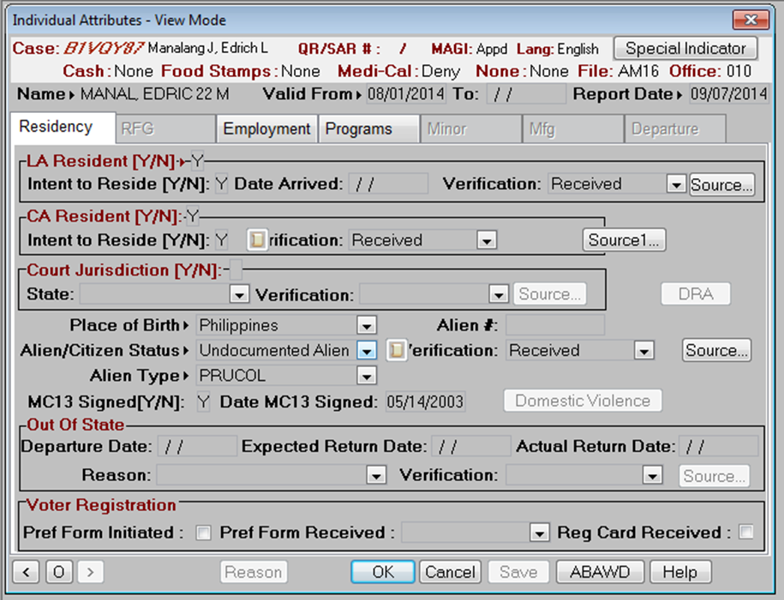
LEADER: Individual Attributes Summary
B123456 DOE , JOHN
ZZ99
1234
DOE , JOHN 29 M
001234567
05/03/2014

Slide 18
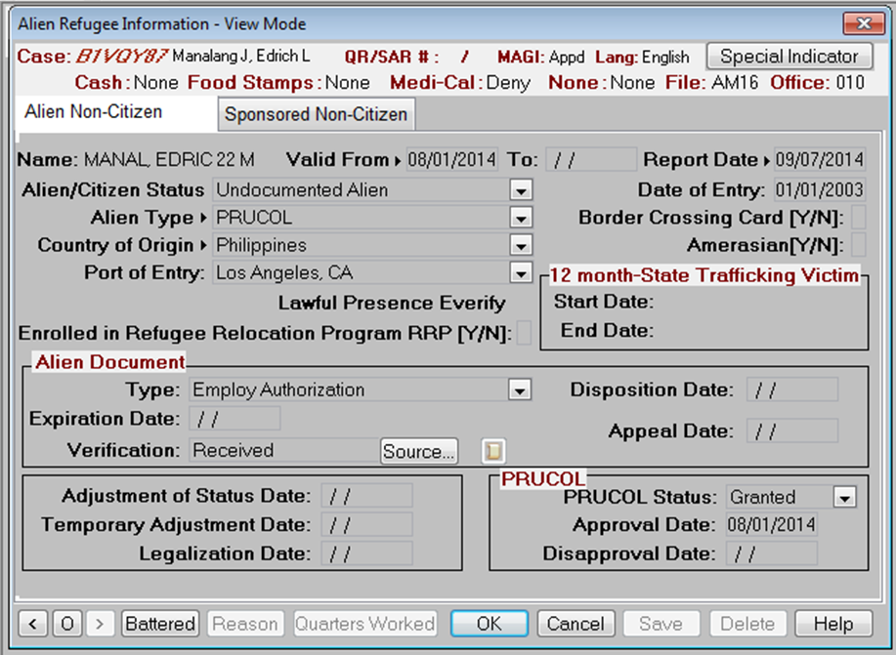
LEADER: Alien Refugee Summary
B123456 DOE , JOHN
ZZ99
1234
DOE , JOHN 29 M
08/01/2016

Slide 19
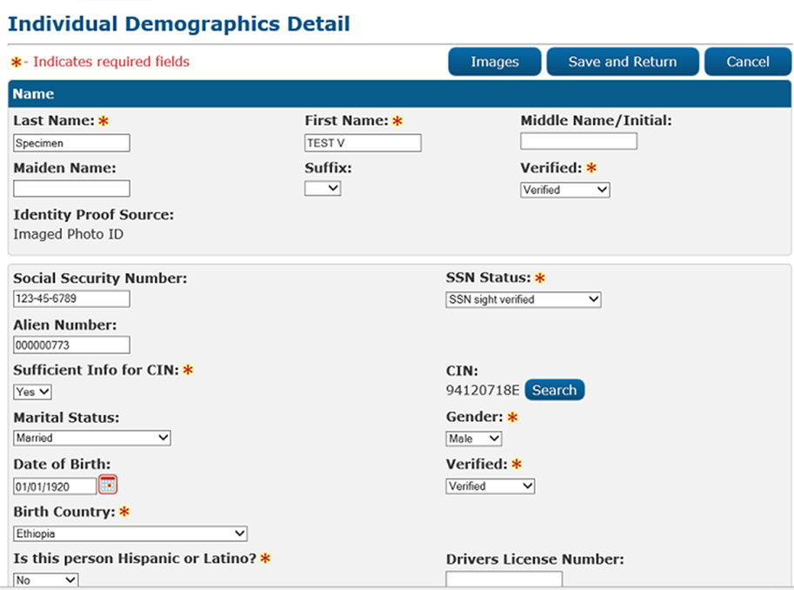
C-IV: Individual Demographics Detail

Slide 20
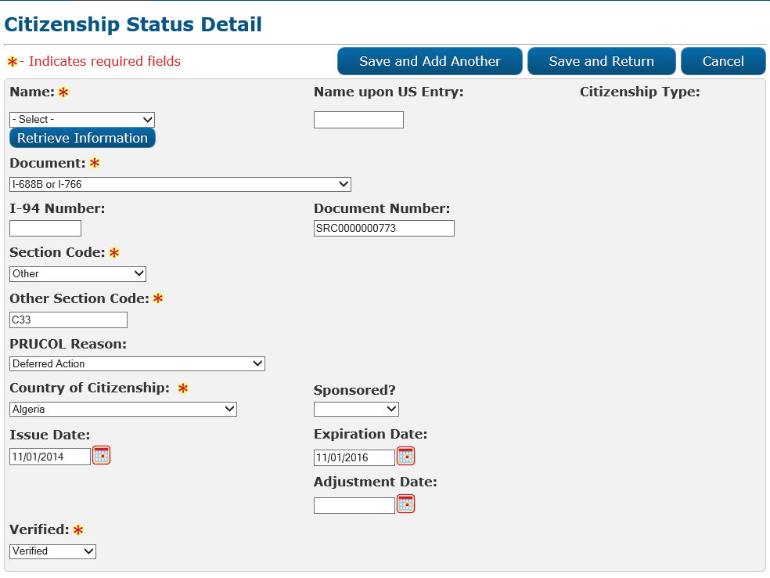
C-IV: Citizenship Status Detail
TEST V SPECIMEN
TEST V SPECIMEN

Slide 21
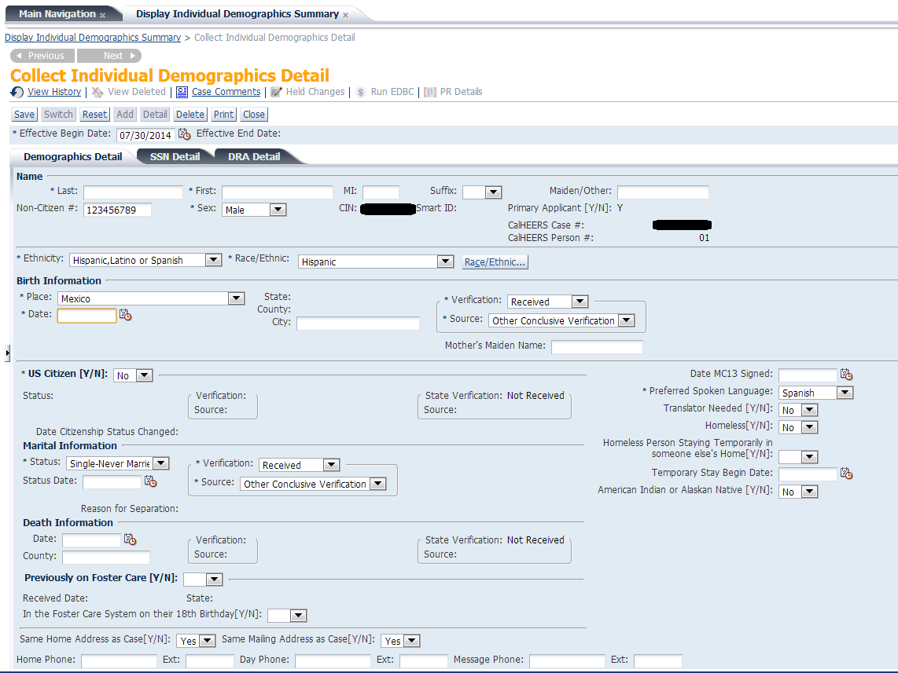
CalWIN: Individual Demographic Detail
Test
Name

Slide 22
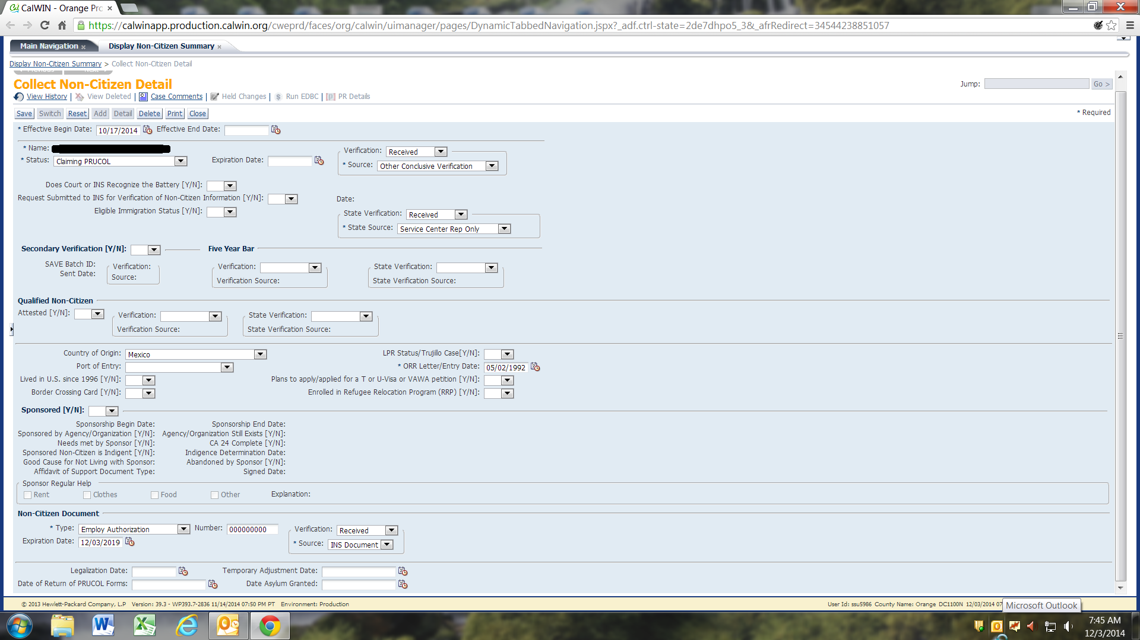
CalWIN: Non-Citizen Detail
Name Test

Slide 23
Pending Future Guidance
Effective January 2015, the President’s new executive order, may broaden existing deferred action policy to include additionally eligible immigrants.
These changes may allow current beneficiaries, or applicants to become eligible for full scope
Medi-Cal benefits under PRUCOL, if these individuals are granted deferred action status.
We are currently awaiting future policy guidance.

Slide 24
Additional Resources
MEDIL I 14-08
MEDIL I 14-11
MEDIL I 14-21
MEDIL I 14-41
MEDIL I 14-45
www.USCIS.gov/childhoodarrivals
Homeland Security

Slide 25

Questions?
Jo Weber: joaweber@comcast.net

