Slide 1
HMIS
Privacy
Policy
Rules for the regulation and administration of HMIS is part of the Code of Federal Regulations, as provided for by the HEARTH Act
A privacy policy must be established that implements procedures that comply with these regulations and any standards established by HUD in notice

Slide 2
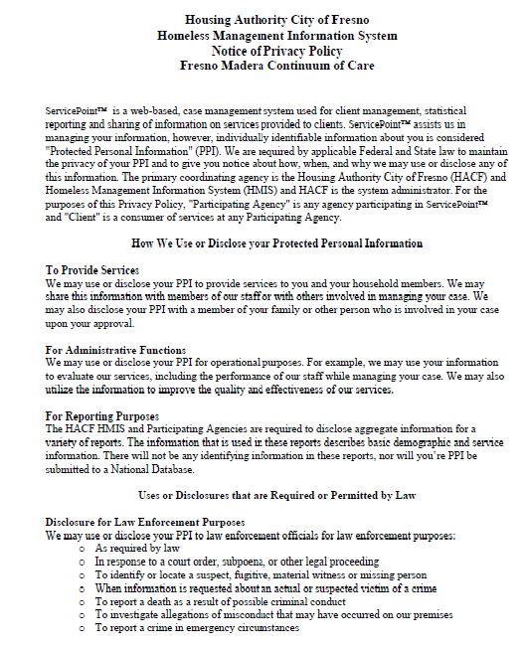
HMIS Privacy Policy
Client notice
Protected Personal Information (PPI)
Participating Agency access
Aggregate Client data

Slide 3
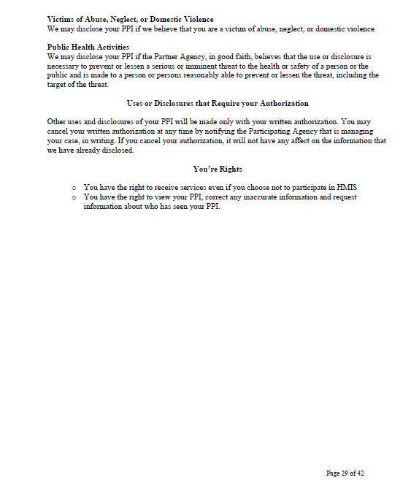
HMIS Privacy Policy
Protections
Client access

Slide 4
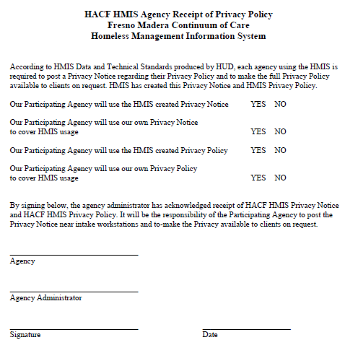
HMIS Privacy Policy
Privacy Notice and Policy covering HMIS usage

