Slide 1
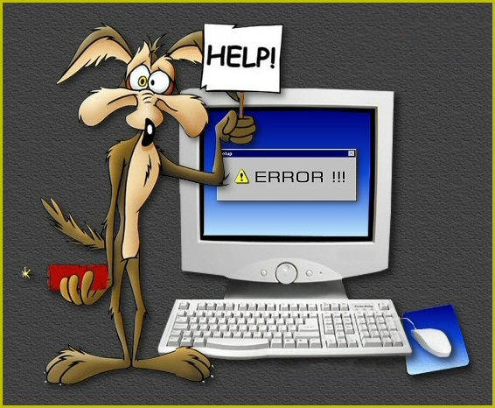
Homeless Management Information System-Data, Challenges and Solutions, Reports
Melissa Mikel
Quality Assurance Analyst- HMIS
September 24, 2014

Slide 2
What is HMIS
Locally-administered data system used to record and analyze client, service and housing data for individuals and families who are homeless or at risk of homelessness.
It has the capacity to integrate and unduplicated data across projects in a community.
Data is used to understand the size, characteristics, and needs of the homeless population at multiply levels.

Slide 3
Data Elements
Basic demographics (i.e., name, DOB, SSN, Household)
Disabling Conditions
Residence Prior to Program Entry
Housing Status
Income and Source
Non-Cash Benefits
Financial Services Provided
Housing Relocation & Stabilization Services Provided
Destination

Slide 4
Challenges
108 page Data Standard Manual – who has time to read that?
Poor data quality among the providers.
Different definitions among providers.
Report formats are easy for funders and policy makers to read; however, case managers continued to contact HMIS staff with data questions (i.e., number of clients served, services provided).

Slide 5
Solutions
Data Standards Manual condensed to 12 pages.
Trainings were divided into 2 parts; data collection and data entry.
HMIS help desk.
Modified data collection sheet.
Monthly data quality reports were distributed monthly. Surprisingly the letter grade was a motivating factor for providers.

Slide 6
HMIS generated Reports
Data Quality Report
Annual Performance Report
Client Case Plan Report
Self Sufficiency Outcome Matrix

