Slide 1

Data Collection, Overview and Best Practices
CalWORKs Housing Support Program (HSP) Seminar
Sacramento, CA
Katharine Gale
September 24, 2014
kgaleconsulting@sbcglobal.net
www.focusstrategies.net

Slide 2
Discussion Outline
Goals of data collection
What data has told us so far about rapid rehousing and prevention
Data sources
Common challenges and key strategies
Community sharing
  Santa Cruz
  Fresno
Discussion and brainstorming

Slide 3
Goals
  Understand how your program is working
  Provide State with key indicators of impact
  # households assisted and characteristics
  Assistance provided
  Outcomes: where do people exit to? (measure housing placement or retention)
  Length of program duration
  Expenditures: amounts and categories
  What else? (we’ll discuss shortly)
  Have ability to do longer-term analysis – cost off-sets, returns to homelessness, etc.

Slide 4
What data has told us so far…
  Rapid Rehousing has high rates of initial exits to housing
    HPRP rate 84% - higher for families
    Rapid Rehousing reduces likelihood of returns to Homelessness
    GA study found 4.7 times more likely to return to homelessness if not rapidly rehoused
    Rapid Rehousing is typically less expensive than other homeless services (see next slide)

Slide 5
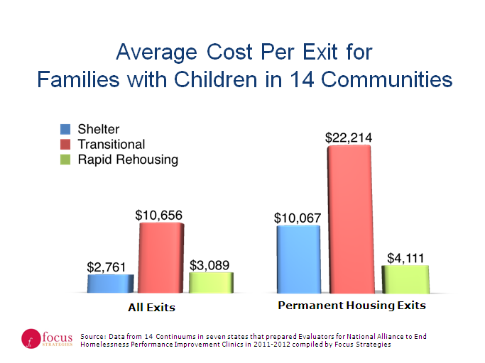
Cost comparisons: Rapid Re-housing

Slide 6
What data has told us so far…
  Prevention assistance also has high reported success rates
    Exits to Permanent housing were 88% with HPRP
    BUT, can’t prove counterfactual – would they have become homeless??
    Research shows that rates of subsequent homelessness among those seeking prevention services are typically very low, whether they are assisted or not.
    Issue of using good targeting and of comparisons….

Slide 7
Data sources
  Homeless Management Information Systems (HMIS)
    Several different software providers, but with common data standards
      Characteristics
      Services provided
      Length of enrollment
      Destinations at exit
  CalWIN, C4, Leader
  Other public systems (Health Care, Behavioral Health, Probation, etc.)
  Provider databases
  Other??

Slide 8
Common Challenges
  Data quality – completeness and accuracy
  Getting good reports that provide what’s needed
    Not just averages: ranges, outliers
    Ability to query, follow up
  Lack of analytic capacity and/or culture of using data
  Data staff that don’t understand program needs (and visa versa!)
  Barriers to Data sharing
    Within programs
    Across programs and funding sources

Slide 9
Key Strategies
  Put data sharing agreements in place from the get go
    Make sure clients sign appropriate releases
  Define key pieces of info you will examine, especially what outcomes you will measure and how
  Make data quality and accuracy a performance measure
  Provide regular reports to all players and examine them at every meeting
  Dig deeper when something isn’t clear- cultivate a habit of inquiry
  Good communication - Support data staff to understand what is being asked of them

Slide 10

Community Presentations

Slide 11
Discussion
  What should be collected for State to make the case?
  # persons and households assisted and characteristics
  Assistance provided
  Outcomes: where do people exit to? (measure housing placement or retention)
  Length of program duration
  Expenditures: amounts and categories
  What else?
  Where will you face challenges doing this?

Slide 12
Thank you!
For more information
Katharine Gale
Katharine@focusstrategies.net
kgaleconsulting@sbcglobal.net
(510) 710-9176
www.focusstrategies.net
1

