Slide 1
Housing and Homeless Services Update
October 13, 2023
Bringing it all together Presentation

Slide 2
Objectives
California Statewide Study of People Experiencing Homelessness
Merced County Funding Matrix
Budget Overview
Navigation Center
Homeless Housing Projects
Merced County Housing Support Program
Point-In-Time Count
Public Role and Increased Jurisdictional Capacity

Slide 3
3,200 administered questionnaires and 365 in-depth interviews.
Nine out of ten participants lost their last housing in California; 75% of participants lived in the same county as their last housing.
Behavioral Health Challenges:
82% reported a period of life where they experienced a serious mental health condition;
62% reported heavy drinking, and
65% reported a regular illicit drug use.
The other common factor in the report was poverty and precarious housing status:
Six months prior to homelessness median household income was $960;
19% entered homelessness following release from institution (i.e. prison), and
49% did not have name on a lease.
Homeless services funding and resources appear to be aligning for the BH side of the equation with projects such as Behavioral Health Bridge Housing, CARE ACT, proposed MHSA changes (30% for homeless services), and 4.68-billion-dollar BH infrastructure bond.
California Statewide Study of People Experiencing Homelessness

Slide 4
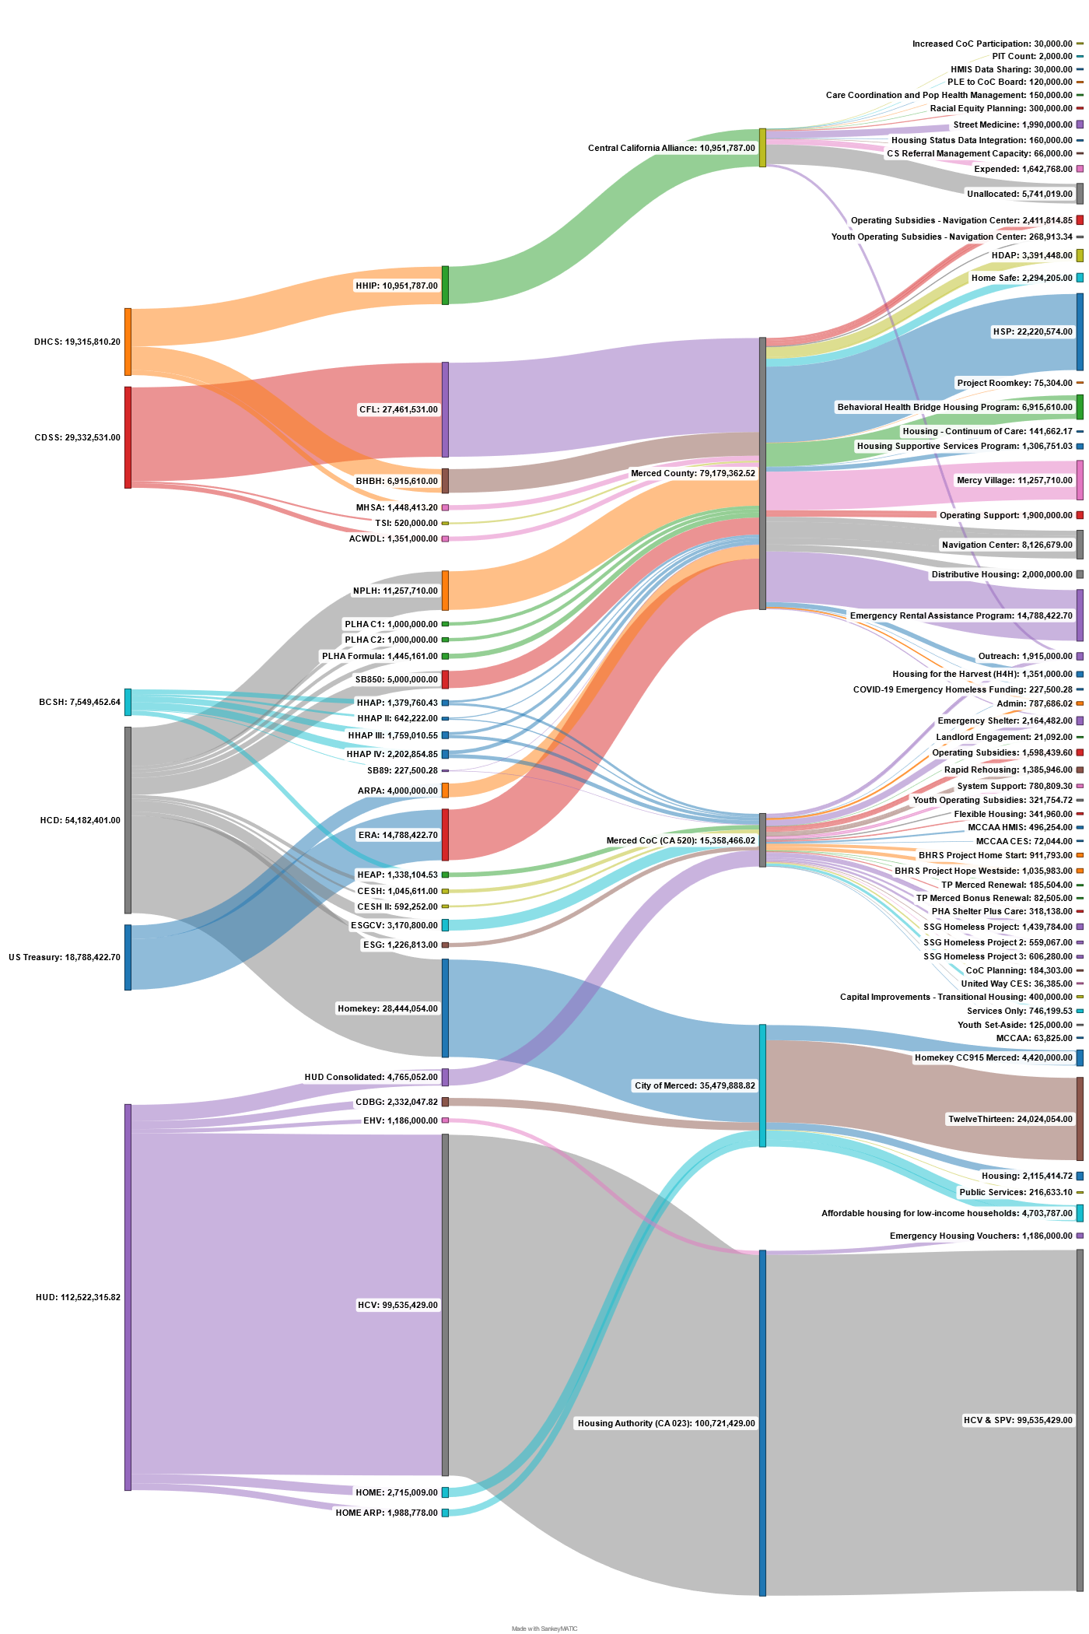
Merced County Funding Matrix

Slide 5
Collaborative Applicant vs Administrative entity Responsibilities
ADMINISTRATIVE ENTITY
Contract with sub-recipients determined qualified to care out eligible activities;
Select qualified sub-recipients through a process that follows a fair and open process that avoids conflict of interest;
Ensure that expenditure of funds is consistent with grant requirements and for eligible activities;
Monitor the activities and expenditures of sub-recipients; and
Submit reports to awarding departments at prescribed intervals.
COLLABORATIVE APPLICANT
Design and carry out the collaborative process of the annual CoC application to HUD, as well as prepare and submit to HUD for program funds;
Evaluate outcomes of projects for which funds are awarded in the geographical area under the CoC and ESG program;
Patriciate in the consolidated plan;
Monitor sub-recipients of CoC funding and enforce compliance with CoC;
Develop communitywide process homeless response system with collaboration;
Conducted PIT as required by HUD; and
Develop a Continuum of Care system.

Slide 6
FUNDING
 | HUD | CESH | CESH 2 | ESG-CV | HHAP Round 1 | HHAP Round 2 | HHAP Round 3 | HHAP Round 4 | HHIP* | CDBG* | MHSA*
2018 | $749,892 |  |  |  |  |  |  |  |  | $38,000 | $40,000
2019 | $774,302 |  |  |  |  |  |  |  |  | $38,000 | $40,000
2020 | $889,550 | $1,045,611 | $592,252 | $3,170,000 | $716,227 |  |  |  |  | $38,000 | $40,000
2021 | $918,952 | Monitoring Contracts | Monitoring Contracts | Monitoring Contracts | Monitoring Contracts | $338,893 |  |  |  | $38,000 | $40,000
2022 | $801,558 | Monitoring Contracts | Monitoring Contracts | Monitoring Contracts | Monitoring Contracts | Monitoring Contracts | $909,988 |  |  | $38,000 | $40,000
2023 | $767,298 | Monitoring Contracts | Monitoring Contracts | Monitoring Contracts | Monitoring Contracts | Monitoring Contracts | Monitoring Contracts | $1,136,537 | $18,000 | $38,000 | $40,000
*Funding to the CA/AE for administrative functions

Slide 7
Budget Overview
$10.2 Million Dollars Budgeted FY 23/24
Thirteen County Funding Sources
Nine County Contracts
Eight Continuum of Care Funding Sources
Nineteen Contracts Managed
$5.5 Million Dollars Budgeted FY 23-24
Two County Staffed Programs
Housing Disability Advocacy Program (HDAP)
Housing Support Program (HSP)

Slide 8
Merced County Navigation Center
The Navigation Center is a 76-bed, 24/7 operation congregate emergency shelter campus. This is a low barrier, Housing First approach serving individuals experiencing homelessness committed to offering an environment that support people through the process of securing housing.
Funding Sources & Annual Budget
FY 23-24 $1,887,326.00
FY 24-25 $1,943,945.00
Funding Source | Funding Amount | Admin FY21/22 | Admin FY22/23 | Admin Allocation | Fiscal Year 20/21 | Fiscal Year 21/22 | Fiscal Year 22/23 | Fiscal Year 23/24 | Fiscal Year 24/25 | Fiscal Year 25/26 | Total Expenditures | Notes
BHRS/MHSA | $ 2,525,507.35 | N/A | N/A | N/A | $ 893,693.16 | $ 1,631,814.19 |  |  |  |  | $ 2,525,507.35
HHAP 1 | $ 663,533.00 | $ 1,934.14 | $ 1,185.86 | $ 46,447.00 |  |  | $ 617,086.00 |  |  |  | $ 663,533.00
HHAP 2 | $ 303,329.00 | $ 3,300.45 | $ 2,276.43 | $ 21,233.00 |  |  | $ 282,096.00 |  |  |  | $ 303,329.00
ARPA CEO | $ 2,000,000.00 | N/A | N/A | N/A |  |  | $ 500,000.00 | $ 500,000.00 | $ 500,000.00 | $ 500,000.00 | $ 2,000,000.00
HHAP 3 | $ 849,322.55 | N/A | $ 1,562.62 | $ 59,452.58 |  |  | $ 390,314.00 | $ 399,555.97 |  |  | $ 849,322.55
PLHA F1 | $ 310,947.00 | $ 7,813.55 | $ 2,047.33 | $ 15,547.00 |  |  |  | $ 295,400.00 |  |  | $ 310,947.00
PLHA F2 | $ 508,297.00 | N/A | $ 1,313.24 | $ 25,414.85 |  |  |  | $ 482,882.15 |  |  | $ 508,297.00
HHAP 4* | $ 1,066,317.63 | N/A | N/A | $ 74,642.23 |  |  |  | $ 305,697.88 | $ 685,977.52 |  | $ 1,066,317.63
PHLA F3* | $ 625,917.00 | N/A | N/A | $ 31,295.85 |  |  |  |  | $ 594,621.15 |  | $ 625,917.00
PHLA F4* | $ 210,263.00 | N/A | N/A | $ 10,513.15 |  |  |  |  | $ 199,749.85 |  | $ 210,263.00
PHLA F5* | $ 210,263.00 | N/A | N/A | $ 10,513.15 |  |  |  |  | $ 106,069.48 | $ 93,680.37 | $ 210,263.00
SB 850 NAV | $ 92,235.81 | N/A | N/A | N/A |  | $ 92,235.81 |  |  |  |  | $ 92,235.81
SB 850 Repairs | $ 1,762,072.11 | N/A | N/A | N/A |  |  | $ 950,000.00 | $ 250,000.00 | $ 250,000.00 | $ 312,072.11 | $ 1,762,072.11
Total |  | $ 13,048.14 | $ 8,385.48 | $ 295,058.81 | $ 893,693.16 | $ 1,724,050.00 | $ 2,739,496.00 | $ 2,233,536.00 | $ 2,336,418.00 | $ 905,752.48 | $ 11,128,004.45 | 0
Total Served FY 22-23: 509 Total Number of Enrollments

Slide 9
Homeless Housing Projects
Operational Projects
The Retreat Apartments. 30 units dedicated to homeless population. This project is up and running with project-based vouchers.
Hope for Families. 20 units dedicated to families experiencing homelessness. This project is up and running with support from HUD VASH and Housing Support Program (HSP).
Projects in Production
1213 V Street. 95 units, 45 dedicated to chronically homeless. This project is slated to open late October 2023. Project is being support through BHBH, CoC Rapid-Rehousing, and tenant-based vouchers.
HUD VASH. 20 units dedicated to veterans experiencing homelessness. Project is slated to open late summer, early fall of 2023. Project supported by HUD VASH vouchers.
No Place Like Home. Mercy Village is a 150-unit mixed-use development that will have an on-site health clinic alongside family and one-bedroom units. The project will have 45 units dedicated to individuals experiencing homelessness.

Slide 10
Homeless Housing Projects
Proposals:
Merced city council approved Homekey applications to be submitted:
Shangra-La Developer, Motel 6 conversion for 80 units. Operating Subsidies support provided by CoC.
Tiny Homes project. 55 units dedicated to individuals and families experiencing homelessness. Support provided by Merced County HSP/HDAP.
Los Banos Motel Conversion of 60 units dedicated to individuals and families experiencing homelessness.

Slide 11
Merced County Housing Support Programs
Merced County Housing Support Program (HSP)
Prior to April 2022: HSP followed CalWORKS (CW) Homeless Temporary Assistance rules. Rental unit could not exceed 80% of Total Monthly Household Income (THMI). Rental assistance provided on a tiered scale
First 3 months, 100% of rent paid
4th month, 75% of rent paid
5th month, 50% of rent paid
6th month, 25% of rent paid
Interim shelter was allowed at 7 nights.
**COVID-19 Pandemic changed interim shelter to unlimited nights.
Changes effective April 2022
No longer follow CW Temporary Assistance rules. Can assist with rental unit at up to 110% of Fair Market Rate (FMR), paying 70% of monthly rent up to 12 months, based on funding allowed.
Interim Shelter Changes
October 2022- Changed to 60 nights allowed
December 2022- Changed to 14 nights allowed

Slide 12
Merced County Housing Support Programs
During the COVID-19 pandemic, interim shelter expenses raised significantly causing major impacts to the overall HSP budget. After the change that took effect in December 2022, interim shelter expenses decreased to monthly average expenses prior to COVID-19 pandemic

Slide 13
The number of our monthly housing placements have increased since our changes that took effect April 2022. Highest month was October 2022 with 37 housing placements!
Merced County Housing Support Programs
Amount of monthly rental expenses have increased to over $100,000 a month.

Slide 14
2023 Point-In-Time (PIT) Results
Department of Housing and Urban Development Requirement
Conducted February 23, 2023
The Merced County CoC requested and received approval from HUD to conduct the unsheltered and sheltered count on February 23 because of experiencing severe storms with flooding during the last 10 days of January
A person was considered homeless, and thus counted, only when he/she fell within the following HUD-based definition by residing in one of the places described below:
in places not meant for human habitation, such as cars, parks, sidewalks, and abandoned buildings;
in an emergency shelter, and
in transitional or supportive housing for homeless persons who originally came from the streets or emergency shelter.
Results
Sheltered 394 (-19%)
Unsheltered 390 (+5.9%)
Total 784 (-8.3%)

Slide 15
2023 PIT Analysis
Families Last Permanent Zip Code By Jurisdiction
Atwater | 3
Dos Palos | 1
Hilmar | 1
Los Banos | 4
Merced | 35
Winton | 1
Families Experiencing Homelessness in Merced County
During our PIT count, 45 families enrolled in HSA temporary homeless assistance program which were made up of 113 individuals of which 58 were adults and 75 were children.
In 2022, 68 families enrolled in HSA temporary homeless assistance program which were made up of 237 individuals of which 86 were adults and 151 were children.
Notes:
2019 162 motel vouchers
2020 80 motel vouchers
2021 155 motel vouchers 61 person increase between 2021 and 2022
2022 216 motel vouchers
835-855
If held steady with 2021 numbers we would have had a 41 person decrease of 4.91%

Slide 16
2023 PIT Analysis Continued
Twin Challenge of
Availability and Affordability
Unit Size | 2022 Fair Market Rents | 2023 Fair Market Rents | Change
Studio | $766 | $854 | +11.4%
One Bedroom | $914 | $1017 | +11.2%
Two Bedroom | $1,120 | $1243 | +10.9%
Three Bedroom | $1,591 | $1767 | +11%
Four Bedroom | $1,917 | $2117 | +10.4%
Data Source HUD.GOV Fair Market Rent
Fair Market Rents
Generally, determine the maximum rent that a Section 8 landlord will be allowed to charge their residents.
Generally calculated as the 40th percentile of gross rents for regular, standard quality units in a local housing market.
Excludes low-quality units, already subsidized units, and units that have been built in the last 2 years.
Vacancy Rates
According to relator research, Merced County has a homeowner vacancy rate of 2.3% and a rental vacancy rate of 5.3%. *
*https://www.point2homes.com/US/Average-Rent/CA/Merced.html#:~:text=Renter%2Doccupied%20units%20make%20up,Merced%2C%20California%20is%20at%204.8.

Slide 17
Public Role and Increased Jurisdictional Capacity
To make meaningful progress in helping those who are unhoused, the California State Association of Counties (CSAC) offers the six pillars of the ‘AT HOME’ Plan.
Accountability- Clear responsibilities aligned to authority, resources, and flexibility for all levels of government.
Transparency- Integrate and expand data to improve program effectiveness.
Outreach- Develop sustainable outreach systems and increase workforce to support these systems.
Mitigation- Strengthen safety net programs
Economic Opportunity- Create employment and education pathways, as well as supports for basic needs
Housing- Increase and maintain housing units across the spectrum.

Slide 18
Public Role and Increased Jurisdictional Capacity
Enhance partnership between County Departments, Jurisdictions, Housing Authority, and Continuum of Care members in accordance with the CSAC AT-HOME Plan, HHAP Round Four Best Practices, HHAP Round Five planning requirements.
Role clarity
Improve capacity of other jurisdictions
Identify a jurisdictional strategy and implement projects
Solutions:
Utilize the Continuum of Care Structure.
Reflective of organizations identified in HHAP Rounds 4&5 best practices document and planning requirement
Establishing a Regional Housing Consortium.
Establish a Regional Public Space Management Consortium.
Conduct a Comprehensive Landscape Analysis (fiscal and services).
Development of a long-term funding and braided funding strategy.

Slide 19
John Ceccoli Merced County Human Services Agency Deputy Director John.Ceccoli@countyofmerced.com 209-628-4040 (cell
Questions?
Thank you

