Slide 1
County of Los Angeles
DEPARTMENT OF PUBLIC SOCIAL SERVICES

Slide 2
Federal rules prevent the purchase of prepared meals.
Restaurant Meals Program (RMP) eligible households are exempt from the federal rule and may use their CalFresh benefits to purchase tax-exempt meals from RMP participating restaurants that meet United States Department of Agriculture Food and Nutrition Service (USDA-FNS) requirements and have entered a Memorandum of Understanding (MOU) with the county.
RMP CalFresh participants are homeless, elderly, and disabled.
Notes:
Federal rules prevent the purchase of prepared meals for all other CalFresh participants. The RMP eligible households may use their CalFresh benefits to purchase tax-exempt meals from RMP participating restaurants that meet United States Department of Agriculture Food and Nutrition Service (USDA-FNS) requirements and have entered a MOU with DPSS.

Slide 3
Counties participating in the RMP are:
  Alameda
  Fresno
  Los Angeles
  Orange, Riverside
  Sacramento
  San Diego
  San Francisco
  San Luis Obispo
  Santa Clara
  Santa Cruz

Slide 4
RMP was implemented in Los Angeles County in July 2005. We focus on restaurants offering healthier meal choices. Restaurants selected to participate in RMP must meet all requirements of our “5-Healthier Options” system:
  Restaurant must offer at least two fruit and/or vegetable side items that meet the benchmark described in the worksheet. The two fruit and/or vegetable side items must appear on the menu.
  Restaurant must have drinking water available at least 12 ounces, at no cost to customers.
  Restaurant must have at least one whole grain item available during all meal periods that meet the benchmark described in the worksheet. The whole grain items available on the menu must be at no added cost to customers.
  Restaurant must offer at least one discounted meal, advertised special, or sale priced meal that includes at least two of the three healthy options:
      •Non-fried fruit and/or vegetables side items;
      •Whole grains; or
      •Healthier meal preparation: grill, bake, boil, roast, poach, stir-fry and steam.
  Restaurant must prominently display DPSS-provided signage.

Slide 5
COLLEGE CAMPUS
Los Angeles County has increased our efforts to reduce food insecurity among college students, and to increase the number or colleges participation in the RMP.
  We have successful enrolled 12 food facilities/restaurants at California State of Northridge (CSUN).
  Compton College, Los Angeles Community College District, and the California State University Dominguez Hills, have are pending USDA-FNS certification.

Slide 6
As of July 2019:
  There are 1,138 restaurants participating in the Restaurant Meals Program; 984 (86%) are restaurants chains and 154 (14%) are “Mom and Pops” restaurants.
  Approximately 41.7 million meals were purchased by RMP participants, which equals to $442 million in sales.
  The average number of transactions per restaurant is 383, and the average amount per transaction is $11.77.

Slide 7

Restaurant meals program
San Diego County

Slide 8
Restaurant meals program
San Diego County fully implemented the RMP in February 2013
As of 09/2019 San Diego County had 344 restaurants participating and 60 pending approval
with a total of 85,721 elderly, disabled and homeless individuals participating in the program

Slide 9
Restaurant meals program
Application Process

Slide 10
Restaurant meals program
Application process
Los Angeles County
    County of Los Angeles DPSS - Restaurant Meals
San Diego County
https://www.SanDiegoRMP.org
Orange County
https://ssa.ocgov.com/calfresh/calfresh/rmp

Slide 11
Restaurant meals program
Application Process
In order to be eligible to apply the Restaurants must meet the following criteria:
  Must Provide low cost meals
  May not charge sales tax or tips
  May not charge alcoholic beverages
  May not charge the purchase of gift cards
  May not charge an advance for future purchases

Slide 12
Restaurant meals program
Application process
Participation is Easy:
  Complete an Application for Meal Services Form FNS -252-2, print and submit with original signatures
  Sign a Memorandum of Understanding (MOU) with the County
  The restaurant must be certified with the United States Department of Agriculture (USDA), Food and Nutrition Service (FNS)
  For Non publicly-owned corporations the following has to be provided:
    Copy of government issued photo identification card
    Verification of Social Security Number
  Copy of valid health permit and/or business license for each location

Slide 13
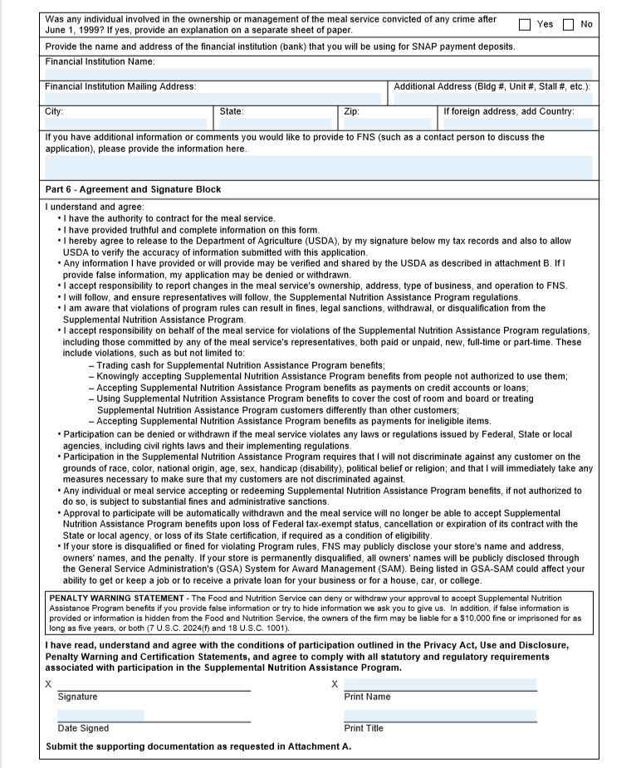
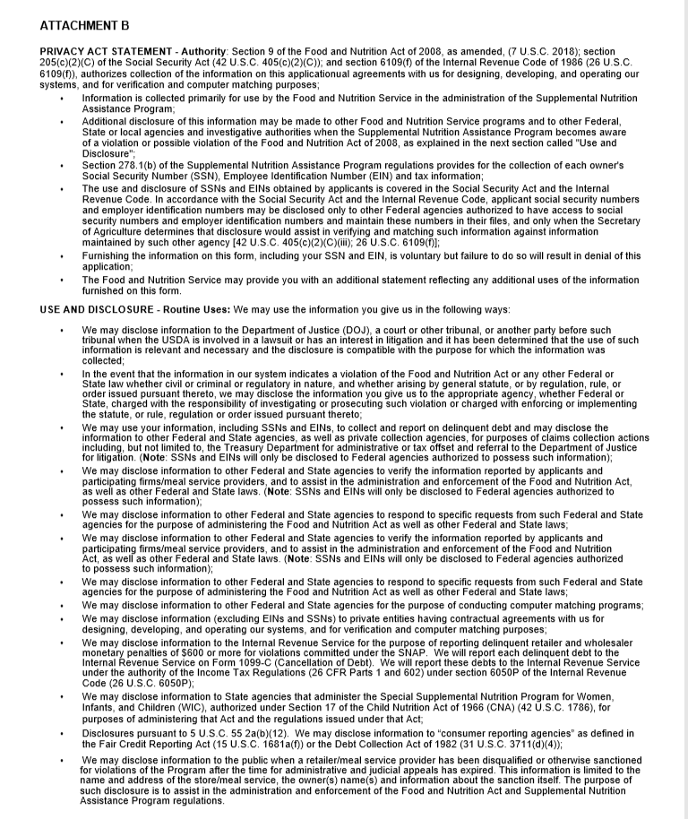
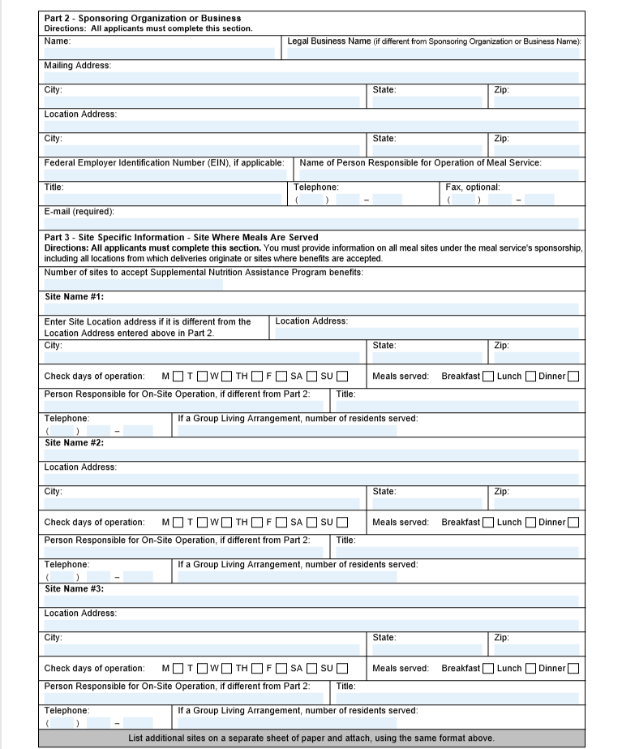
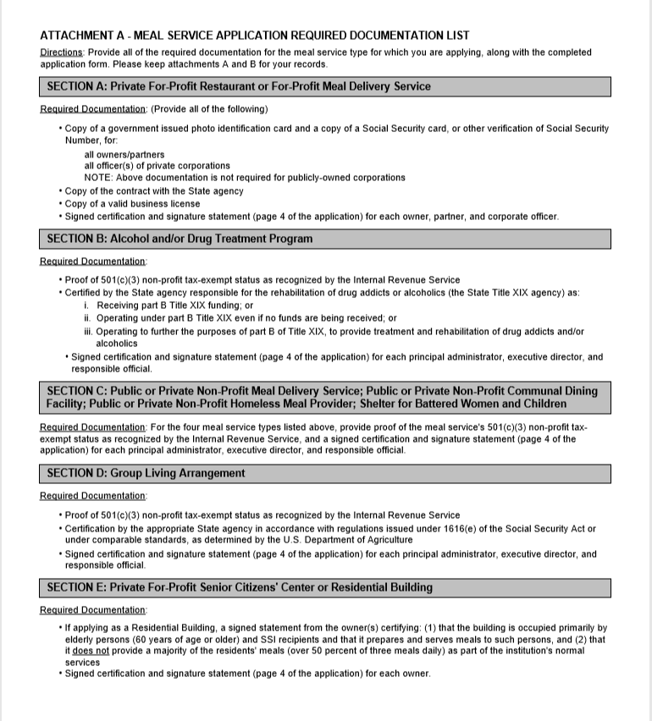
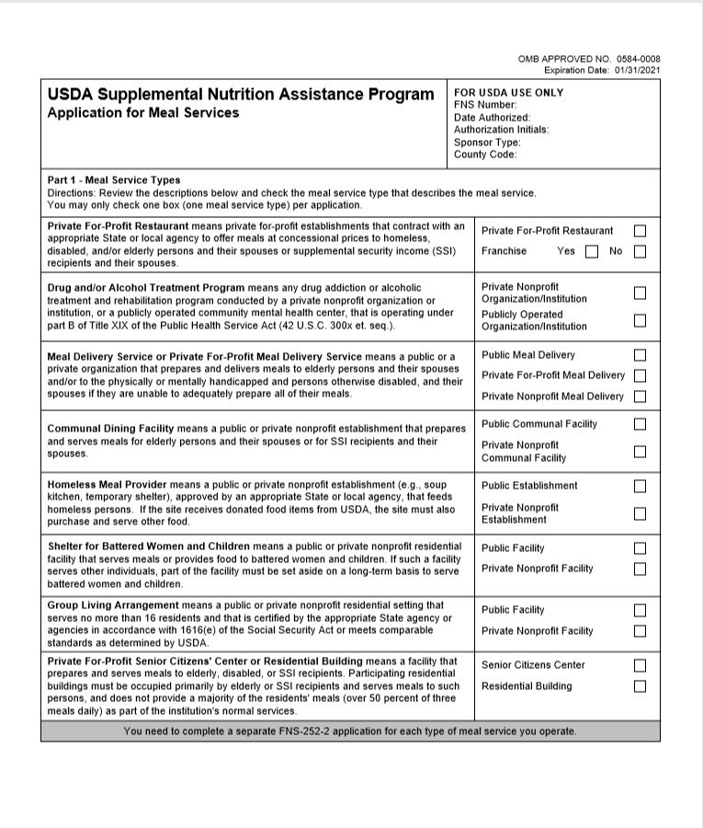
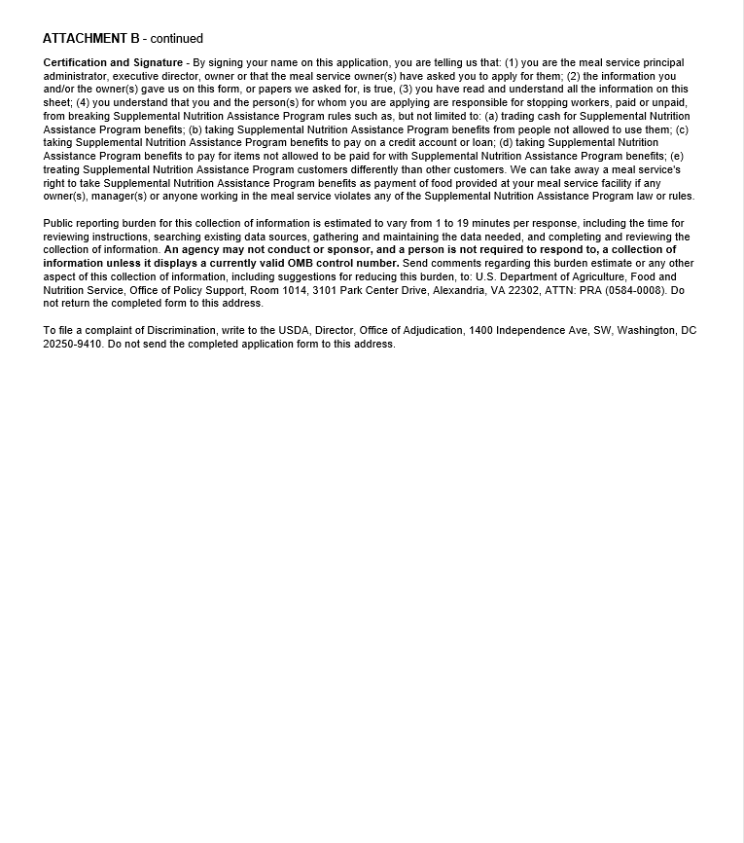
Restaurant meals program
Application process
7 Pages

Slide 14
Restaurant meals program
Application process
What happens next?
  After submission of all required documentation, the process can take up to 120 days
  Restaurant owners will receive approval and FNS number from USDA
  County must be notified of approval
  Update current Point-of-Sale (POS) equipment or complete EBT agreement with goEBT and receive equipment

Slide 15
Restaurant meals program
The Restaurant Meal Program has been successfully implemented in San Diego County
22% of the total CF recipients have access to the program
For September 2019, there were 74,392 EBT transactions and $696,567.17 in Redemptions
and a total of $7,447,382.87 for 2019

Slide 16

County of Orange Social Services Agency
Notes:
INTRO
Quick show of hands, how many of you are from counties that have already implemented the Restaurant Meals Program? Okay, great! I think information we are sharing with you today is valuable whether are currently an RMP county or are considering implementing the program.
I would like to give you some food for thought regarding outreach to restaurant owners when soliciting their participating in RMP and outreach to CalFresh recipients that will benefit from this program. I will also share some details of the metrics that we have found valuable when gathering data regarding RMP.
You have decided to implement the Restaurant Meals Program in your county
You are familiar with the program’s guidelines and the application process for restaurant owners.

Slide 17
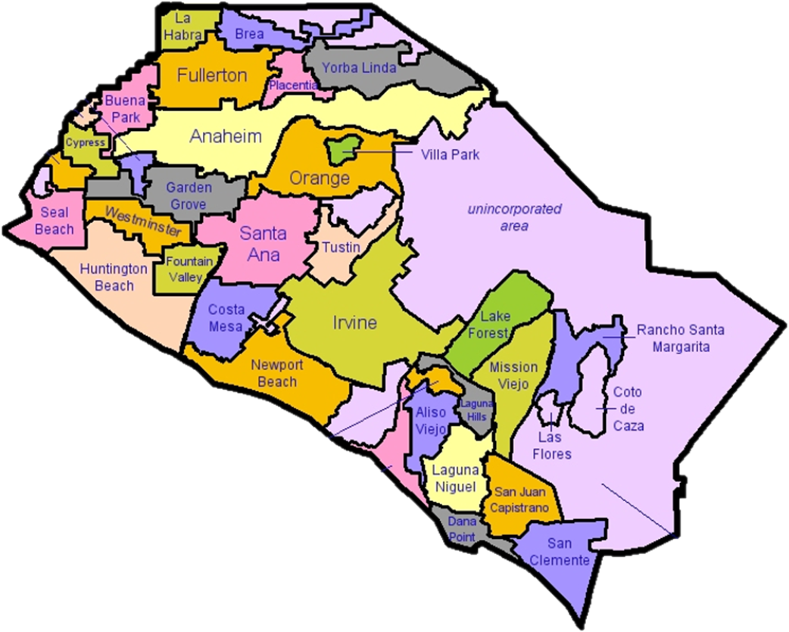
Implemented February 2018
Pilot program in the cities of Anaheim and Santa Ana
Two cities with highest concentration of the RMP eligible CalFresh recipients
Notes:
During the pilot phase we only solicited participation from restaurants in the two pilot cities.
RMP-eligible CalFresh customers from any OC city could use their benefits at participating restaurants.
SSA Planned to implement RMP as a pilot program in our highest CF populated cities-Anaheim/Santa Ana

Slide 18
Expanded the program in January 2019.
Approved or pending RMP applications in 29 out of 34 cities
Notes:
Email blasts were used to communicate the expansion to Orange County restaurant owners
Restaurant owners already participating in RMP were also contacted to add their additional locations outside of the original pilot cities.
CBOs and other county partners were informed of the expansion to help in the outreach efforts.

Slide 19
As of October 2019:
89 Participating Restaurants
82 Pending Approval
15 Unique Restaurant brands
Over 93,000 EBT Transactions
$1,035,829 in redemptions

Slide 20
Restaurant and Customer Outreach
    Health Care Agency/Environmental Health
    Email blasts
    Community Based Organizations
    Presentations
    SSA Web content-Restaurant Locator Tool
    Press Releases and News coverage
    Working with other RMP counties
Notes:
Health Care Agency/Environmental Health provided restaurant contact list for restaurants
Allowed us to use email blasts
We published RMP article in EH newsletter
Attended Food and Safety Advisory Committee meetings
CBOs have existing touchpoints with the E-D-H population and can approach restaurants regarding participation
Presentations to CBOs county partners
Post RMP information/links to Veteran Services/Office on Aging
Working with other RMP counties is vital. San Diego and LA are good partners

Slide 21

How many RMP eligible CalFresh recipients are in your county?
Where are the RMP eligible CalFresh recipients in your county?
Which participating restaurants are RMP eligible customers frequenting?
Who is using the program benefits?
Notes:
Why is RMP data valuable
Allows our efforts and accomplishments to be measurable
Crucial to reporting to leadership and board of supervisors
Vital to collaborating with CBOs
Targeted outreach to each RMP-eligible population

Slide 22
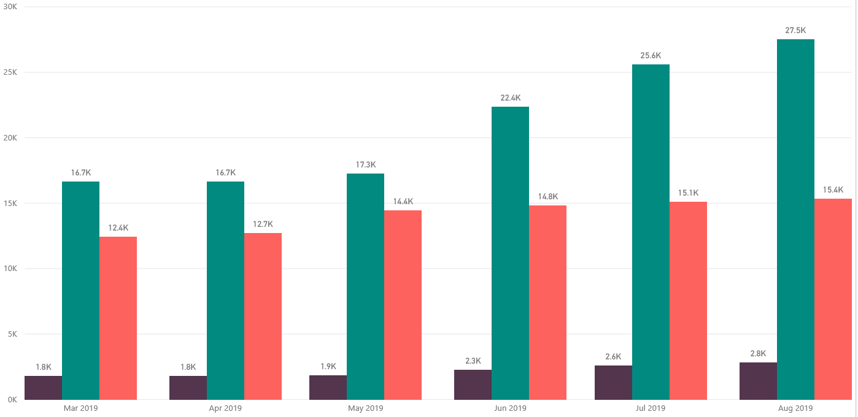

RMP- Eligible Population
27.5K
25.6K
22.4K
16.7K
16.7K
17.3K
Mar. 2019
Apr. 2019
May 2019
Jun. 2019
Jul. 2019
Aug. 2019
Notes:
Disabled, Elderly and Homeless by Month
Targeted Outreach
Get the help of Community and County partners
We saw a spike in June 2019 due to the CalFresh Expansion to SSI Recipients

Slide 23
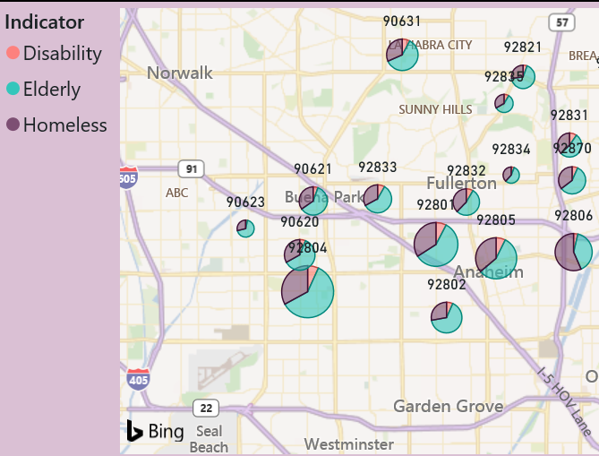
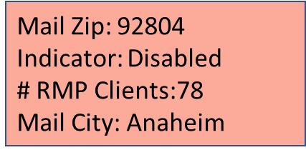
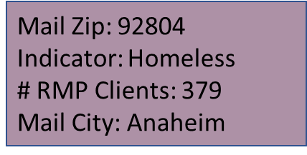
RMP-Eligible Population
Mail Zip: 92804
Indicator: Elderly
# RMP Clients:693
Mail City: Anaheim
Notes:
Data has been crucial part of managing the RMP from early in the implementation planning stages.
Knowing where the RMP eligible population resided throughout our County allowed us to select the pilot cities when we started.
We were able to measure our success in reaching the eligible Calfresh recipient population by comparing their location to newly added RMP locations and the expenditure data.
This data was vital in reporting to our executive team and when responding to inquiries from our Board of Supervisors.
Helpful when collaborating with CBOs with existing touchpoints with the RMP eligible population
Helpful to identify locations that are lacking RMP coverage/representation

Slide 24
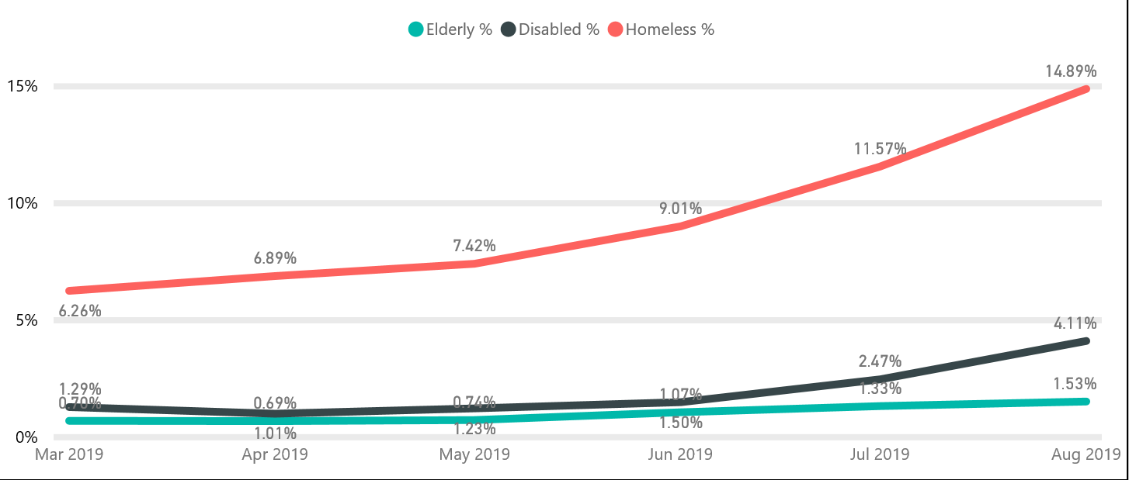
RMP Redemptions by population
Notes:
Data regarding EBT transactions is provided by the Office of System Integration
It includes information regarding EBT transactions completed in your county, including at restaurants.
It does automatically include case level data to identify the CalFresh household associated with the transaction
OSI can help

Slide 25
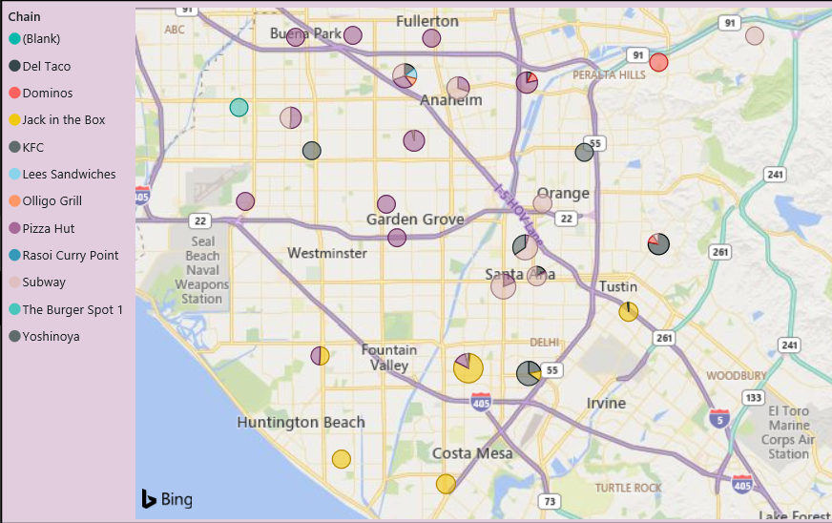
Sales by Vendor
Postal Code: 92704
Chain: Pizza Place
Amount: $ 2,307
Postal Code:92704
Chain: Burger Place
Amount:$ 2,274
Notes:
Initially, we saw more of our county‘s RMP eligible CalFresh recipients utilizing benefits in neighboring RMP counties like Los Angeles and San Diego. As we grew and added additional locations, the trend was reversed and County of Orange RMP expenditures by CalFresh recipients tripled the amount spent in other counties.
Helps us track the most frequently visited participating RMP restaurants in our county.
We track expenditures by city and the number of transactions by city each month
This data can be useful when soliciting new restaurants and illustrates how participants can expand their business

Slide 26

Restaurant Owner feedback
Notes:
Soliciting feedback from owners already participating in our county’s RMP helps us improve on our application process
We can identify any steps that may stop owners from participating in RMP or slow the process down.
Where can we streamline the process?
We can identify the most effective ways to reach new restaurant owners
Helps identify ways we can communicate updates more effectively to participating owners
Quotes and feedback provide by participating restaurant owners can help with future messaging.

Slide 27
How did you hear about the Restaurant Meals Program?
How long have you been participating in the program?
What is your preferred method of communication?
Describe the experience regarding the application process for RMP.
What was your reason for participating in the Restaurant Meals Program?
What areas could be improved upon?
What do you like best about the Restaurant Meals Program?
Notes:
We send out a survey to participating restaurant owners once a year
Helps to streamline our applications process where possible
Ensures we have the most effective means of communicating with owners
Can we do better?
Quotes can be used for future messaging and restaurant solicitation

Slide 28

When asked their reasons for participating in RMP….
“Increase traffic in our stores”
“So we can increase sales”
“To increase exposure and help”
“ To help those who are unable to cook for themselves”
“Get the opportunity to serve the community”
Notes:
Restaurant owners want to see their business grow but they also see value in helping the community

Slide 29
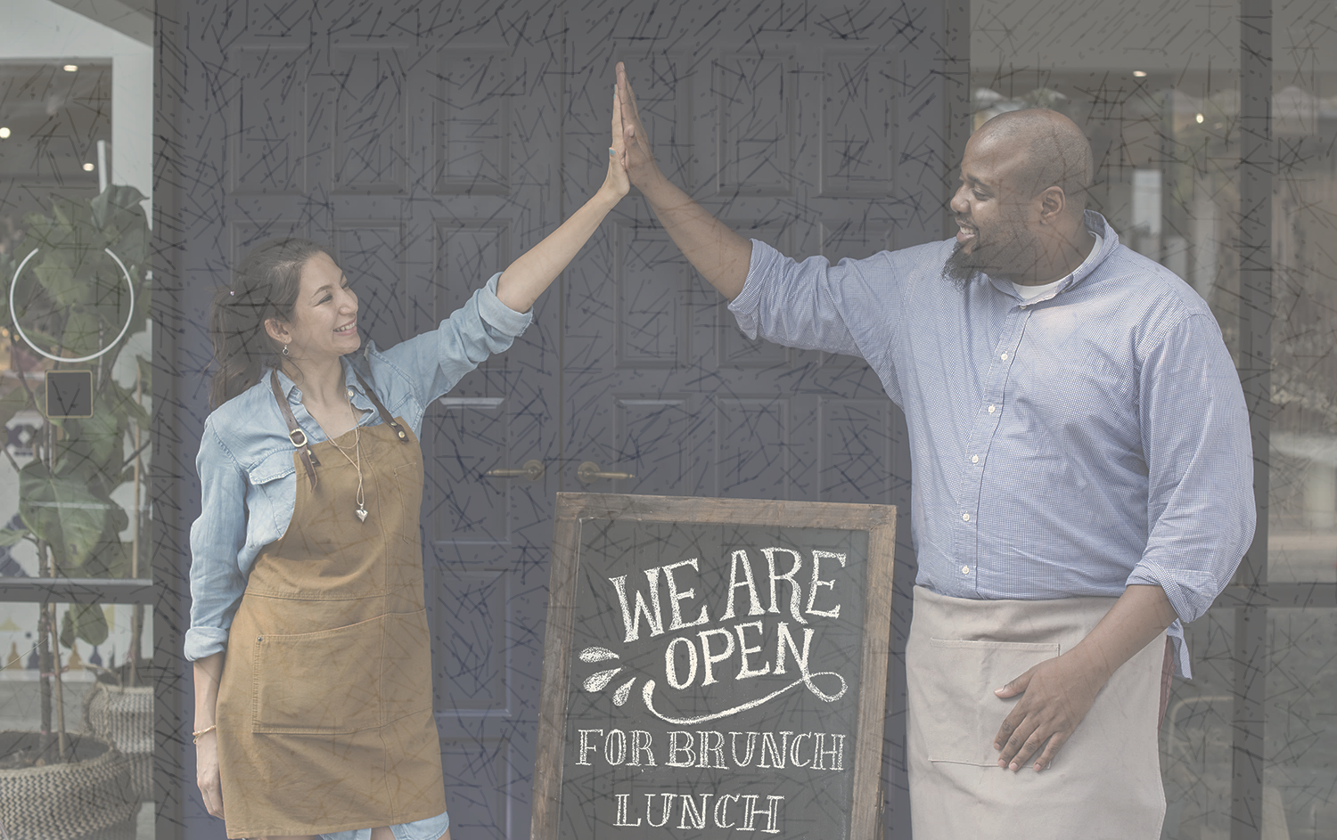
When asked what they like best about RMP….
“It helps sales”
“It brings new customers”
“Keeps needy customers happy”
“Our business can provide meals to those who may not be able to store food”
Notes:
Restaurant owners want to see their business grow but they also see value in helping the community

Slide 30
Questions?

