Slide 1

The Provider Assistance Team (PAT)
Improving and Expediting In-Home Supportive Services (IHSS) Provider Enrollment
Notes:
Angel Introduces Slide 1

Slide 2


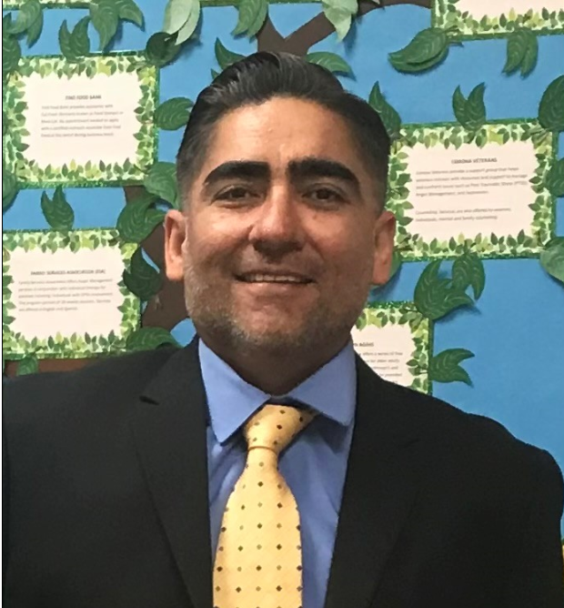


Deputy Director : Ryan Uhlenkott
Regional Manager: Angel Jaimes
Office Support Supervisor: Alicia Mesa
Office Support Supervisor: Laura Castellon
Presenters
Notes:
All presenters speak in line order:
Name:
Current Title:
Years with the county:

Slide 3
Introduction
Aging population has increased the demand for In-Home Supportive Services (IHSS).
01
Potential providers encounter challenges in their enrollment process.
02
The Provider Assistance Team (PAT) was created to address the challenges of the provider enrollment process.
03
Notes:
Ryan's Slide
PAT was designed to provide a prompt and more efficient streamline for our provider enrollment.
PAT was envisioned as a one stop shop where providers can complete their enrollment from start to finish.
The goal of this presentation is to share best practices and successful strategies on provider enrollment.

Slide 4

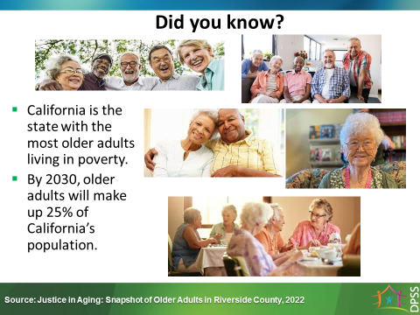
Notes:
Angel's Slide
Its expected that Riverside County elder population during the same period will increase by 40%.
The current projected growth is 7% each year.
It's expected that the overall California elderly projected growth yearly increase by 6%

Slide 5
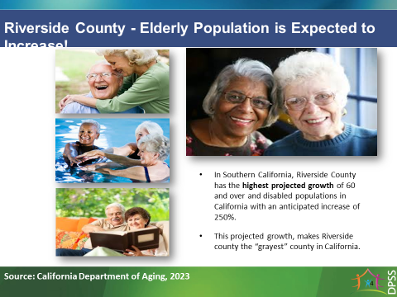
Notes:
Angel's Slide
Riverside County is the 4th largest county in California. Riverside County is 7, 303 miles, bordering Los Angeles County on West end and Arizona on the East end. The population of Riverside County is currently estimated to be 2.5 million.

Slide 6

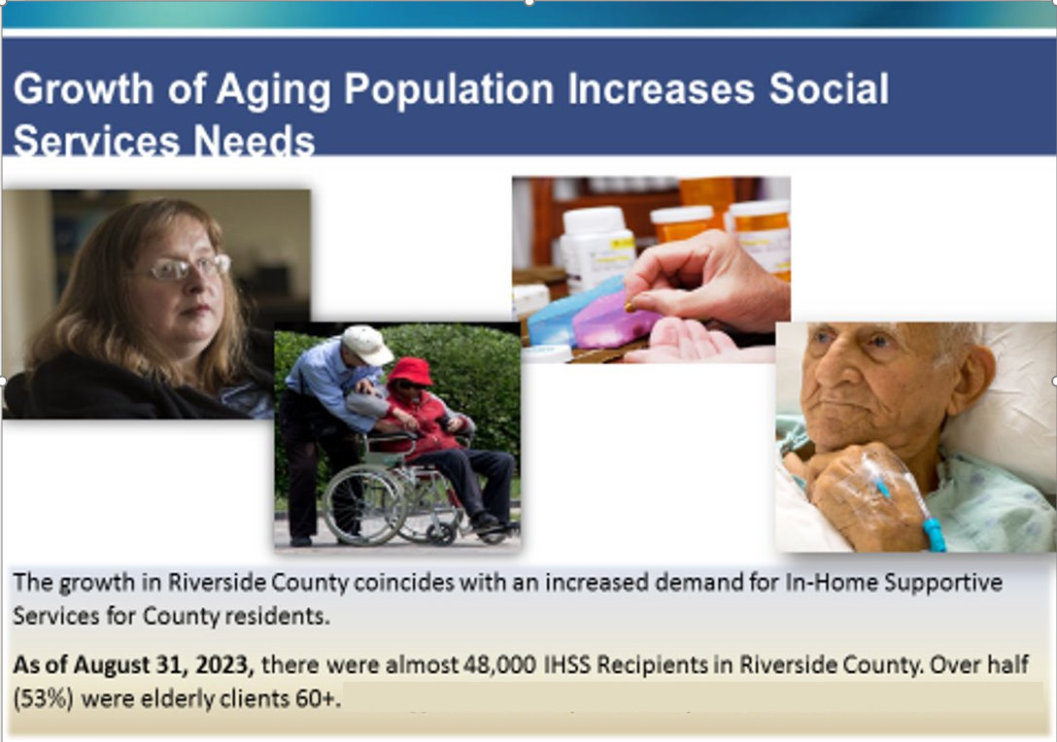

Notes:
Angel's Slide
Note: IHSS growth over the years, enter data.

Slide 7

Notes:
Angel's Slide

Slide 8
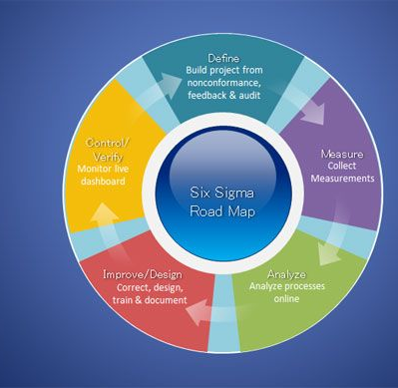
Solution
Lean six sigma process mapping – What is process mapping ?
Identify the issue
Discuss a streamline process
Identify a solution
What steps and resources are needed to move the solution forward
Notes:
Ryan's Slide
Committee engaged in the Lean Six Sigma Training to learn process mapping.
Training focuses on changing the mindset to better lead and streamline a process to better your organization.
Consisting of staff with different experiences, titles, background who have their own unique perspective about issue but with common goal/solution.
Structuring the issue who met as a collaborative group with all internal stakeholders consisting of All levels of IHSS Staff: Executive Team
We do it because this is meeting the needs of the client, which is all about client safety and well-being
Lead us to the Conclusion of PAT
Timeline
Launched in August 2022
Insert slide with process mapping sample

Slide 9
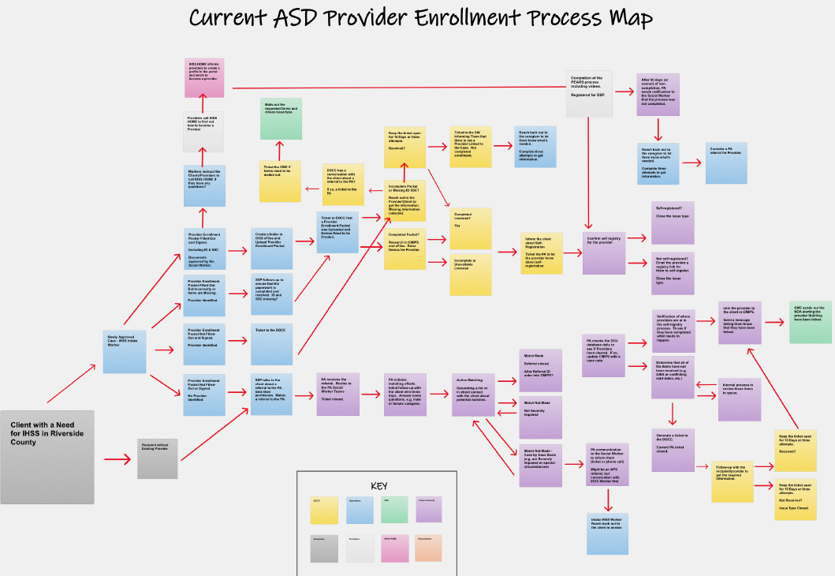
Pre-PAT
Notes:
Ryan's Slide
PAT process mapping facilitator was Ryan Uhlenkott.
In process mapping talk about how long it used to take compare how long it takes now.

Slide 10
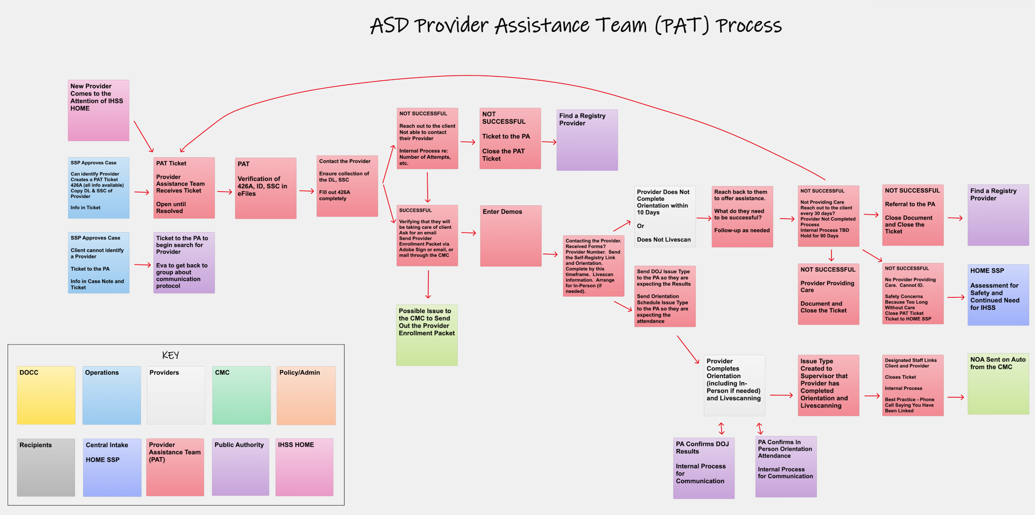
Post-PAT
Notes:
Ryan's Slide
In process mapping talk about how long it used to take compare how long it takes now.
120+ days to enroll IP

Slide 11
Approve IHSS recipient case
Identified potential provider
Social Worker referral to PAT via Ticketing System
HOME call center referral via Ticketing System
Case management of workload
PAT staff outreach to both recipient and provider.
Ongoing communication and support
Technology
  Ticketing System
  Adobe Sign
  eFiles
  PEARS
  CMIPS II
  Eventbrite
  IHSS Website– RiversideIHSS.org
Linking
Nuts and Bolts
Notes:
NUT'S and BOLTS
Laura Slide
Intake and Client/Provider Meeting
Referral through Ticketing:
PAT staff engagement
Progress and Communication: Staff provide direct phone number for ongoing communication.
Technology (ticketing, Adobe Sign, eFiles, PEARS, CMIPS, Eventbrite, IHSS Portal - RIVERSIDEIHSS.ORG)
Linking

Slide 12
Management
Elements which support management
Organizational Chart
PAT Process Management
Auditing
Notes:
Angel Speaks

Slide 13
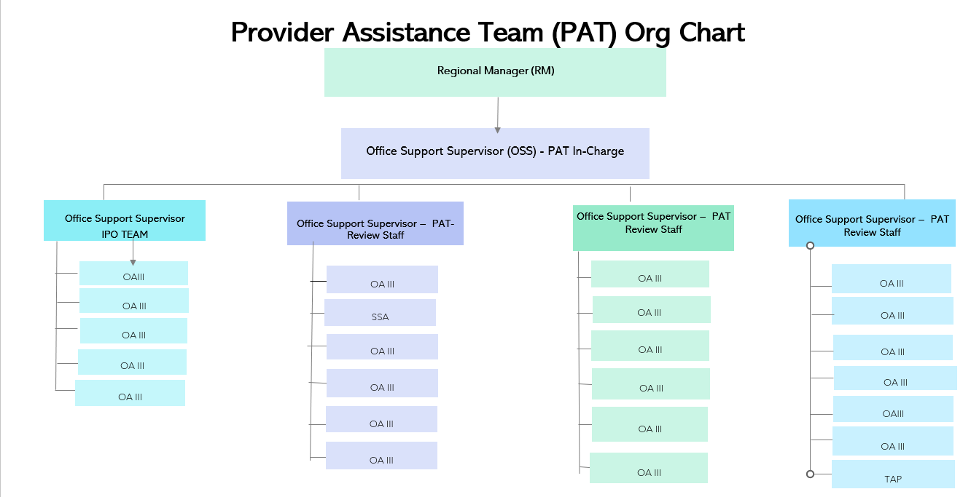

Slide 14




PAT Process Management
Productivity
Ticketing
Workflow management
Timeline report
Notes:
Laura Speaks: Productivity and Ticketing (tool used to deligate and manage productivty)
Alicia: Workflow Management and Timeline
Supervisor - what do they do and how do you do it?
Productivity Measures (Data table)
Ticketing processing
Ticket Workflow management (Case management/expectations)
Timeline report ( Monique’s report)

Slide 15


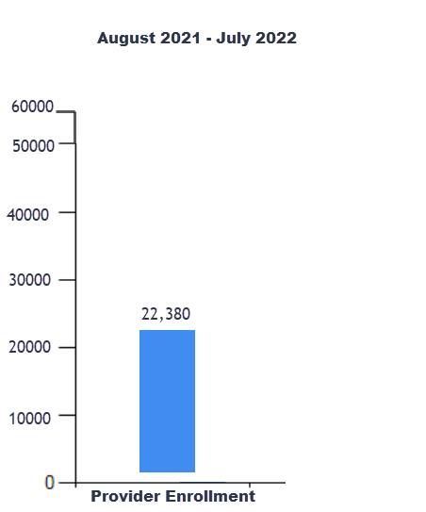

Productivity Report
Pre-PAT
Notes:
Laura's Speaks
Pre PAT – 2021-2022
Timeframe of enrollment was 6 months to a year.
Why: Pandemic limited our customer outreach and we went to a full virtual enviorment.
Not including backlog of 10,000 providers that where in a backlog.
Under 25,00 provider enrollment

Slide 16
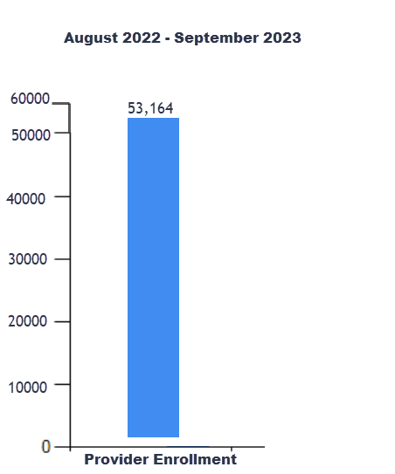
Productivity Report Post-PAT
Notes:
Laura Speaks
Post PAT Data 2022-2023(current)
Development of PAT process allowed us to stream line completion of enrollment to 90 days or less.
Increase of more than half of the provider enrollment we had Pre PAT.

Slide 17
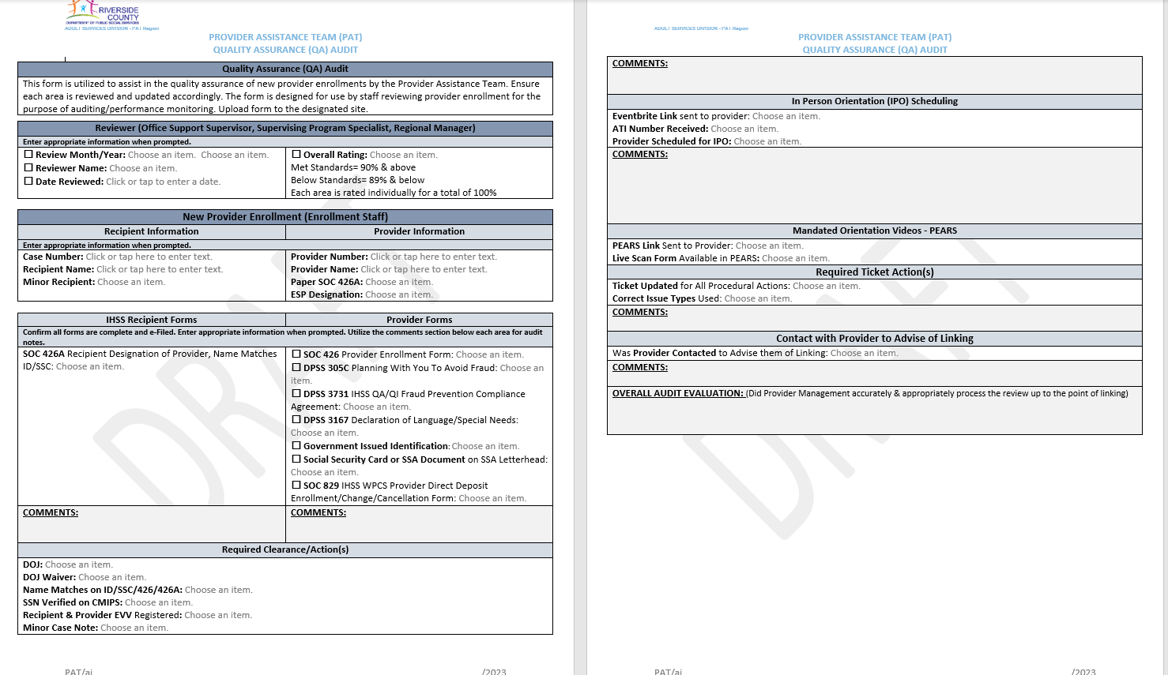
Auditing
Notes:
Alicia's Slide
Overall PAT Performance (Add graphs use ticketing report)
Audits Consist of 2 audits per worker each month.
Gemba walk has allowed us to make changes for a better leaner process
2 way we audit.
1. Manual auditing that is done by supervisors monthly for quality assurance and to address performance concerns and to have discussions with staff to train and improve work.
2. Policy Auditing- these are done quarterly to ensure that the county as a whole, is complying with the state regulations for provider enrollment.

Slide 18




Challenges
Department challenges
Staffing
Training
Policy clarification
Provider focus for PAT
Own success
Customer challenges
Continued changes can feel overwhelming
Technology
PEARS/video challenges
Customer technology awareness and access
Notes:
Laura
Temporary assignment folks
Policy: what we can not do. Making forms accessible and what forms are mandated or not. Changes can take time.

Slide 19
Telework flexibility
Team building
PAT team member of the week/month
Providing clear staff expectations
Option for in person assistance
Clear processes and policies
Clear communication
Solutions
Notes:
Alicia
Team Building
Staffing: attrition and retention of staff,
Seeking promotional opportunities.
Difficulty of keeping moral within a virtual work setting.
Now that we are teleworking spacing is limited in office
Personal customer service recognition from our customers via customer survey reports
Incentives: offer in office attendance I space is available
Virtual team building example, birthday card, PAT member of the month
Training:
Trainers consist of seasoned staff and supervisor and can hinder the productivity.
Customers: we acknowledge that someone who is already providing care for the elderly now we are asking them to have some level of awareness of the new innovative technology. Unfamiliarity with the programs can become difficult
Ways we support: We give them the ability to have direct communication with a staff member that can guide them through some of the changes.
Next Steps Flyer was created for both recipient and provider
The goal is to have it in the provider’s hand at the time of intake or reassessment.
due to technology limitations Offer in person assistance for completion of provider packet and offer slots for in person view on orientation videos.

Slide 20
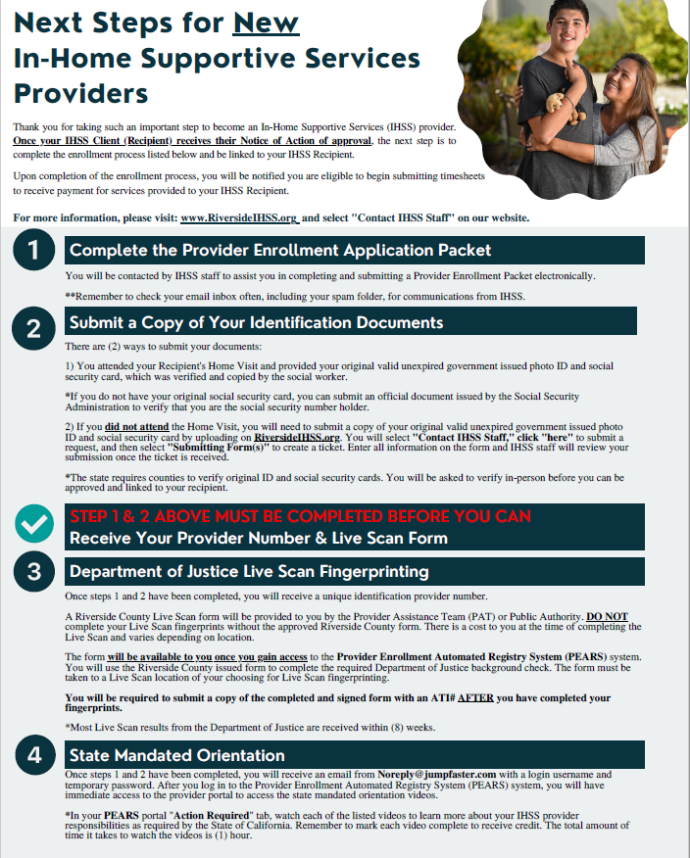
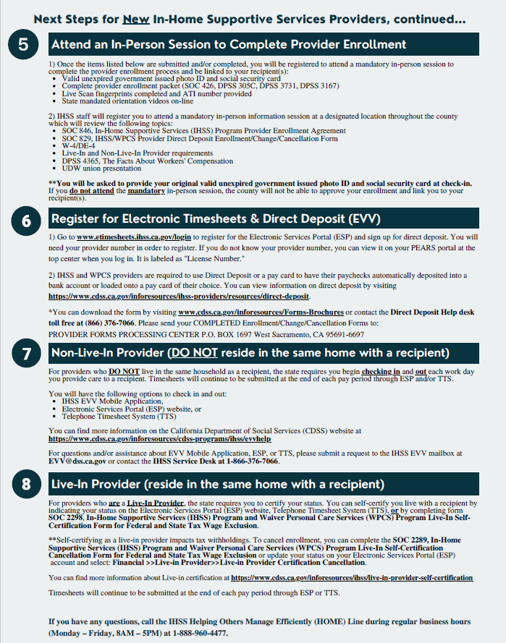
Notes:
Alicia
This an example of the developed Next Steps Flyer that supports educating our provider on what to expect of their enrollment.
(continuing solution slide)

Slide 21



Macro Issues
Collaborative partnerships with the United Domestic Workers union, County Board Aides, and Riverside County IHSS Advisory Committee
Operations and Intake Flyers
Public Authority
Notes:
Ryan's Slide
Public authority This partnership supports our efforts with the following:
Completion of in person orientation which encompasses with union orientation and they assistance with Live Scan results for our providers

Slide 22
Data/Successes
Started with 20% of providers present at intake - Increased to 80%
Between 90-100% of productivity for staff
Elimination of the backlog of unlinked providers
Riverside County IHSS Advisory Committee feedback
Increase of new registry providers for Public Authority
NACo Award
Notes:
Ryan's Slide
Elimination of backlog for operations - in first four months - 5,500 providers

Slide 23
Notes:
Ryan’s Slide

Slide 24
Notes:
Ryan’s Slide

Slide 25
Riverside County IHSS Advisory Committee Feedback
“This is fantastic.”
“You all are doing a great job.”
“I love how Riverside is at the cutting edge of technology.”
“Ryan, please let everyone on the team know how much we appreciate them.”
“I needed to enroll two providers this month. Both told me that someone got a hold of them right away to start the process and explain everything. This is great!”
“The message told me I would be waiting for 20 minutes. Someone called me back in just 10!”
“You know that I was reluctant to try this [technology] at first, but I just think it works so well.”
Notes:
Ryan's Slide

Slide 26
Summary
The demand for providers surged in part due to an increase in our aging population.
Enrollment procedures, processes, and pain points were addressed by using Lean Six Sigma to outline and streamline the process, which resulted in the Provider Assistance Team (PAT)
The use of technology increased our ability to reach and link a larger number of providers.
Collaboration both within the Department, and outside to Community Partners, is important and contributed to the success of the project.
Quickly and appropriately linked providers help ensure the safety of our customers. As such, it is our highest priority.
Notes:
Angel's Slide

Slide 27
Conclusion
Deputy Director : Ryan Uhlenkott
E-mail: RYuhlenk@RIVCO.ORG
Regional Manager: Angel Jaimes
E-mail: AJaimes@RIVCO.ORG
Office Support Supervisor: Alicia Mesa
E-mail: AliMesa@RIVCO.ORG
Office Support Supervisor: Laura Castellon
E-mail: Lcastell@RIVCO.ORG
Inspirational quote: To care for those who once cared for us is one of the highest honors. - Tia Walker
Notes:
Laura's speaks: What are our final thoughts about PAT
Ryan ends with the final quote.
How do you get in contact with us if we can help you out
Thank you (Ryan) to Administration
Thanking CWDA for their time
Any Questions?

