Slide 1


Transitional Assistance
Enhancing the
Call Center Experience Through Technology
Now We’re Talking
Presenters:
James Locurto, Assistant Director
Ariana Michel, Deputy Director
Jared Kuester, Contact Center Team Lead

Slide 2



Transitional Assistance – Now We’re Talking
#
2
Introduction
This presentation will cover:
Use and flexibility of technology
  Authentication Assistant
  Push Notifications
  Welcome Assistant
  Web Chat
  Emergency Queue
  Appointment Rescheduling
Improving the customer experience
Potential technology enhancements

Slide 3
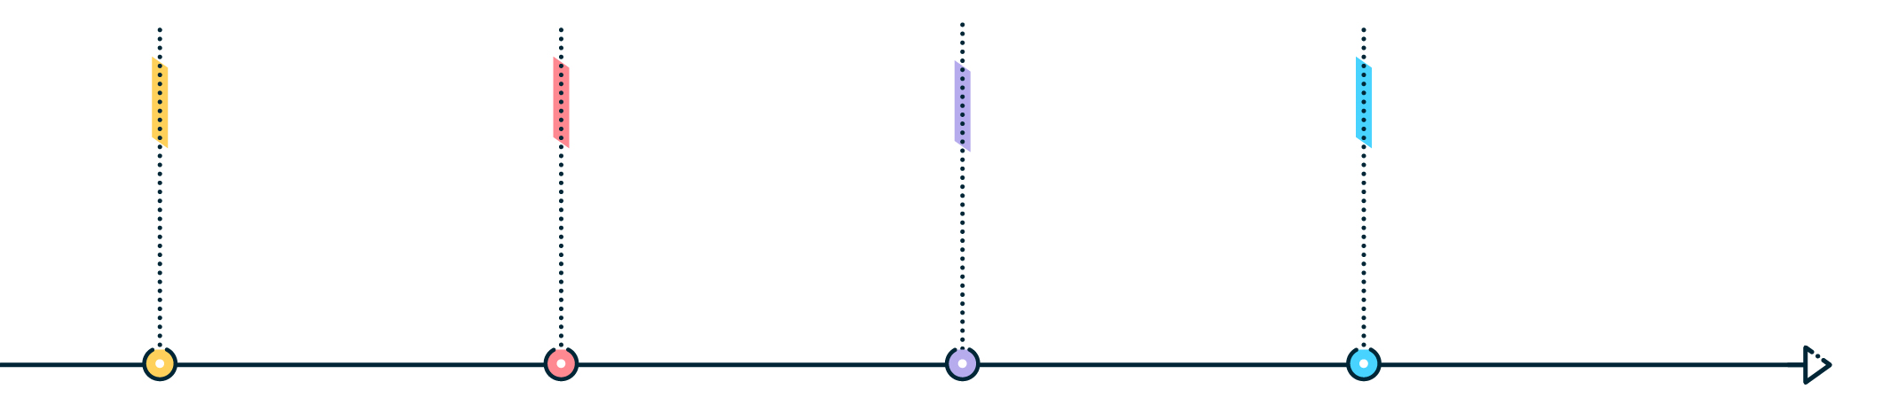






Transitional Assistance – Now We’re Talking
3
San Bernardino County Facts
Geography
Population
Income
Poverty
20,105 square miles
70 sovereign nations
Larger than nine states
2,225,586
5th most populous in California
14th most populous in the
united states
$70,287 – Household median
14.3% of the population LIVE in poverty

Slide 4


Transitional Assistance – Now We’re Talking
3
4
San Bernardino County Caseloads
Active cases through July 2023
CalWORKs only: 2,643
CalFresh only: 163,337
CalWORKs and CalFresh combo: 26,347
Medi-Cal: 469,804
Applications submitted in July 2023
CalWORKs only: 1,367
CalFresh only: 12,623
CalWORKs and CalFresh combo: 2,292
Medi-Cal: 10,357

Slide 5




Transitional Assistance – Now We’re Talking
4
5
In August 2011, San Bernardino County transitioned to task-based work. As a result, three Call Centers were established and staffed in San Bernardino, Ontario, and Hesperia.
Eligibility Worker I/II
Eligibility Worker III
Eligibility Worker Supervisor
196
21
196
22
18
18

Slide 6
Transitional Assistance – Now We’re Talking
6
Call Center Model
Programs
  CalWORKs
  CalFresh
  Medi-Cal
Queues
  General inquiry
  CalWORKs
  CalFresh
  Medi-Cal
Services
  General inquiry
  Program applications
  Form completion
  Change reporting
  Duplicate forms/benefit cards
  Appointment assistance
  Income/benefit verification
  Assistance with BenefitsCal.com
  Resolution to customer complaints
  Referral to additional resources

Slide 7
Transitional Assistance – Now We’re Talking
7
Call Center Model, Continued…
The Customer Service Center (CSC) operates with a “one-and-done” guiding principal. Customer issues and resulting case actions are handled at the time of customer contact whenever possible, and all queues are available in English and Spanish. The following are some task actions that are completed by CSC staff.
Add person/Deemed Eligible (DE) newborn
Address change
Appointment scheduling
Benefit inquiry
CalFresh recertification
Disability status change
Employment status start/stop/end
Form/verification received status

Slide 8



Transitional Assistance – Now We’re Talking
8
Authentication Assistant
Push Notifications
Welcome Assistant
Three automated assistants, also known as BOTS, were implemented in the San Bernardino County Interactive Voice Response (IVR) system. The Authentication Assistant launched June 18, 2021. Push Notifications and the Welcome Assistant launched August 27, 2021.

Slide 9


Goal
Transitional Assistance – Now We’re Talking
9
Call Gone Bad
BOT technology has been redesigned to strengthen efficiencies and improve the customer experience. The goal is to:
Simplify the customer experience and allow more options for self-service.
Limit the total amount of time on the phone and reduce hold times for customers.
Handle increased caseloads with decreased staff.
Use the best available technology to enhance the customer experience and increase satisfaction with service.

Slide 10
Transitional Assistance – Now We’re Talking
10
Authentication Assistant
After successful authentication, customers can complete the following without worker assistance:
Change IVR PIN
Get information about upcoming appointments
  Reschedule appointments, if needed
Request forms or copies of notices
Receive status updates of documents submitted
Access:
  Benefit information
  Office locations and hours
Allows customers to verify identity and access case information by providing two of the following factors:
County case number
Date of Birth (DOB)
Social Security Number (SSN)
Driver’s License or State ID card
IVR Personal Identification Number (PIN)
Electronic Benefit Transfer (EBT) card number

Slide 11

Transitional Assistance – Now We’re Talking
11
Authentication Assistant
Continued…
June 2023 - August 2023
Calls received: 274,795
Calls completed by BOT: 173,058
Overall success rate: 78%

Slide 12
Transitional Assistance – Now We’re Talking
#
12
Push Notifications
June 2023 - August 2023
16,007 calls were completed after hearing Push Notifications message.
24,071 calls were completed after hearing the Push Notification message and selecting another self-service option from the menu.
Provides upfront information to the caller using active programs.
Benefit amounts/status
Status of returned document
Request a document/form

Slide 13
Transitional Assistance – Now We’re Talking
#
13
Welcome Assistant
The Welcome Assistant gets the customer to the appropriate location as quickly as possible, with a 66% success rate, and has saved 12,600 work hours over six months.
Asks customer open-ended questions regarding the reason for the call to assist with routing the call to the correct queue or self-service option.
Uses 15 of the most common case actions
Supports CalWORKs, CalFresh, and Medi-Cal programs
Routes the customer to the correct IVR location, self-service option, or program queue using the responses given

Slide 14

Transitional Assistance – Now We’re Talking
14
Preparing Staff and Customers
Customer marketing was posted to the TAD Facebook page to notify customers of the new authentication options available through the IVR system.
CSC staff:
Received emails from management about the forthcoming launch of the BOT emphasizing the benefits for staff and customers.
Were informed about the enhanced options that would be available to customers without needing to speak to a CSC representative.
Progress of the launch was tracked and staff were provided with status
updates indicating an overall reduction of staff workload.

Slide 15



Transitional Assistance – Now We’re Talking
#
15
The following is customer feedback about the BOT technology:
“There have been many times I initially request to speak with an agent and the BOT identifies exactly what I am calling for. By offering me additional options I received faster service.”
“The technology has cut down my wait time. The messaging shares enough information that helps me decide if I want to hold to speak with an agent, if I can use the self-service options or if I want to use the call back feature.”
“The technology is not difficult and easy to use and has many options. I’ve successfully used voice recognition to authenticate every time!”

Slide 16

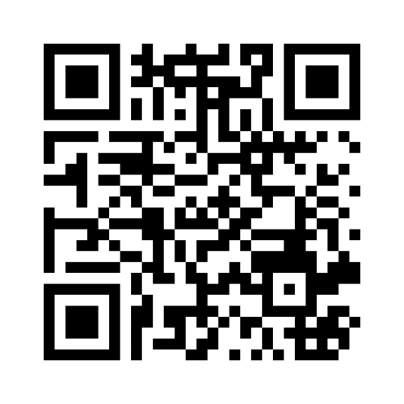
Transitional Assistance – Now We’re Talking
16
Join at Menti.com Use code 3987 0048
Notes:
Presenter talking points: potential BOT enhancement for change of address, add person, enhancing appt rescheduling

Slide 17
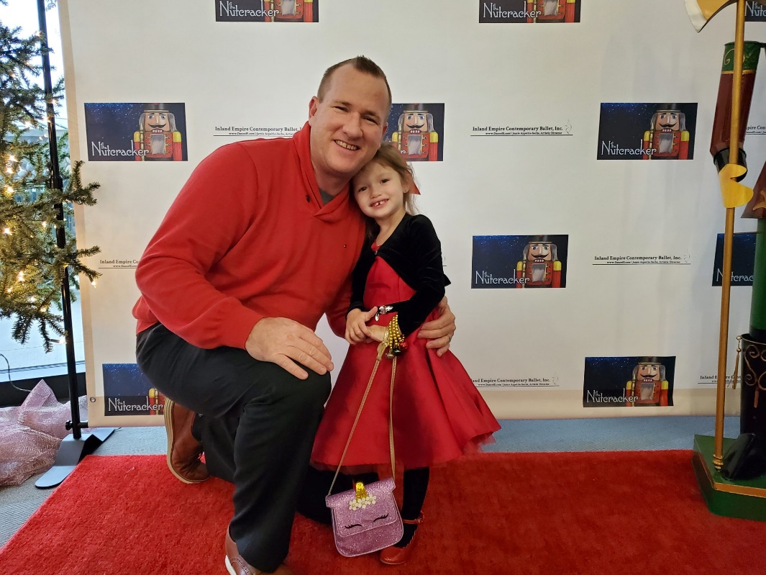
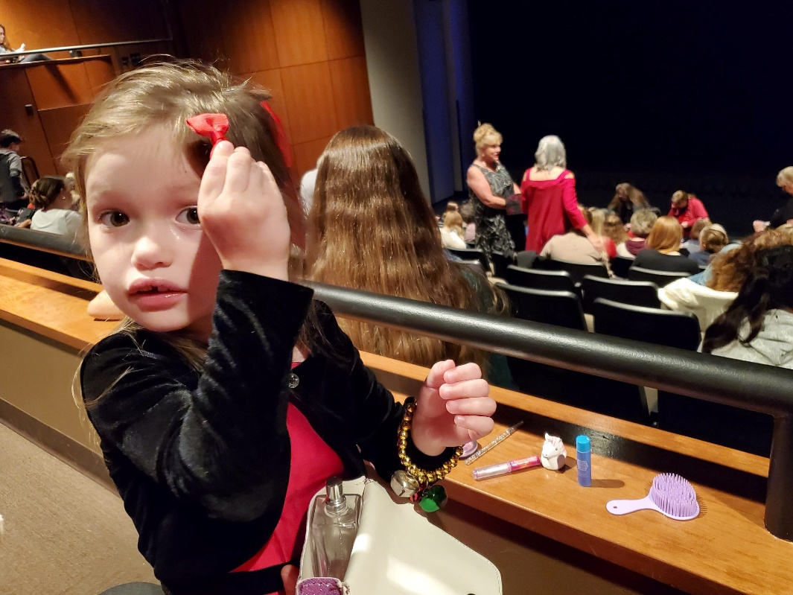
Transitional Assistance – Now We’re Talking
17
Notes:
James’ intermission story

Slide 18

Transitional Assistance – Now We’re Talking
18
Web Chat
Supports BenefitsCal.com to assist with technical issues rather than answer program specific questions.
Primarily staffed by Work Experience (WEX) employees (Welfare-to-Work participants gaining experience in temporary positions within the County).
February 2023 – July 2023
Chats received: 42,361
  Monthly average: 7,060
Chats completed: 39,926
  Monthly average: 6,654
Average chat time: 6:05
Average speed of answer: 3:51
Web Chat is staffed daily by an average of four agents:
WEX – 4
Office Assistant – 2
Eligibility Worker – 1

Slide 19

Transitional Assistance – Now We’re Talking
19

Slide 20

Transitional Assistance – Now We’re Talking
#
20

Slide 21
Transitional Assistance – Now We’re Talking
21
Emergency Queue
Emergency Queue Calls
April 2023
Received: 2,338
Completed: 2,302
Average call time: 12:10
Average speed of answer: 0:13
The 2023 winter storm event was a unique opportunity to activate the call center Emergency Queue for Disaster CalFresh.
The queue was already under development for use. When the winter storm disaster struck, California Statewide Automated Welfare System (CalSAWS) expedited development and deployment to enable the system.
The Emergency Queue was staffed by an average of 41 agents who also provided additional community resources.
Disaster CalFresh Applications
April 2023
Received: 838
Approved: 71
Benefits issued: $43,641

Slide 22

Transitional Assistance – Now We’re Talking
22
Emergency Queue Continued…
How it Works
Stage | Description
1 | Customer: Receives automated welcome message. Makes language selection.
2 | Automation: Plays a message indicating a recent disaster has occurred. Asks customer if they think they have been impacted and are eligible to Disaster CalFresh. Gives customer the option to obtain more information.
3 | Customer: Selects option to receive more information on the disaster, Confirms request to apply for Disaster CalFresh and Is routed to the Emergency Queue to complete the application, or Declines option to receive more information on the disaster, and Is routed to the main menu.
Used for expedited services
Designed with an on/off option
Customizable prompts

Slide 23

Transitional Assistance – Now We’re Talking
23
Flexibility
The Emergency Queue can be:
Turned on and off as needed.
Used as an ad-hoc queue to offer other services or resources.
Easily updated with appropriate message prompts and menus.

Slide 24
Transitional Assistance – Now We’re Talking
24
EMERGENCY QUEUE
Notes:
CSC prompt from 2023 Winter Storm Event

Slide 25

Transitional Assistance – Now We’re Talking
25
Join at Menti.com Use code 3987 0048
Notes:
Presenter talking points: Potential use of queue for VITA, emergency allotment, WTW re-engagement

Slide 26

Transitional Assistance – Now We’re Talking
26
Re-Evaluation (RE)/Re-Certification (RC) Rescheduling
Customer:
Selects the option to reschedule RE/RC appointment
Is routed to the rescheduling queue
Chooses:
  Morning or afternoon
  Appointment time from options given by the system
  Confirms rescheduled appointment date, time, and location
The district is notified of reschedule via Outlook with an appointment notification.
RE/RC rescheduling technology is unique to San Bernardino County. The following rescheduling parameters have been built into CalSAWS for San Bernardino County:
Only RE/RC appointments can be rescheduled
RE/RC must be for the current month
Appointments will only be rescheduled:
  During existing RE/RC appointment time slots
  At the originally assigned district office
System will not reschedule on weekends or holidays, or on Friday office closures

Slide 27

Transitional Assistance – Now We’re Talking
27
Re-Evaluation/Re-Certification Rescheduling
Continued…
May 2023
Appointment information provided = 1,806
Rescheduled Appt. = 116
Confirmed Appt. = 34
June 2023
Appointment information provided = 1,023
Rescheduled Appt. = 93
Confirmed Appt. = 70
July 2023
Appointment information provided = 1,142
Rescheduled Appt. = 107
Confirmed Appt. = 43

Slide 28

Transitional Assistance – Now We’re Talking
28
Closing Thoughts

Slide 29

Transitional Assistance – Now We’re Talking
CONTACT US
Ariana Michel
TAD, Deputy Director
(909) 386-0820
Ariana.Michel@hss.sbcounty.gov
James Locurto
TAD, Assistant Director
(909) 388-0245
James.Locurto@hss.sbcounty.gov
Jared Kuester
CalSAWS Project, Contact Center Team Lead
kuesterjm@calsaws.org
www.SBCounty.gov/tad

