Slide 1



Addressing Secondary Traumatic Stress, Supporting Skill Development, and Improving Workforce Resilience Through Reflective Supervision/Consultation

Slide 3
PHASE ONE
Start - Month 3
PHASE TWO
Month 3 - Month 6
PHASE THREE
Month 6 - Month 9
  Weekly meetings with Champions
  Monthly meetings with Implementation Team
  Planning &
  Exploration
  Bi-monthly meetings with Champions
  Monthly meetings with Implementation Team
  Exploration & Implementation
  Monthly meetings with Champions
  Monthly meetings with Implementation Team
  Implementation & Sustainment

Slide 4

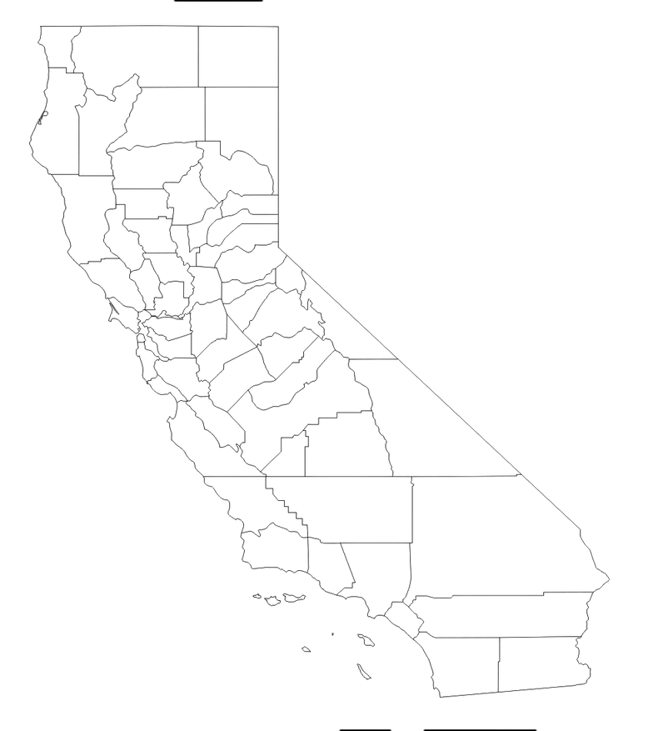
Del Norte
Tehema
California Counties
Lassen
Glenn
Calaveras
Solano
Tuolumne
Santa Cruz
Tulare
Madera
Santa Barbara
Los Angeles
Riverside
San Diego

Slide 5
Supporting the Workforce
Turnover
Secondary Trauma
System- level Strategy Needed

Slide 6
Addressing STS
Organizational
Strategies
Individual
Strategies
Reflective
Supervision
Self-Care
Time Off
Crisis Debriefing
Training
Therapy

Slide 7
Reflective
Supervision
Supervisor can value both compliance and caring for staff
Based in trust and respect for each other
Sharing of emotions and feelings about the work
Occurs regularly during most supervisions

Slide 8

What Reflective Supervision isn’t…
“How was your weekend?”
Reactive
Crisis Driven
One time response
Therapy
Required
Notes:
Not adding more to your plate

Slide 9





Reflective Skills
  Reflective listening
  Emotional Questioning
  Supervisor Modeling
  Maintaining Boundaries
  Compassion Satisfaction

Slide 10
Reflective Practice for Leaders
1
  2
  3
Environment
of transparency and trust
Focus on positive feelings and outcomes
Reinforce and model reflective practice skills

Slide 11

How to Implement
Reflective
Supervision

Slide 12







Reflective Practice
Leadership
Managers
Supervisors
Staff

Slide 13





Trained executive leadership, managers, and supervisors
LA
County
Provided small group coaching at all levels
Incorporated RP into meetings at all levels
Created RS onboarding resources for new workers

Slide 14


Outcomes
1
Small
County
1 Medium
County
1
Large
County

Slide 15


Pre/Post Questionnaire
Pre-Questionnaire:
Before
Starting ACTS
ACTS Project:
9-15 months
Post Questionnaire:
~6 month after completion

Slide 16







22%
Greater awareness around STS and emotional toll of the work
Supervisors were more knowledgeable around RS
23%
More consistent reflective supervision

Slide 17
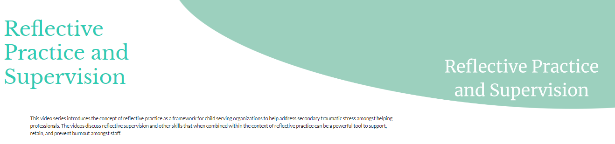
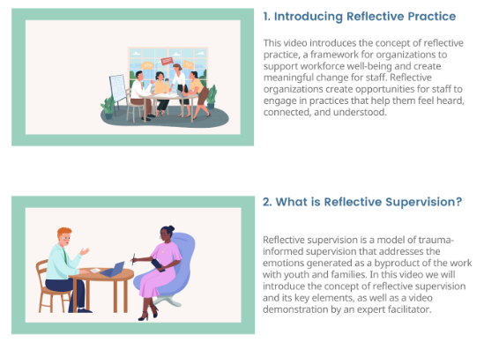
Notes:
Video Series

Slide 18
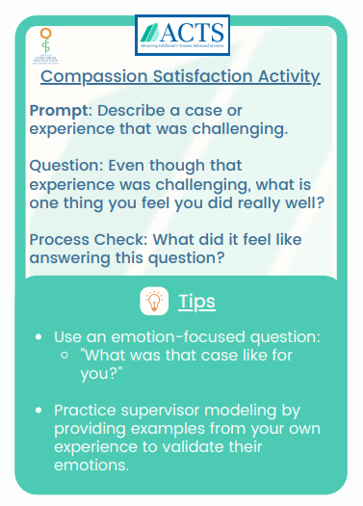
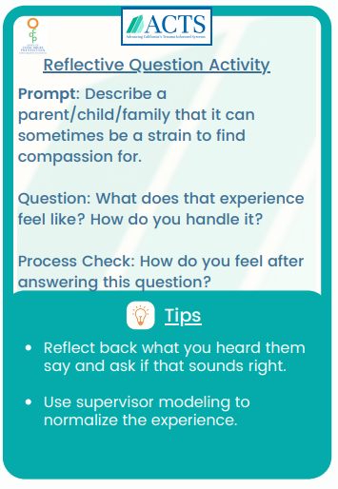

Slide 19
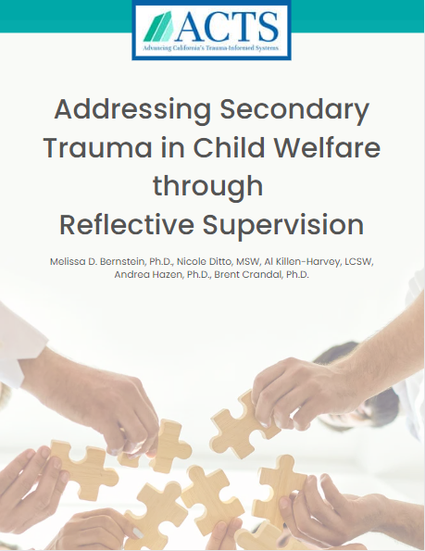
www.actsproject.com
mbernstein1@rchsd.org

Slide 20
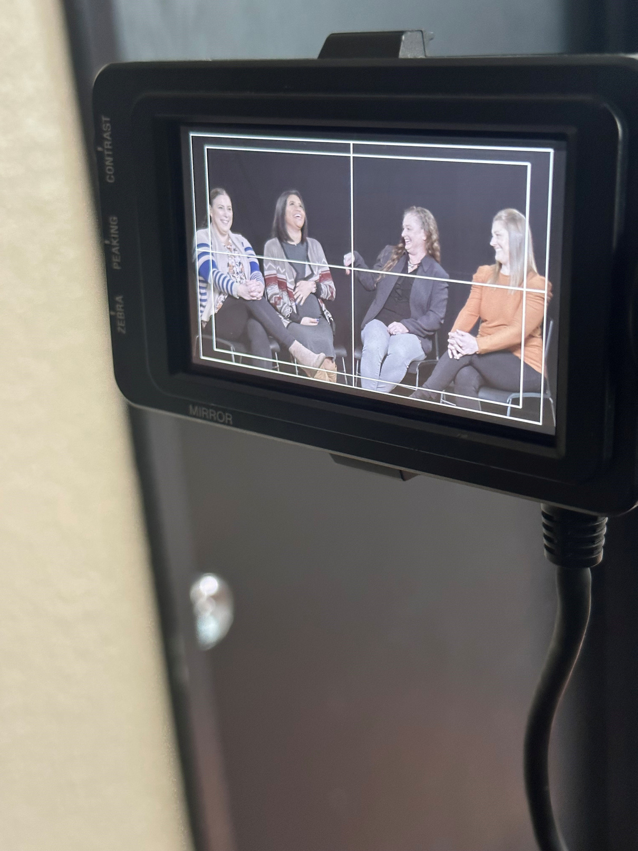


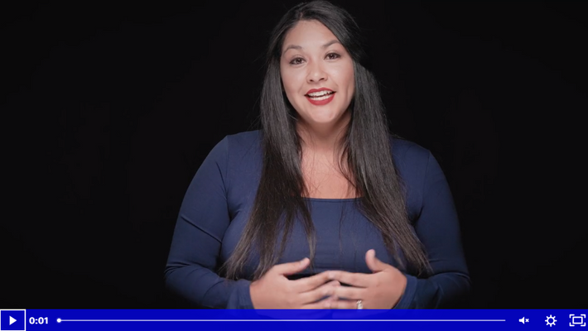

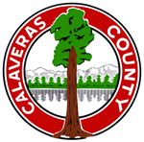


MODEL OF IMPLENTATION
REFLECTIVE CONSULTATION
ALYSSA NAJERA, LCSW
Consultant, Podcaster, and Small Town Therapist
CORI ALLEN, MPA
  Offsite Field Instruction
  Clinical Supervision
  Custom Online Training
  Reflective Consultation
Health and Human Services Agency
Director
Calaveras County
MICHELLE CLARK
-alyssanajera.com
Dept. of Social Services Director
Systems of Care
Tuolumne County
Addressing Secondary Traumatic Stress, Supporting Skill Development, and Improving Workforce Resilience through Reflective Supervision/Consultation (RSC), CWDA Conference 2023
BUSINESS MODEL

Slide 21
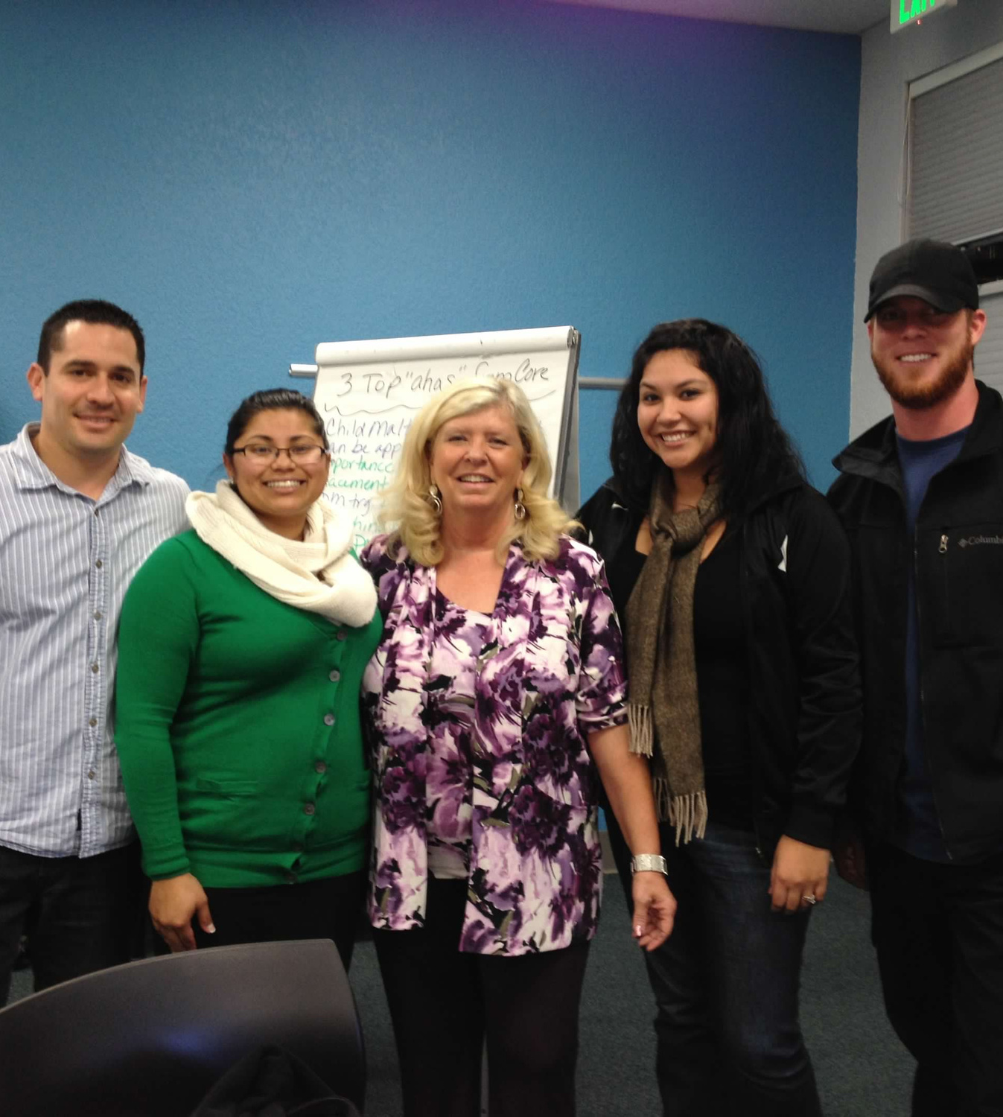

UC Davis Social Worker Core Training, 2012ish
2011 - 2016
Tuolumne Co.
Addressing Secondary Traumatic Stress, Supporting Skill Development, and Improving Workforce Resilience through Reflective Supervision/Consultation (RSC), CWDA Conference 2023
Alyssa Najera Consulting | Calaveras County Health and Human Services | Tuolumne County Department of Social Services
Addressing Secondary Traumatic Stress, Supporting Skill Development, and Improving Workforce Resilience through Reflective Supervision/Consultation (RSC), CWDA Conference 2023
Alyssa Najera Consulting | Calaveras County Health and Human Services | Tuolumne County Department of Social Services
Calaveras County
Health and Human Services Agency
BUSINESS MODEL

Slide 22






Field Instruction
Reflective Supervision
Employee/Student
5+ years
later...
2017 Pilot Supervisor Group
Addressing Secondary Traumatic Stress, Supporting Skill Development, and Improving Workforce Resilience through Reflective Supervision/Consultation (RSC), CWDA Conference 2023
Alyssa Najera Consulting | Calaveras County Health and Human Services | Tuolumne County Department of Social Services
BUSINESS MODEL

Slide 23






  ADDRESSES BURNOUT, TRAUMA, COMPASSION FATIGUE
REFLECTIVE
CONSULTATION
  PROMOTES TEAMING, COLLABORATION
Facilitated by an offsite consultant, usually with a background in mental health
  PRIORITIZES RELATIONSHIPS AND THE PARALLEL PROCESS
  PROMOTES RESILIENCE BUILDING ACTIVITIES
Addressing Secondary Traumatic Stress, Supporting Skill Development, and Improving Workforce Resilience through Reflective Supervision/Consultation (RSC), CWDA Conference 2023
Alyssa Najera Consulting | Calaveras County Health and Human Services | Tuolumne County Department of Social Services
BUSINESS MODEL

Slide 24
HOW DO WE REPLICATE THIS RESOURCE?
Title IV-E
specialized training
Addressing Secondary Traumatic Stress, Supporting Skill Development, and Improving Workforce Resilience through Reflective Supervision/Consultation (RSC), CWDA Conference 2023
Alyssa Najera Consulting | Calaveras County Health and Human Services | Tuolumne County Department of Social Services

Slide 25


IMPLEMENTATION
RSC Groups
On Demand RSC
Onboarding
  all levels of staff
  1-2x monthly
  small groups, max 8
  individual RSC as needed
  online scheduling
  weekly 1x1 RSC
  monthly group during probationary period
2017
2021
2021
2023
Dept. of Social Services
Health and Human Services; Protective Services
Health and Social Services;
Child Welfare
Health and Human Services; Social Services
Addressing Secondary Traumatic Stress, Supporting Skill Development, and Improving Workforce Resilience through Reflective Supervision/Consultation (RSC), CWDA Conference 2023
Alyssa Najera Consulting | Calaveras County Health and Human Services | Tuolumne County Department of Social Services

Slide 26

  "There's not enough time."
  "You just have to get there."
It's the new
  Flavor of the Week.
  Demonstrated consisteny.
BARRIERS TO
IMPLEMENTATION
  Reservations about intent/safety.
  Confidential
  Time in RSC is not protected.
  Requires support from management
  Funding
  Title IV-E Funded
Let's hear from Calaveras and Tuolumne on their experiences.
Addressing Secondary Traumatic Stress, Supporting Skill Development, and Improving Workforce Resilience through Reflective Supervision/Consultation (RSC), CWDA Conference 2023
Alyssa Najera Consulting | Calaveras County Health and Human Services | Tuolumne County Department of Social Services

Slide 27




CALAVERAS
  PROTECTIVE SERVICES
  REFLECTIVE CONSULTATION EXPERIENCE WITH ALYSSA NAJERA TEAM, DEC. 2021-PRESENT
WHY REFLECTIVE CONSULTATION
  CORI ALLEN, MPA
(She/Her)
Health and Human Services Agency Director
Calaveras County
Vision and Goals
ONBOARDING EXPERIENCE
Navigating Implementation
Addressing Secondary Traumatic Stress, Supporting Skill Development, and Improving Workforce Resilience through Reflective Supervision/Consultation (RSC), CWDA Conference 2023
Alyssa Najera Consulting | Calaveras County Health and Human Services | Tuolumne County Department of Social Services

Slide 28
% of participants who answered positively
IT'S A PROCESS
6 MONTHS
18 MONTHS
n=136
n=200
Reflective Consultation has improved my ability to slow down, observe, and reflect within my professional role of working with trauma-exposed populations.
64.2%
96%
+31.8%
I gained the skills, support, or knowledge I needed to help navigate the topics/cases brought to this month's consultation(s).
58.2%
95.5%
+37.3%
IT'S LIKE BUILT-IN SELF CARE.
  -child welfare social worker
*Positively defined as strongly agree or agree responses
strongly agree
agree
somewhat agree
disagree
strongly disagree
Source: Calaveras Monthly Evals, 2021 - Present
Addressing Secondary Traumatic Stress, Supporting Skill Development, and Improving Workforce Resilience through Reflective Supervision/Consultation (RSC), CWDA Conference 2023
Alyssa Najera Consulting | Calaveras County Health and Human Services | Tuolumne County Department of Social Services

Slide 29





"It allows for everyone to support each other, regardless of our roles in the workplace".
"THERE IS MORE POSITIVITY."
TEAMING
OUTCOMES
IT'S LIKE BUILT-IN SELF CARE.
  - SOCIAL WORKER
WORKPLACE ENVIRONMENT
"It has created a positive and supportive atmosphere [and] helped create a healthy dynamic among coworkers, supervisors, and decrease of employees leaving."
RETENTION
Source: Calaveras Monthly Evals, 2021 - Present
Addressing Secondary Traumatic Stress, Supporting Skill Development, and Improving Workforce Resilience through Reflective Supervision/Consultation (RSC), CWDA Conference 2023
Alyssa Najera Consulting | Calaveras County Health and Human Services | Tuolumne County Department of Social Services

Slide 30

TUOLUMNE
  DEPT. OF SOCIAL SERVICES (DSS)
  REFLECTIVE CONSULTATION EXPERIENCE WITH ALYSSA NAJERA TEAM, 2017-PRESENT
  MICHELLE CLARK
(She/Her)
DSS Director
Systems of Care
  Tuolumne County
IMPLEMENTATION | OUTCOMES | WHAT WE LEARNED
Addressing Secondary Traumatic Stress, Supporting Skill Development, and Improving Workforce Resilience through Reflective Supervision/Consultation (RSC), CWDA Conference 2023
Alyssa Najera Consulting | Calaveras County Health and Human Services | Tuolumne County Department of Social Services

Slide 31

IMPLEMENTATION
ONCE MONTHLY PROBATIONARY GROUP
SUPPORT TEAMS
SEASONED SOCIAL WORKERS
SUPERVISORS
AGENCY MGRS
EXECUTIVE LEADERSHIP
AVAILABLE AS NEEDED FOR
ALL STAFF
WEEKLY 1:1
FIRST 1-3 MONTHS
ONBOARDING
GROUPS
ON DEMAND
Addressing Secondary Traumatic Stress, Supporting Skill Development, and Improving Workforce Resilience through Reflective Supervision/Consultation (RSC), CWDA Conference 2023
Alyssa Najera Consulting | Calaveras County Health and Human Services | Tuolumne County Department of Social Services

Slide 32


9.24
"Reflective consultation was a life raft I needed during my first two years at [child welfare]. I'm not sure what I would have done without it."
on a scale of 1 to 10
How likely are you to recommend RC to a colleague?
  I've been able to process some very difficult situations at work that could easily derail me from my day and take up a lot of brain power.
OUTCOMES
9.47
n=17, RC Experience Survey,
April 2023
on a scale of 1 to 10
"It has given me the ability to really look within myself and patterns I may exhibit caused by trauma or burnout which then gives me the ability to better coach my team."
How necessary is it to keep Reflective Consultation available as a resource?
Source: Tuolumne Monthly Evals, 2021 - Present
n=17, RC Experience Survey,
April 2023
Addressing Secondary Traumatic Stress, Supporting Skill Development, and Improving Workforce Resilience through Reflective Supervision/Consultation (RSC), CWDA Conference 2023
Alyssa Najera Consulting | Calaveras County Health and Human Services | Tuolumne County Department of Social Services

Slide 33


WHAT WE LEARNED
  Supervisors
LESSONS ON IMPLEMENTATIONS
  2017
  ongoing assessment
  adapt
  commitment
Social Workers
Pilot Groups
  On Demand RSC
OPPORTUNITIES
Agency Managers
Support Team
  Executive Leadership
  replication across programs
  PRESENT
Addressing Secondary Traumatic Stress, Supporting Skill Development, and Improving Workforce Resilience through Reflective Supervision/Consultation (RSC), CWDA Conference 2023
Alyssa Najera Consulting | Calaveras County Health and Human Services | Tuolumne County Department of Social Services

