Slide 1


Fiscal Essentials 101
Presenters:
Monica L Bentley – Riverside County
Robert Manchia – San Mateo County
Ardee Apostol – San Diego County
Maria Lucia Gonzales – Sacramento County

Slide 2

AGENDA
Budgeting
Funding Sources
  Federal
  State
  Realignment
    1991
    2011

Slide 3


Slide 4

Budgets are Multi-Purpose
Policy Document
Financial Plan
Operations Guide
Communication Tool
Not Actual Expenditures

Slide 5
Big Ticket Items Impacting the Budget
County Budget
Revenue: County General Fund, Sales Tax, and State General Fund
Policies: Federal, State and Local
Demand: Caseload Growth/ Demographics
Expenditures: Salaries and Operating Costs, Vacancies, Time Studies

Slide 6

Funding Sources

Slide 7
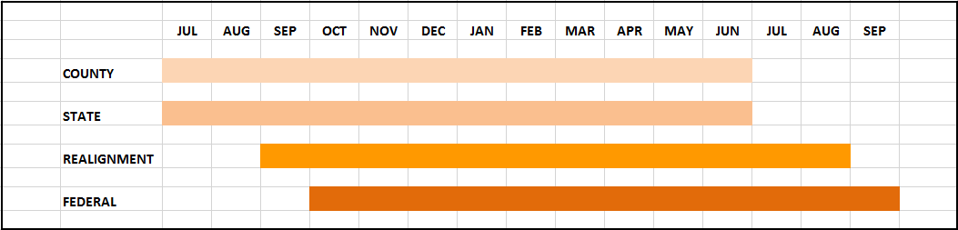
Chart of Fiscal Years

Slide 8

Funding/Revenue Components
Federal Participation
State Participation
Realignment
County Participation
Grants
Other/ Miscellaneous

Slide 9

Federal Budget
Federal fiscal year is October 1-Sept 30
The majority of our mandated program funding begins at the federal level.
Federal program regulations describe the funding parameters that are to be used for each federal funding source.

Slide 10

Federal Funding
The Federal budget delineates how much each state will receive.
Federal funds require a match.
  Match is usually required to be non-Fed.
Federal funding is usually open ended.

Slide 11

State General Funding
State fiscal year is July 1- June 30
The State budget delineates how much State General funds will be available
  State General Fund is used to draw down Federal dollars.
  There are also State only programs.
Allocations letters inform counties on how much they will receive.

Slide 12

Allocation Development
Each Allocation uses a prescribed methodology to develop county specific amounts.
Usually outlined in Allocation Letter.
Outlined in Annual Allocation Matrix developed by the CWDA FAAD’s workgroup.

Slide 13


Realignment

Slide 14
Realignment
Social Services is funded with two Realignment pools.
1991 Realignment
2011 Realignment
There are two dedicated revenue sources to fund the programs:
State sales tax
Vehicle license fees

Slide 15
1991 REALIGNMENT STRUCTURE - STATE
SALES TAX/VLF DISTRIBUTIONS
Sales Tax/VLF
Source: ½ cent Sales Tax; Source: 74.9% Vehicle License Fees
Sales Tax/VLF Base Account
Sales Tax/VLF Growth Account
(Revenues in Excess of Base Payments)
Mental Health Subaccount ª
($1.12 billion base funding from 2011 Realignment)
Social Services Subaccount
Health
Subaccount
CMSP
(Base Account)
CalWORKs MOE ^{b}
(capped at $1.12 billion)
County Allocations
CMSP
(County Shares)
Sales Tax Caseload Subaccount
(1st call on Growth)
CMSP Growth
(2nd call on Growth; 4.027% plus 4.027%
of caseload growth paid if over $20M)
General Growth
(remaining Growth)
Mental Health
(approx. 40%)
Health
(approx. 52%)
Social Services
(approx. 8%)

Slide 16
1991 Realignment Program Ratios
Program
CalWORKs Aid Payments
CalWORKs Eligibility
Foster Care
Child Welfare Services
Adoptions Assistance
CalWORKs Employment Services
In-Home Supportive Services
County Services Block Grant
California Children’s Services
Old Share (non-Fed)
11%
50%
5%
24%
0%
0%
3%
16%
25%
New 1991 Share (non-Fed)
5%
30%
60%
30%
25%
30%
35%
30% total
50% total

Slide 17
Local Revenue Fund 2011
State Structure
Local Revenue Fund 2011
Mental Health Account
(1991 Mental Health Responsibilities)
Support Services Account
Law Enforcement Services Account
Sales and use Tax Growth Account
(Excess revenues above
base allocations)
County Intervention Support Services Subaccount
Trial Court Security Subaccount
District Attorney and Public Defender Subaccount
Support Services Growth Subaccount
Law Enforcement Services Growth Subaccount
Protective Services Subaccount
Community Corrections Subaccount
Juvenile Justice Subaccount
Protective Services Growth Special Account
Trial Court Security Growth Special
Account
Behavioral Health
Subaccount
Enhancing Law Enforcement Activities Subaccount
Juvenile Reentry Grant
Special Account
Behavioral Health Services Growth
Special Account
Community Corrections Growth Special
Account
Youthful Offender Block
Grant Special Account
Mental Health Subaccount
Juvenile Justice
Growth Special
Account
Women and Children’s Residential Treatment Special Account (subset of BH Subaccount)
Enhancing Law Enforcement Activities Growth Special Account (Residual VLF revenue above the capped allocation)
District Attorney & Public Defender Growth Special
Account

Slide 18
County Local Revenue Fund 2011
Support Services
County Local Revenue Fund 2011
Support Services Account
Support Services Reserve Subaccount
(Local option – subject to direction of BOS)
Behavioral Health Subaccount
Drug Court
Drug Medi-Cal
Nondrug Medi-Cal
Early and Periodic Screening, Diagnosis & Treatment (EPSDT)
MH Managed Care
Protective Services Subaccount
Adoptions
Adult Protective Services
Child Abuse Prevention, Intervention & Treatment (CAPIT)
Child Welfare Services
Foster Care
Ability to transfer up to 10% of the lesser subaccount between these Subaccounts
County Women and Children’s Residential Treatment Services Special Account

Slide 19
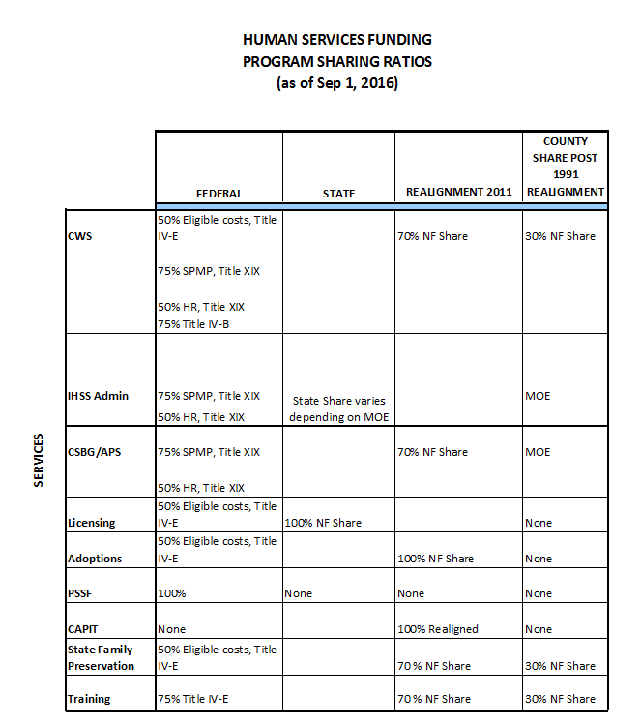
Sharing Ratios

Slide 20
1991 REALIGNMENT STRUCTURE - STATE
SALES TAX/VLF DISTRIBUTIONS
Sales Tax/VLF
Source: ½ cent Sales Tax; Source: 74.9% Vehicle License Fees
Post AB-85
Sales Tax/VLF Base Account
Sales Tax/VLF Growth Account
(Revenues in Excess of Base Payments)
Mental Health Subaccount ª
($1.12 billion base funding from 2011 Realignment)
Social Services Subaccount
Health
Subaccount
CMSP
(Base Account)
Child Poverty and Family Supplemental Support Subaccount
(Base is $0 in 2013-14)
CalWORKs MOE ^{b}
(capped at $1.12 billion)
County Allocations
Sales Tax - Family Support Subaccount
($300 M in 2013-14)
CMSP
(County Shares)
Sales Tax Caseload Subaccount
(1st call on Growth)
CMSP Growth
(2nd call on Growth; 4.027% plus 4.027%
of caseload growth paid if over $20M)
General Growth
(remaining Growth)
Mental Health
(approx. 40%)
Health
(approx. 18.45%)
Child Poverty & Family Supplemental Support
(remaining growth)
If CalWORKs has reached cap, funds in excess go to Mental Health

Slide 21
Intersection of Realignment Programs
2011 Realignment
1991 Realignment
Adult Protective Services
Child Abuse Prevention, Intervention & Treatment (CAPIT)
Women and Children’s Residential Treatment
Drug Medical
Nondrug Medical
Drug Court
Law Enforcement
  Trial Court Security
  Juvenile Justice
  District Attorney and Public Defender
  Community
  Corrections
  Local Public Safety
  Subventions
AB 8 County Health Services
Local Health Services
California Children’s Services
Indigent Health
CalWORKs
Employment Services
County Services Block Grant
In-Home Supportive Services
County Stabilization Subvention
County Juvenile Justice Subvention (AB90)
Shared
Foster Care
CWS
Adoptions
Mental Health
EPSDT
Managed Care
Notes:
21

Slide 22
Realignment “Rolling” Base Funding
Base met, growth available
Year 1 Base
Year 1 Growth
Year 2 Base
Example:
$100
$10
$110
Base not met, growth unavailable
Year 1 Base
Actual Sales Tax comes in lower
than base
Year 2 Base
Example:
$100
$90
$90

Slide 23
What does this mean for you?
Budgets are planning documents
Know where you can be flexible
Discover funding opportunities
Know your Fiscal/Program Person

Slide 24



