Slide 1
Department of Health Care Services
Highlights

Slide 2
Medi-Cal Continuous Coverage Unwinding
Medi-Cal Eligibility Division

Slide 3
Medi-Cal Continuous Coverage Unwinding
DHCS Continuous Coverage Unwinding Guiding Principal:
  Maximizing Continuity of Coverage for Medi-Cal beneficiaries
Ensuring individuals have timely and correct redeterminations based upon their current information
Implementing innovative policy and waivers to relieve the administrative burden on County Eligibility Workers and beneficiaries.
Notes:
As California has moved into the Continuous Coverage Unwinding period, the guiding principle outlined in the DHCS operational plan is even more paramount. That principle is maximizing continuity of coverage for all Medi-Cal beneficiaries.
What that means is that DHCS needs to ensure that all Medi-Cal members have timely and accurate redeterminations during the unwinding period. These redeterminations need to be based upon the beneficiary's current circumstances.
Additionally, DHCS has endeavored to implement innovative policies and waivers to help with that redetermination. To help the counties in processing the renewals, easing the administrative burdens, and to help beneficiaries complete the paperwork if necessary.

Slide 4
Medi-Cal Temporary Waivers and Flexibilities
Waiver or Flexibility | Authority | Letter
MAGI Medi-Cal Reasonable Compatibility Threshold Increase | MAGI Verification Plan | ACWDL 22-17
Reasonable Explanation | MAGI Verification Plan | ​ACWDL 22-22​
Partnering with Managed Care Plans to Update Beneficiary Contact Information | 1902(e)(14)(A) | ​MEDIL 22-20E
Partnering with Program of All-Inclusive Care for the Elderly (PACE) Organizations to Update Beneficiary Contact Information | 1902(e)(14)(A) | MEDIL 22-45​
Partnering with the National Change of Address Database and United States Postal Service In-State Forwarding Address to Update Contact Information | 1902(e)(14)(A) | MEDIL 22-45​
Asset Test Waiver | 1902(e)(14)(A) | MEDIL 23-19
Zero Income | 1902(e)(14)(A) | MEDIL 23-21E​
​State Fair Hearings Waiver Flexibilities​​​ | 1902(e)(14)(A) | ​MEDIL 23-26​
Ex Parte Renewal for Individuals With Income at or Below 100 Percent of the Federal Poverty Limit (FPL) and No Data Returned | 1902(e)(14)(A) | ​MEDIL 23-40​
Renewing Medicaid Eligibility, Based on Available Information, Establishing a New Eligibility Period When Contact is Made with Hard-to-Reach Populations | 1902(e)(14)(A) | MEDIL 23-40​
Unconditionally Available Income Requirement Waiver | 1902(e)(14)(A) | MEDIL 23-42
Stable Income Waiver | 1902(e)(14)(A) | MEDIL 23-42

Slide 5
Medi-Cal Waivers and Flexibilities: Pending Approval
The waivers listed below have been submitted, but are pending approval by the Centers for Medicare and Medicaid Services (CMS). Once approved, DHCS will release a policy guidance letter.
Waiver or Flexibility and Description | Authority
Medical Support Enforcement Waiver: Waiving the requirement for a Medi-Cal applicants to apply within 90 days of approval of benefits for medical support (if available and at no cost) from a non-custodial parent that is not in the home. | 1902(e)(14)(A)
County Requested Waivers: Recommendation by the continuous coverage unwinding workgroup to waive requirements related to the renewal process that would allow Medi-Cal members to continue in coverage and reduce county administration workload. | TBD

Slide 6
Medi-Cal ​​Continuous Coverage Unwinding Dashboard
DHCS posts a monthly Interactive Dashboard of the Continuous Coverage Unwinding eligibility measures.
The dashboard includes the following measures:
  Total Enrollment
  Applications in Progress
  Redeterminations
  Disenrollments.
The data can be accessed through:
  The Medi-Cal Enrollment and Renewal Data page https://www.dhcs.ca.gov/dataandstats/Pages/Medi-Cal-Eligibility-Statistics.aspx
  The interactive dashboard https://www.dhcs.ca.gov/dataandstats/dashboards/Pages/default.aspx
Notes:
Finally, DHCS would like to highlight the Medi-Cal Continuous Coverage Unwinding Dashboard. This interactive dashboard details statewide and county-level demographic data on Medi-Cal application processing, enrollments, redeterminations, and renewal outcomes. DHCS will update, and continue to adjust, the dashboard monthly throughout the remainder of the year-long redetermination process.
This demonstrates our commitment to transparency and collaboration by quickly providing an unprecedented level of data. There is more work ahead, and we are dedicated to actively monitoring the redetermination process and adjusting plans based on what we learn. We are grateful for our county workforce, state agencies, external partners, and thousands of community-based organizations for partnering with us to complete this monumental task.

Slide 7
County Best Practices During the Unwinding
Staffing
Hiring incentives
Collapsing entry-level positions for county eligibility workers to allow new employees to have a higher starting wage
Classification studies on eligibility positions to inform wage increases
Offering telework opportunities
Leveraging Welfare-to-Work paid work experience employees to handle certain tasks within the renewal process
Increasing classroom sizes to accommodate more new hires
Rewards such as casual dress day, potlucks, and other celebrations to engage existing staff
Focused Renewal Work Efforts
Unit focused on renewals and improving the county’s renewal process
Staff available in the call centers to help with case related questions
Staff available at the Managed Care Plans to assist with Medi-Cal related issues
Blitz days for processing renewals and conducting manual ex parte reviews
Training new hires on specific Medi-Cal tasks and focusing on only processing those items
Staff in the training unit to review Medi-Cal renewals for completeness and conducting manual ex parte and verification requests on incomplete cases

Slide 8
County Best Practices During the Unwinding
Staff Training and Resources
Daily or weekly meetings to discuss cases, policy, and provide other clarifications
Working together with internal policy and functional teams
Single location for State and County developed trainings
Open office training sessions to discuss case scenarios
Regular updates of Medi-Cal policy guides and handbooks
Regular trainings and policy refreshers (recorded, web, and in person)
Reviewing unwinding materials together as a team
Using experienced staff as mentors during Medi-Cal renewal processing to answer quick questions and trouble shoot complex cases
Director engagement through listening sessions to gather staff concerns and recommendations. Staying visible and present for staff.
Department renewal processing goal chart with moveable tracker that allows staff to see the progress made.
Collaboration
Working with local Managed Care Plans for outreach
Working with Navigators for outreach
Reaching out to other counties for resources
Collaborating with outside agencies to increase awareness of the unwinding
Conducting target outreach to hard-to reach or vulnerable populations through community wide campaigns

Slide 9
County Best Practices During the Unwinding
Lobby Management
Increasing self-service messaging
Self-serve kiosks
Lobby tablet for in-person customers to use to communicate with telecommuting staff
Lobby kiosk for customers to scan their documents into their case
Resource centers to access portals and upload documents
Adding staff to work in lobbies to triage customer assistance
Increasing staffing at busier locations
Call Center
Dedicated phone line for Medi-Cal related issues
Reallocate staffing resources during high call volumes
Routing non-eligibility specific calls such as change of address for Medi-Cal to special que that is worked by staff other than county eligibility workers
Additional self-service options within the interactive voice response system including providing the renewal date, frequently asked questions, and options of alternative sources of help
Call back feature
Use of chat feature (often quicker than a phone call)

Slide 10
Continuous Coverage Unwinding Outreach Efforts

Slide 11
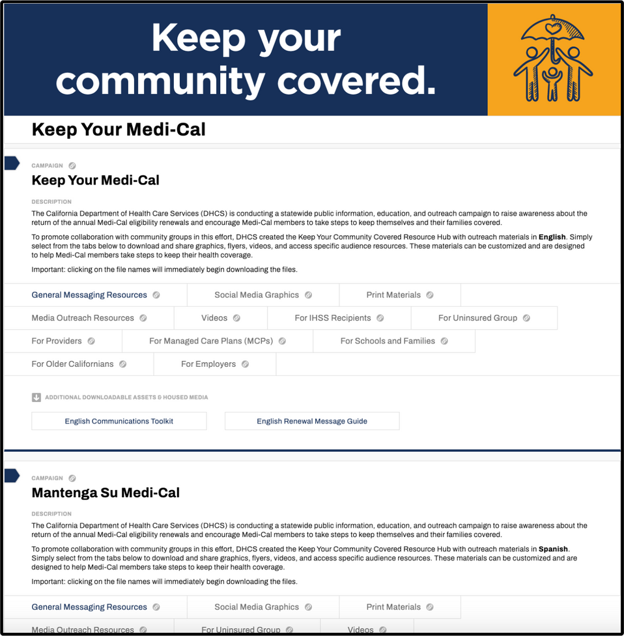

Keep Your Community Covered Resources Hub
DHCS launched the Keep Your Community Covered Resources Hub to support collaboration in this effort.
Download and share resources in all 19 threshold languages.
Notes:
The resource hub is a one-stop-shop to download and share the latest communication communications resources.
Theses resources were created based on feedback navigators, ambassadors, and community partners like you.
The hub is updated regularly with the latest ready-to-share resources in 19 languages.
There are sections for each language, and tabs in each section for different types of resources

Slide 12

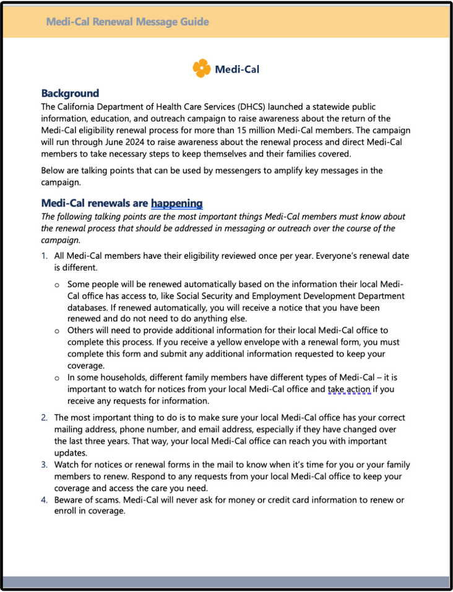
General Messaging Resources
The Phase 2 toolkits include messaging for landing pages, call centers, emails, and much more.
A new messaging provides easy-to-reference messages about:
  Renewal process
  Updating contacting information
  Completing a renewal form
  What happens once their renewal form is submitted
  Transition to Covered California
Notes:
The first tab is the general messaging resources
Phase 2 Unwinding Toolkit
Renewal Message Guide
NOTE: When you click on a file, it will download immediately.

Slide 13
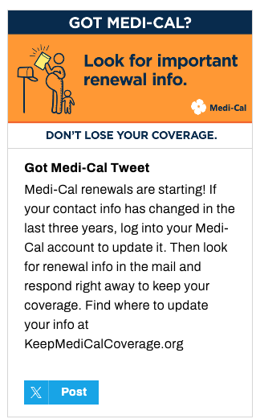





Social Media Graphics
Notes:
In the “Social Media Graphics” tab, you can directly share posts to your channels.
You can also download the graphics along with a Word document that shows each graphic with its accompanying post copy.
NOTE: Sharing function is only operational for English and Spanish. This is to avoid translations losing integrity when shared in languages that do not use the Latin alphabet.

Slide 14
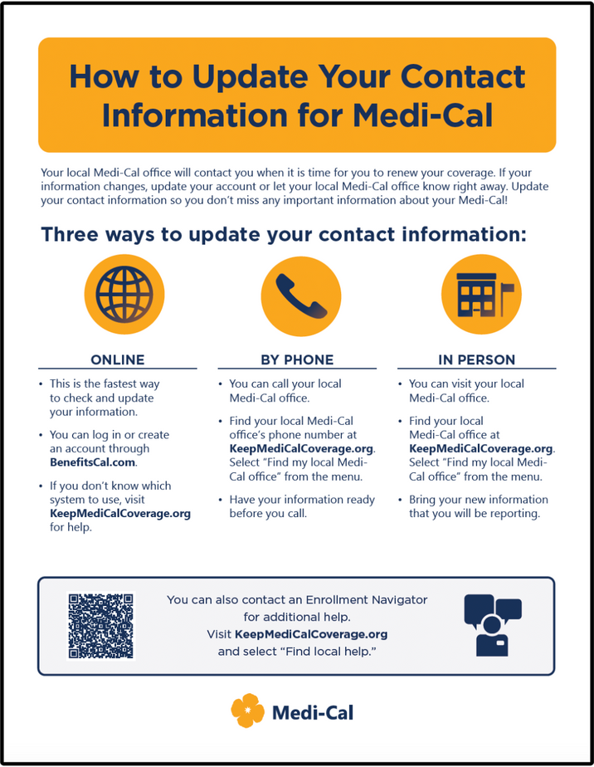
Print Materials
Customizable flyers, poster, and palm card are available in 19 threshold languages.
You can add a logo and contact information using free Adobe Reader.
To add your organization's logo, click on the grey mountain icon and upload your logo.
There is also a text box to add contact information.
Notes:
You will find a 11x17 poster, a general messaging flyer as well as a How-to Complete Your Renewal flyer and a How-to Update Your Contact Information flyer, and a 5.5x8.5 palm card.
All of these files allow for customization so you can add your logo, organization name, and additional contact information. Recommend having one of these downloaded and demonstrating how to add a logo and organization contact info

Slide 15




Videos
Detailed How-To explaining the step-by-step renewal process. This is perfect for lobbies and waiting rooms.
Short videos made for social media and advertising, including “Take Care” and “Stay Covered”.
Notes:
There is a How-to video available in all 19 threshold languages
Other videos that have been part of the advertising campaign.
You can download
Videos
Document with titles and copy that can be used to post on social channels – including YouTube
SRT files for captions for any videos with voice-over.

Slide 16
Media Outreach Resources
Radio readers are scripts for radio hosts to read on air and share information about Medi-Cal renewals.
A MAT release is a pre-written article about renewals for community newspapers, websites, and newsletters.
There are pitch emails to send with each of these to ask news outlets to use them.
Notes:
The resource hub has resources to support outreach through local media
Pitch and two radio readers—scripts for radio personalities to read on air
You can use this pitch to send the radio reader with local press to ask them to talk about renewals on air
Mat release -- pre-written news article about renewals—and a pitch to help you share it with community newspapers, websites, and newsletters.
All of these earned media resources are available in all 19 threshold languages.

Slide 17
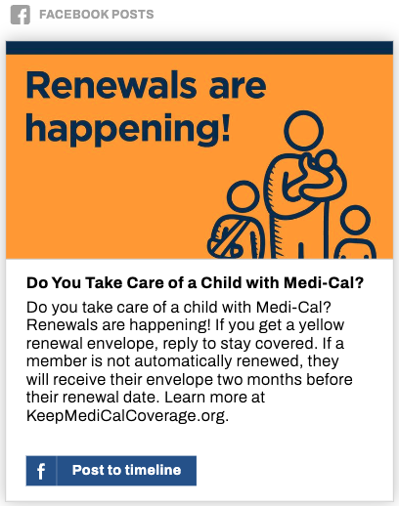
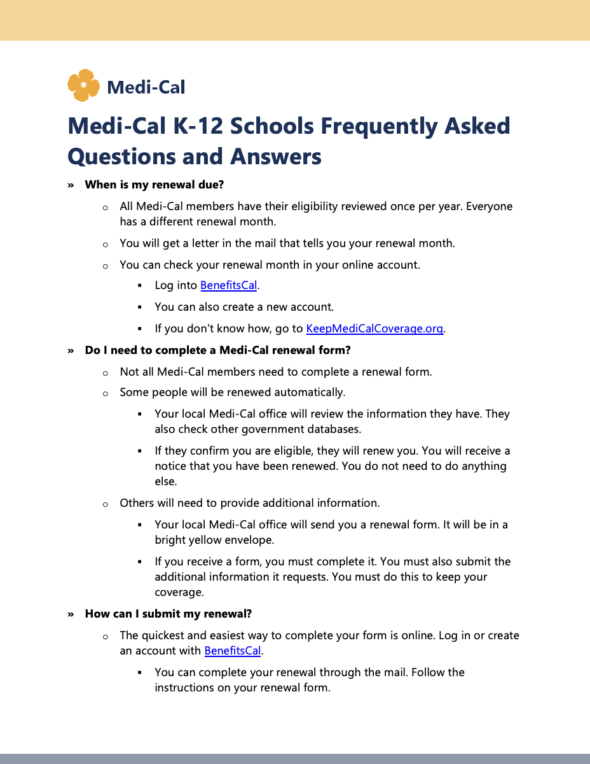
Tailored Audience Resources
Tailored resources for specific audiences and outreach partners, including In-Home Supportive Services (IHSS), Managed Care Plans (MCP), Providers, Schools and Families, and older Californians.
Notes:
There are several tabs with tailored resources for specific audiences and outreach partners, including In-Home Supportive Services (IHSS), Managed Care Plans (MCP), Providers, Schools and Families, older Californians, on Medi-Cal.
They all include key messages, a frequently asked questions (FAQ) document, and at least one customizable flyer.
Many also have at least one social media graphic with post copy and a supplemental messaging document with draft emails, text messages, website copy, and/or IVR scripts.

Slide 18
Pages to Bookmark
Ambassador Resources:
Ambassador sign-up page
Medi-Cal Continuous Coverage Requirement, Unwinding and Renewal Tool kit
Keep Your Community Covered Resource Hub
Medi-Cal member-facing pages:
Keep Your Medi-Cal Coverage - English member landing page
Mantenga Su Medi-Cal - Spanish member landing page

Slide 19
Communication and Outreach Best Practices
The Department of Health Care Services (DHCS) is committed to improving the usability of written communications distributed to our enrollees.
For the past several years, DHCS has worked with a communications vendor, to review, update, and test different forms with and notices with current Medi-Cal enrollees to determine areas in need of improvement.
DHCS received valuable feedback from this process and has moved forward to incorporate the feedback from this process into all DHCS written communication.
The goal is to ensure enrollees can easily understand how to apply for and retain their Medi-Cal coverage and also understand any changes that may result in their benefits.

Slide 20
User Testing Benefits & Purpose
Ensure Clarity and Accessibility: Ensures that outreach materials are clear, concise, and easy to understand for the target audience.
Enhance the User Experience: Provides insight into how outreach materials are received and experienced by users with the goal to improve the user experience.
Identify Barriers and Concerns: Allows for the identification of potential barriers or concerns that may prevent individuals from engaging with the Medi-Cal program.
Tailor Outreach Efforts: Helps the Department align outreach efforts with the specific needs and preferences of the target audience.

Slide 21
User Testing Process & Results
DHCS recruited and interviewed Medi-Cal enrollees with varying backgrounds and demographic differences to review and provide their feedback on several different Medi-Cal forms and notices.
The results of user testing prompted DHCS to ensure the following is completed when updating written communications:
    Remove complex terms and jargon
    Omit non-essential information
    Present information in a logical manner
    Provide clarifying explanations throughout the document
    Provide clear information on who an enrollee can contact with questions

Slide 22
Age 26-49 Adult Expansion
January 1, 2024
Medi-Cal Eligibility Division

Slide 23
Age 26-49 Adult Expansion
The Adult Expansion will implement on January 1, 2024, and will provide full coverage Medi-Cal to California residents, regardless of immigration status, if they meet all Medi-Cal eligibility criteria.
With this expansion, full coverage Medi-Cal will be available to all otherwise eligible Californians, regardless of immigration status.
The Governor’s 2022-2023 Budget estimates the Adult Expansion population to be 707,000 individuals.

Slide 24
Impacted Populations
New Enrollee Population:
  Individuals who are 26 through 49 years of age in January 2024, who are not currently enrolled in Medi-Cal, who apply for Medi-Cal starting January 1, 2024, and who meet all eligibility criteria for full scope Medi-Cal, except for satisfactory immigration status (SIS).
Transition Population:
  Individuals who are 26 through 49 years of age and are currently enrolled in restricted scope Medi-Cal because they do not have an SIS or are unable to establish SIS for full scope Medi-Cal.

Slide 25
Retroactive Medi-Cal
Applicants can request retroactive Medi-Cal coverage for up to three months prior to the month of application.
Under the Age 26-49 Adult Expansion, full scope retroactive coverage will be available no sooner than January 2024.
  Eligible Age 26-49 Adult Expansion individuals, who request retroactive coverage for any month(s) prior to the month of implementation, will be granted restricted scope Medi-Cal based on eligibility policies in effect prior to implementation of the Age 26-49 Adult Expansion.

Slide 26
Noticing
First Notice (General Information Notice) and Frequently Asked Questions (FAQ)
  Transition Population
Second Notice (Notice of Action Snippets)
  Transition Population and New Enrollees
Third Notice (Managed Care Enrollment Notice)
  Transition Population

Slide 28
Outreach
DHCS is developing a Global Outreach Toolkit that will be translated into all threshold languages.
DHCS highly recommends counties and partners utilize the messaging and integrate it into their outreach and social media campaigns.
DHCS will share the global outreach language broadly for use by Medi-Cal Managed Care Plans, other State departments, Medi-Cal providers, and other community partners for use in their outreach activities.

Slide 29
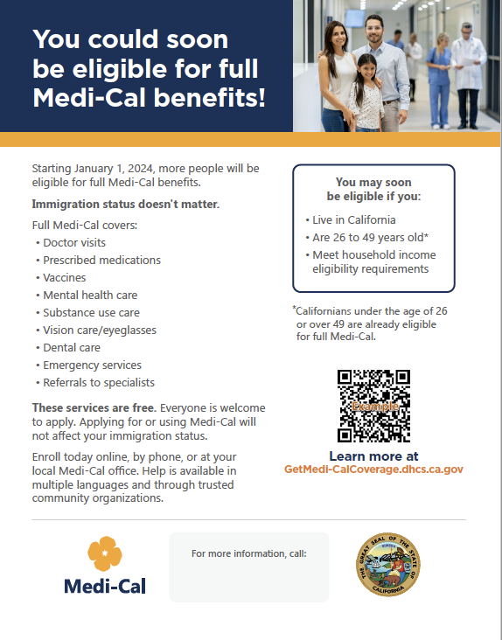

Resources for Direct Outreach
New .gov landing page with information on expanded eligibility and how to apply for Medi-Cal
DHCS providing for Navigators, Ambassadors and other partners:
  Key messages
  Video
  Flyers
  Call scripts
  Email copy
  Web copy
  Social media graphics/copy
Notes:
Strategy – paid media – make sure to also include the email/text campaign direct to members when time to renew
Direct member outreach: Pull contact information for those already in the DHCS databases to target directly with expansion information that applies to them

Slide 30
Immigration Status
Applying for or using Medi-Cal will not affect an individual’s immigration status.
The U.S. Department of Homeland Security and U.S. Citizenship and Immigration Services do NOT consider health, food, and housing services as part of the public charge determination.

Slide 31
Stakeholder Engagement
Provider and Medi-Cal Managed Care Plan Updates
  DHCS will post a provider bulletin on the Medi-Cal Provider website approximately 45 days prior to the transition date.
DHCS is using existing stakeholder engagement forums to discuss and provide updates on Age 26-49 Adult Expansion implementation, including but not limited to:
  Age 26-49 Adult Expansion Stakeholder Workgroup;
  The Consumer-Focused Stakeholder Workgroup;
  County Welfare Directors Association of California (CWDA) meetings;
  Managed Care Operations Plan conference calls; and
  Medi-Cal Dental Advisory Committee meetings.

Slide 32
Resources
The DHCS Adult Expansion webpage provides Age 26- 49 Adult Expansion publications and information
Full Scope Medi-Cal Expansion for Persons 26 Through 49 Years of Age​ ACWDL 23-08
To learn about public charge: California Health and Human Services Agency Public Charge Guide​

Slide 33
Elimination of Assets for Non-MAGI Medi-Cal Programs
Medi-Cal Eligibility Division

Slide 34
Legislation
Assembly Bill 133 was signed into law by the Governor on July 27, 2021.
This law included a two-phased approach to eliminating the asset test used to help determine eligibility for Non-MAGI Medi-Cal Programs.

Slide 35
Asset Elimination - Phase I
Phase I was implemented on July 1, 2022.
Individuals newly eligible for Non-MAGI Medi-Cal Programs as a result of the asset limit increase:
  July – September 2022: 5,283
  October – December 2022: 3,767
  January – March 2022: 1,945
This increased asset limits to $130,000 per individual and $65,000 for each additional household member (up to 10).
The increase applies to all Non-MAGI Medi-Cal programs, including Long-Term Care and Medicare Savings Programs.
Notes:
-Prior asset limits were $2,000 for one person, $3,000 for a couple, and $150 for each additional household member.
-Asset limit data is available online at the DHCS website on the Asset Limit Changes webpage: https://www.dhcs.ca.gov/services/medi-cal/eligibility/Pages/Asset-Limit-Changes-for-Non-MAGI-Medi-Cal.aspx

Slide 36
Asset Elimination - Phase II
Phase II is scheduled for implementation on January 1, 2024.
On July 14, 2023, the federal Centers for Medicare & Medicaid Services approved DHCS’ State Plan Amendment to eliminate the asset test.
This phase will eliminate the asset test entirely for Non-MAGI Medi-Cal programs, including Long-Term Care and Medicare Savings Programs.
Notes:
On July 14, 2023, CMS approved DHCS’ SPA to eliminate the asset test for all Non-Modified Adjusted Gross Income (MAGI) Medi-Cal programs. Beginning January 1, 2024, the asset test will be eliminated for all Non-Modified Adjusted Gross Income (Non-MAGI) Medi-Cal programs, including Medicare Savings Programs (MSP) and Long-Term Care (LTC).

Slide 37
Current Activities/Outreach
DHCS is working to update multiple forms and notices by removing information regarding assets and asset limits. These forms are used by applicants and counties.
DHCS will provide additional policy guidance on eligibility topics related to Asset Elimination such as Spousal Impoverishment, Trusts, Annuities and other Income-Producing Assets, and Transfers of Assets and Periods of Ineligibility
DHCS will update the website to reflect the changes affected by Asset Elimination.
Notes:
The forms that have been prioritized for updates are the MC 14A, DHCS 7077, and Pub 10.
Estate Recovery MEDIL I 23-39 published June 20, 2023.
Spousal Impoverishment ACWDL 23-16 published on August 2, 2023.
DHCS is publishing the policy letters as they are completed and the target date for publishing all related policy guidance is October 31.
DHCS is developing a landing page on the website to explain the changes to Medi-Cal for applicants, including a section dedicated to discussing the changes regarding asset limits beginning January 1, 2024.

Slide 38
Outreach
DHCS has developed an Outreach Toolkit for Asset Elimination. These materials can be used by counties and other partners for outreach purposes.
DHCS will send an outreach letter to individuals who were denied or discontinued from Medi-Cal in the six months prior to Asset Elimination implementation for exceeding the resource limit under current law.
  This outreach letter will inform the individuals of the asset elimination and encourage the individuals to re-apply for Medi-Cal.
Notes:
-Outreach Letter: MEDIL 22-44
-Outreach Toolkit includes: New Applicant Flyer, Existing Member Flyer, Asset Elimination Key Messages, Asset Elimination FAQ, Asset Elimination Additional Messaging, Asset Elimination Social Media.
-The denial/discontinuance letter will be mailed to individuals after implementation.

Slide 39
Questions?
Yingjia Huang– Assistant Deputy Director, Health Care Benefits and Eligibility
Yingjia.Huang@dhcs.ca.gov
Theresa Hasbrouck – Chief, Policy Development Branch
Theresa.Hasbrouck@dhcs.ca.gov

